Slide 1

Running with Endurance…
Looking unto Jesus
Hebrews 12:1-2
Notes:
Hebrews 11 shows us that living a life of faith requires extraordinary endurance. But as we run life’s race focusing on Jesus, faith itself fuels our endurance.

Slide 2
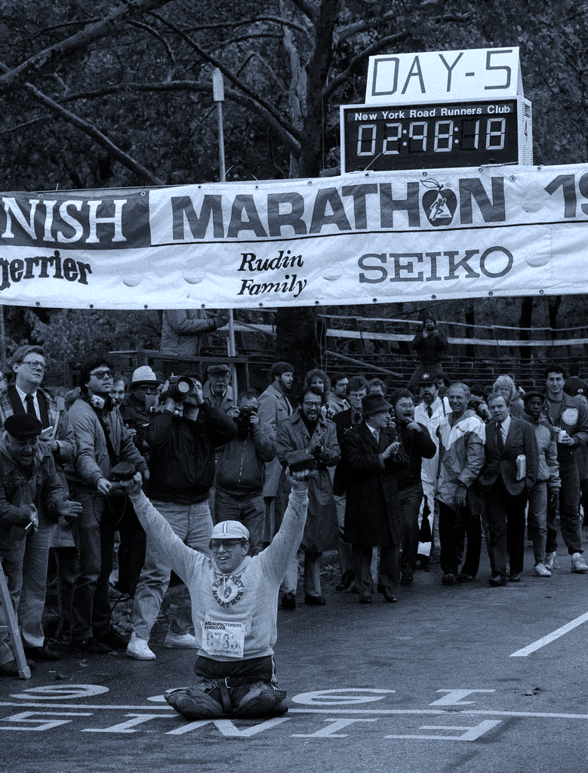
Bob Weiland
Finishing the New York City marathon (1986)

Slide 3

Running with Endurance
Hebrews 11 contains a great list of people who by faith ran with endurance (Hebrews 11:32-38).
We must run with endurance as they did (Hebrews 12:1).
We run with endurance “by faith” (Hebrews 11).
Notes:
.

Slide 4
Looking unto Jesus
Seeing Him by faith, we endure (Hebrews 12:2).
  He is the “author and finisher” of faith (1 Peter 2:23; Luke 23:46)
He is visible to us by faith although He may be invisible to everyone around us (Hebrews 11:1, 27).

Slide 5
Make Jesus your Pursuit
Paul gave up everything to pursue Jesus! (Philippians 3:8, 10).
Jesus is the goal (Philippians 3:14).
You have need of endurance in order to receive the promise (Hebrews 10:32-36).

