Slide 1

Serving in the Local Church
Galatians 5:13-14
Notes:
Being a part of a local church provides many opportunities for service. Christians are privileged to serve one another through love, and we must make the most of our abilities and opportunities to do so if the local church is to function as God designed.

Slide 2

Opportunities for Spiritual Service
Faithful attendance and involvement (Hebrews 10:24-25; Philippians 2:4)
Opportunities to share the word
Brethren teaching publicly (Acts 11:26; 13:1)
Reading Scripture in and out of assemblies (Col. 4:16, 1 Tim. 4:13)
Women teaching women (Romans 16:1-2, Titus 3:3-4)

Slide 3

Opportunities for Spiritual Service
Opportunities to develop abilities and use them (Romans 15:14; 12:4-8; Ephesians 4:11-13).
Opportunities to prepare for and participate in worship (Acts 20:7; 1 Cor. 11 & 14).

Slide 4
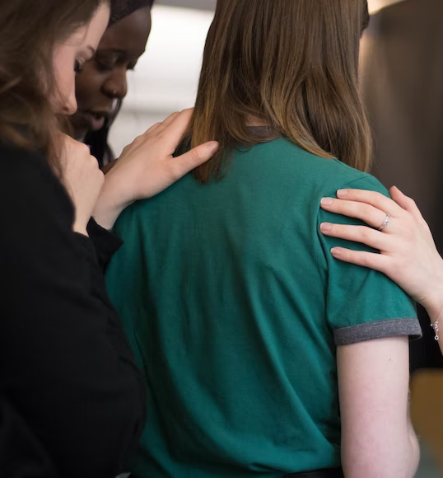
Opportunities to minister to physical needs
Opportunities to pool resources to accomplish great works (Phil. 4:15-17; 2 Corinthians 9:7-15).
Opportunities to comfort in sickness, hard times, and loss (James 5:14; 1 Thess. 4:18; 5:11, 14)

