Slide 1

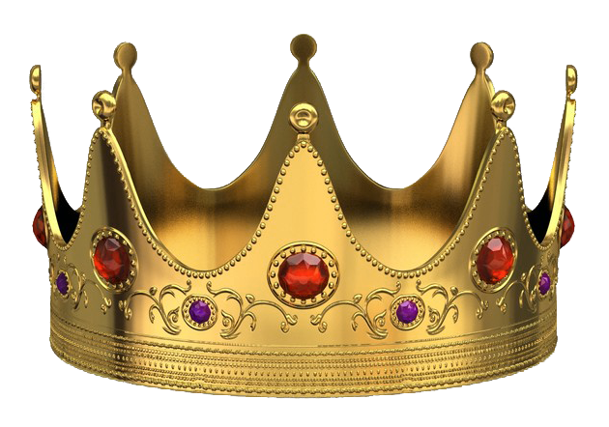
We Will Glorify the King with Works & Words
Notes:
The world does not know the King of kings. It is the privilege of every citizen of the Kingdom to enable the world to see the glory of the King through our words and actions!

Slide 2
We Will Glorify the King with Works & Words
We will do good works in His name!
  Giving gifts in the name of the King! (Acts 3:6)
  Sharing what His grace has entrusted to us with one another (1 Peter 4:9-11; Acts 4:33-35; Mark 9:41; Hebrews 6:10)
  Sharing with those outside of Christ (Galatians 6:10; Matthew 5:16; Prov. 14:31)
We will share His words!
  Speaking as the oracles of God (1 Peter 4:11; Romans 15:0; Isaiah 55:4-7)

Slide 3
Does the world know the King through your works and words?
Mark 13:21-22 * Luke 19:14, 27
The world gives its allegiance to false Christs, false religions, faulty political systems, and to the god of materialism.
The world needs to know who the King is!!!
Let us glorify the King of kings!

