Slide 1
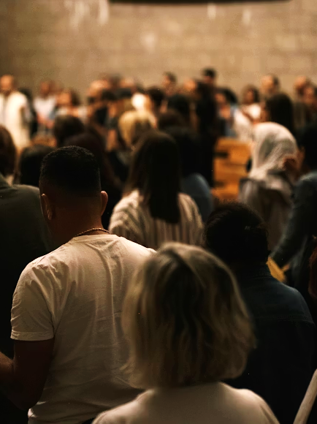
Pursuing Peace and Edification through Worship
Hebrews 10:24-25
1 Corinthians 14:26
Notes:
Worshipping as a church draws us together and builds us up. Everything in a worship assembly is “be done for edification.” And so, worship activities such as taking the Lord’s supper, giving, singing, praying, and receiving instruction from God’s word are each designed by God to result in unity and edification as an outcome.

Slide 2
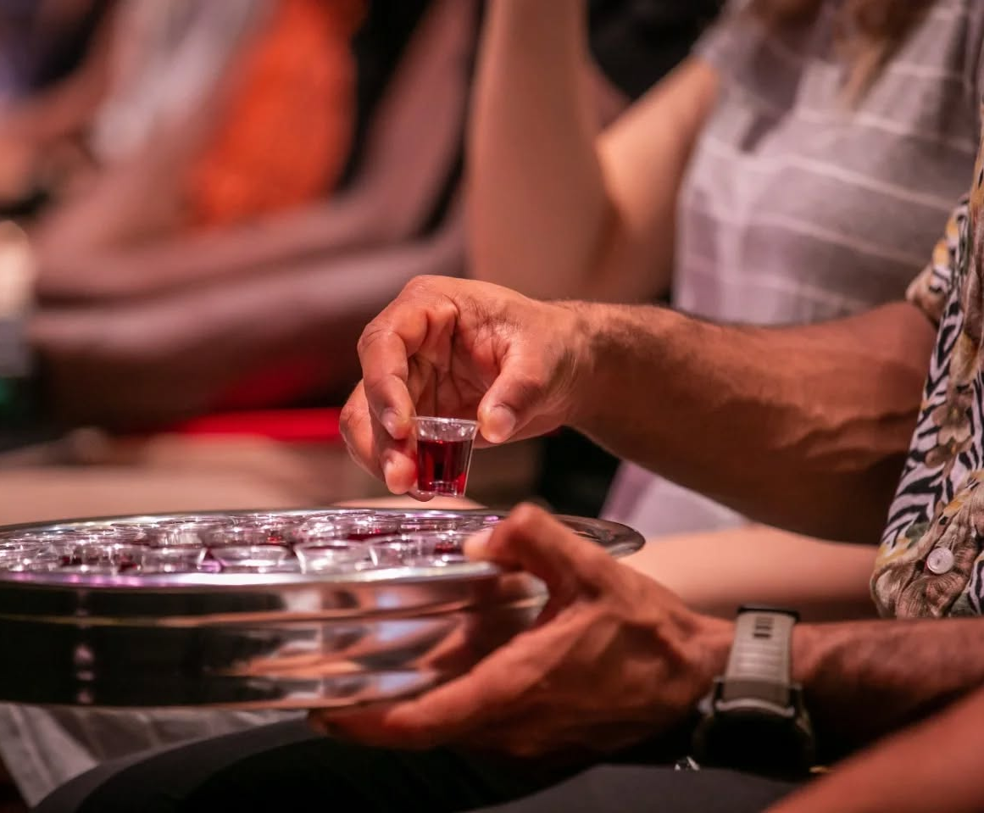
How shared worship experiences edify and unify:
The Lord’s Supper builds us up and unifies us when taken properly (1 Corinthians 11:17-30; 10:16-17)

Slide 3

How shared worship experiences edify and unify:
Giving expresses mutual love and encourages more of it (Acts 4:32-35; 2 Corinthians 9:1-13)

Slide 4
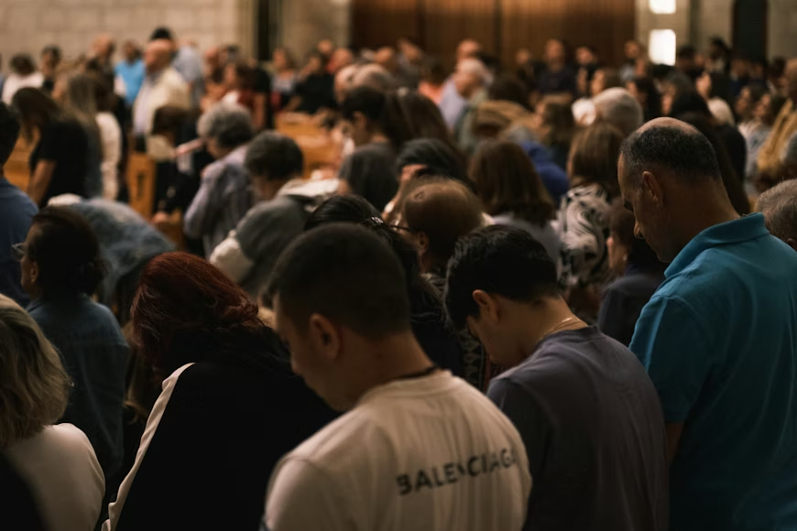
How shared worship experiences edify and unify:
Prayer builds up the one who prays and the one who is prayed for (Jude 20; 1 Timothy 2:1; 2 Corinthians 1:11; Colossians 1:8-9)

Slide 5
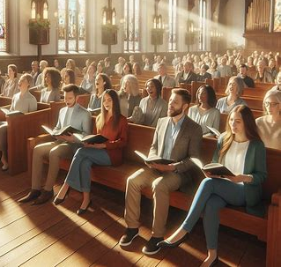
How shared worship experiences edify and unify:
Singing to one another from the heart edifies us and magnifies praise (Colossians 3:16; Ephesians 5:19; Romans 15:5-6; Hebrews 13:15).

Slide 6
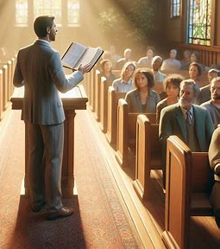
How shared worship experiences edify and unify:
Teaching and preaching God’s word builds us up and secures our inheritance (Acts 20:32; 14:21-22; Ephesians 4:11-15; 1 Peter 1:23; 2 Timothy 4:2).

