Slide 1

The Essence of Brotherhood: Sharing the Burden of Adversity
Proverbs 17:17  Galatians 6:2
Notes:
The essence of brotherhood is sharing life’s experiences as we love and help one another along the way. Jesus called us “brethren” and laid down His life to lift our burdens and raise us up. We are to follow His example of brotherhood.

Slide 2
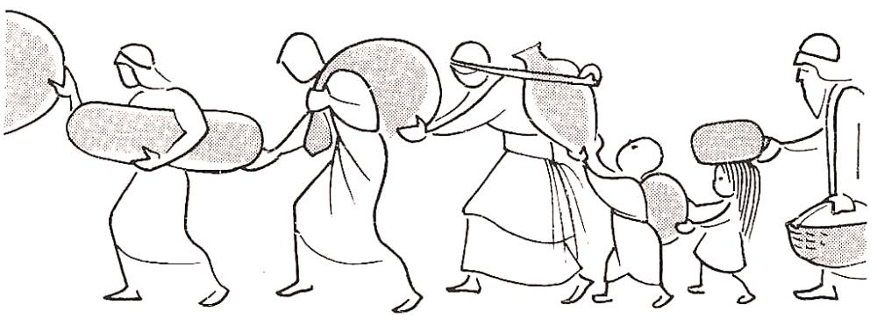
Christ is our example “Surely He has borne our griefs and carried our sorrows…” (Isaiah 53:4)
Consider what Jesus has done for us:
He called us “brethren” and gave His life to deliver us from fear and death (Hebrews 2:11-15).
He raised us up (Ephesians 2:4-6).
What Jesus did for us, He expects to do for others!

Slide 3
What Jesus did for us, we are to do for others!
We lay down our lives for brethren (1 Jn. 3:16).
We are willing to suffer for the welfare of brethren as Paul did (Col. 1:24; 2 Cor 12:15).
And brethren are willing to reciprocate (Gal. 4:13-15; 2 Cor 7:4-7; 1 Thess. 3:7).

Slide 4
We are brothers and sisters in Adversity!
We are companions in tribulation (Proverbs 17:17; Revelation 1:9).
We have been comforted in order to comfort others (2 Corinthians 1:3-4; Job 2:11-13).
Let us comfort one another and help each other to overcome trials, temptations, and sin (1 Peter 5:8-9; 2 Corinthians 2:6-7).
“Bear one another's burdens, and so fulfill the law of Christ” (Gal. 6:2).

