Slide 1
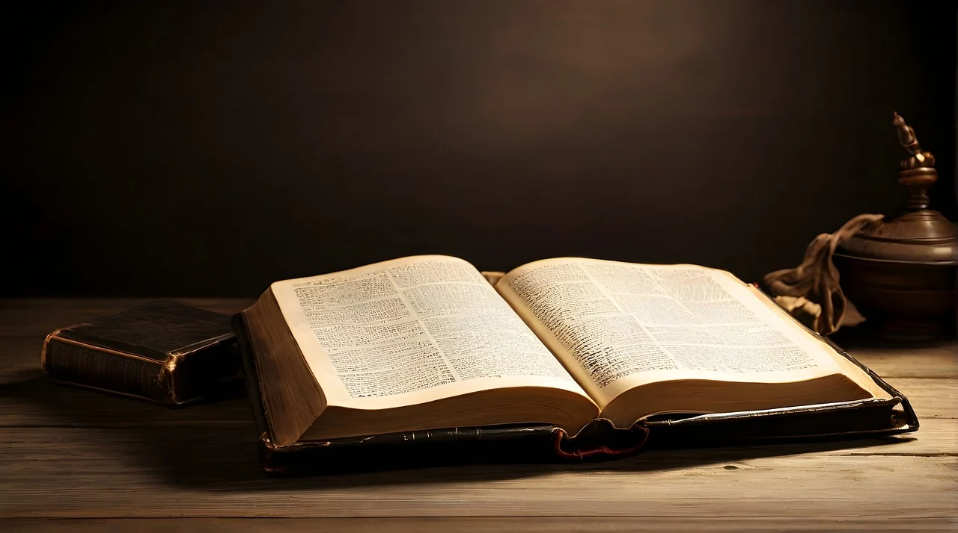
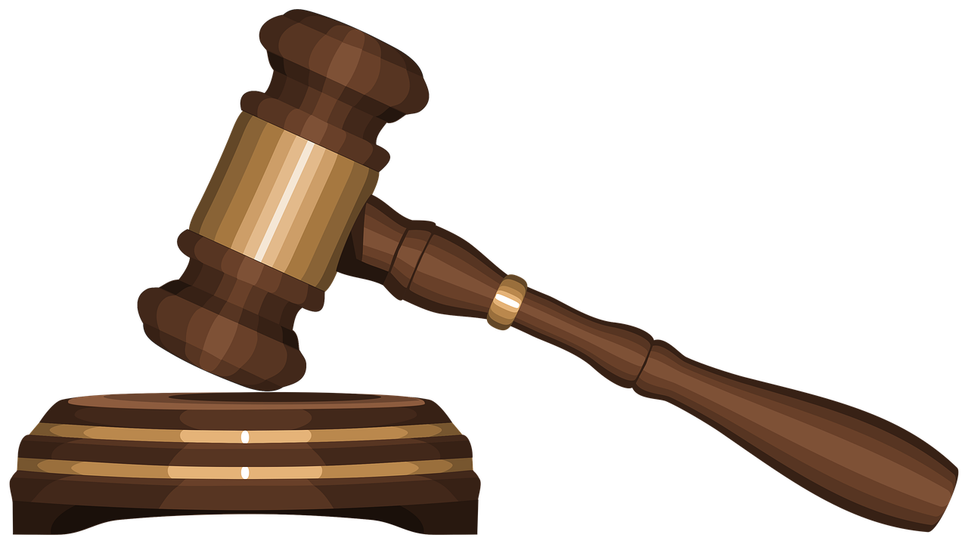
The Righteous Judgment of God
Genesis 18:25  Romans 2:5-11
Notes:
God’s judgment is righteous. He is the definition of what is right, and He judges fairly by the standard of righteousness, both in this world and the world to come. If we are truly pursuing righteousness, we must therefore learn His standard of righteousness and live by it.

Slide 2
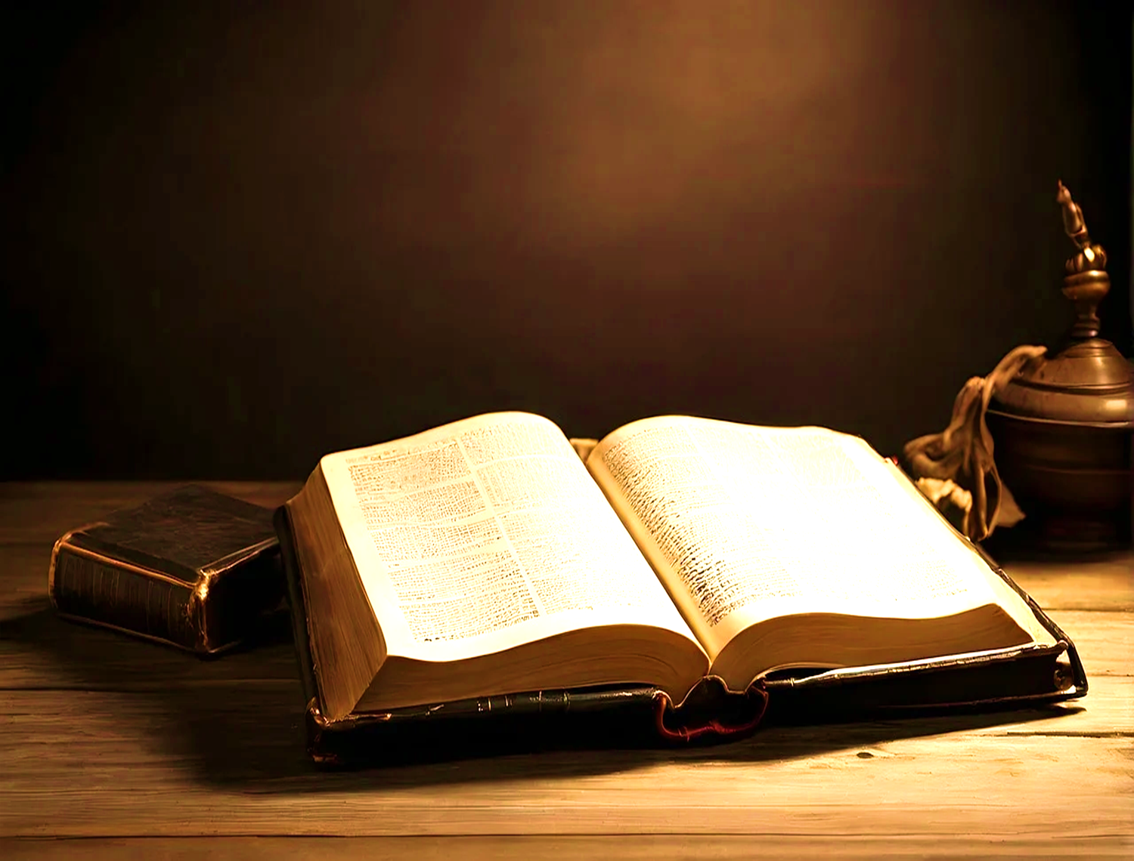

God’s Righteous Judgment is active in Human Affairs
It is a reflection of His nature (Jeremiah 9:24).
David experienced it (Psalm 9:4-8).
God is to be praised for His righteous judgment (Psalm 67:3-4; 96:9-13; Revelation 16:5-7; 19:2).
Because God is righteous, “all things work together for good to those who love” Him (Romans 8:28; Psalm 72:2-4).

Slide 3
God’s Word Contains His Righteous Judgments
God’s righteous judgments are greatly to be desired (Psalm 19:9-11).
The righteous will follow God’s righteous judgments (Psalm 94:12-15).
The righteous will render praise and obedience to God for His judgments (Psalm 119; 7, 62, 164, 106, 137, 160, 164; Isaiah 26:9).

Slide 4
Righteousness in the Messiah’s Kingdom
Isaiah prophesied that righteous justice would characterize the Messiah’s kingdom (Isaiah 11:4; 16:5).
Jeremiah proclaimed this also (Jeremiah 23:5; 33:15).
The Messiah Himself confirmed it (Matthew 6:10; John 5:22).

Slide 5
Final Judgment will be According to Righteousness!
The world will be judged in righteousness by Jesus (Acts 17:30-31).
Those who have loved and obeyed the Lord, will be given a crown of righteousness (2 Timothy 4:8).
Those who have refused to repent and obey will incur God’s righteous wrath (Romans 2:5).

Slide 6
God’s Judgment is Righteous!
He “Will render to each one according to his deeds” (Romans 2:6-11; 2 Corinthians 5:10).
“And if you call on the Father, who without partiality judges according to each one's work, conduct yourselves throughout the time of your stay here in fear” (1 Peter 1:17; Acts 24:25).

