Slide 1
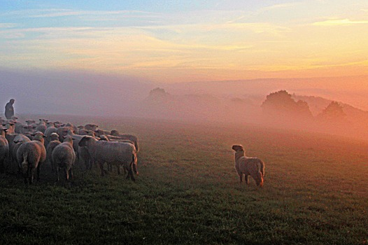
Appointing Elders
Utilizing what the Lord has provided for the growth, upbuilding, maturity, and unity of the church.
Notes:
Elders are a vital part of what the Lord has provided the church for its growth, upbuilding, maturity, and unity. We are blessed to be able to appoint additional elders.

Slide 2
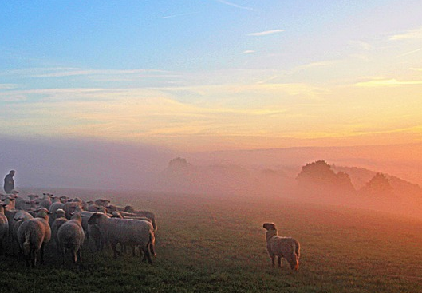
Appointing Elders
Pastors (shepherds) are a vital part of what the Lord has provided the church for its growth, upbuilding, maturity, and unity (Eph. 4:11-16).
  “till we all come to the unity of the faith” (v. 13)
  “to a perfect man” = “mature manhood” (ESV, v. 13)
  “no longer children” (v. 14)
  “grow up in all things” (v. 15)
  “growth of the body for the edifying of itself in love” (v. 16)

Slide 3
Appointing Elders
Elders (overseers, shepherds) are appointed to work! (1 Timothy 3:1-7)
  “This is a faithful saying: If a man desires the position of a bishop, he desires a good work” (NKJV)
  “Here is a trustworthy saying: Whoever aspires to be an overseer desires a noble task.” (NIV)
  “If anyone aspires to be an overseer, he desires a noble work.” (HCSB)
  “Anyone wanting to become an overseer desires a good work.” (NCV)

Slide 4
Appointing Elders
The WORK of elders and their ATTITUDES toward their work are the focus of 1 Peter 5:1-3
The WORK involves shepherding, overseeing and “being examples”.
The ATTITUDES toward the work are “willingly” and “eagerly.”
  Not motivated by force – “compulsion”
  Not motivated by personal profit – “dishonest gain”
  Not motivated by power or a desire for an elevated position -- “lord’s over”

Slide 5
Appointing Elders
The church is to accept and recognize those who are duly appointed as elders.
“And we urge you, brethren, to recognize those who labor among you, and are over you in the Lord and admonish you” (1 Thessalonians 5:12)

