Slide 1
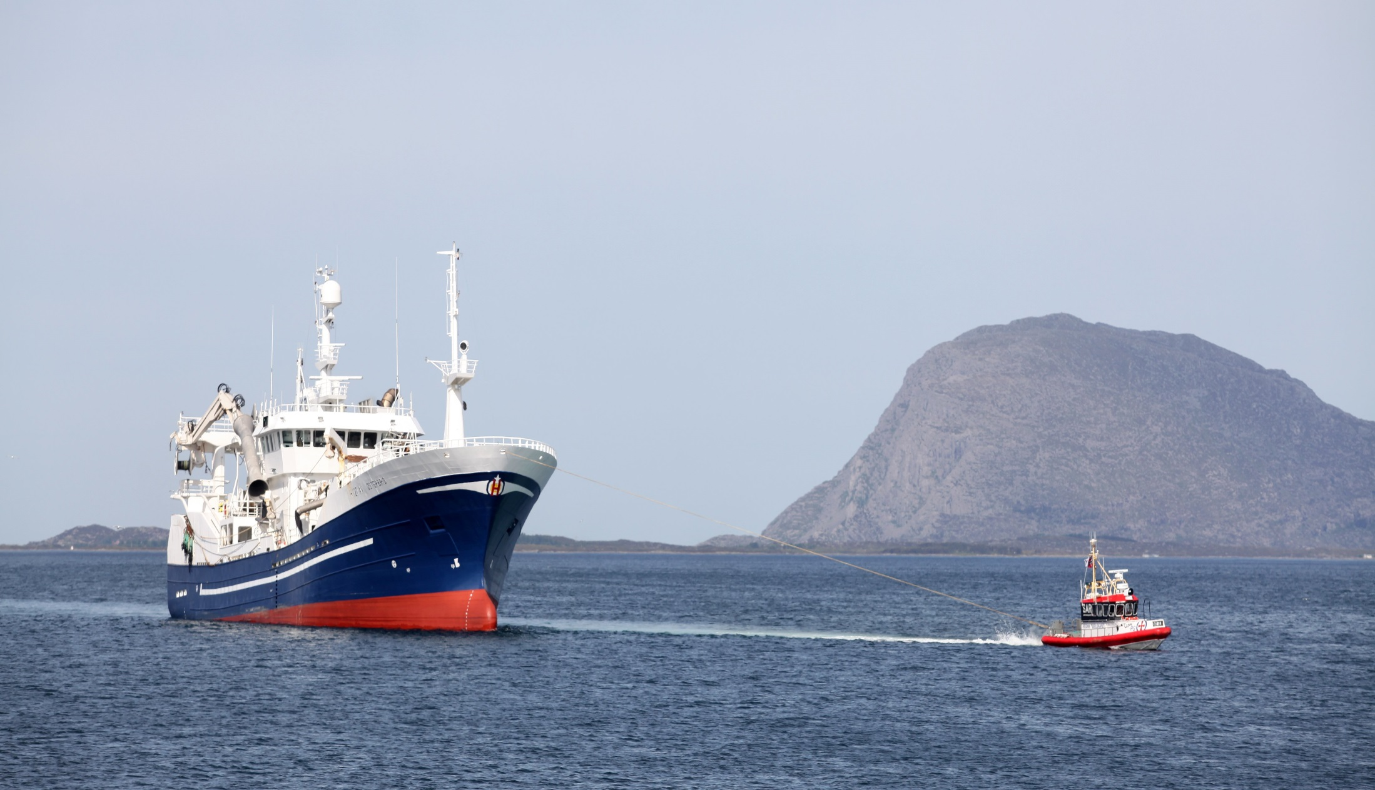
Little Tugs
Parents & Children:
Escorting one another to heaven!
(Matthew 21:12-17)
Notes:
Children influence us in many ways. They are great examples when it comes to faith, praising God, humility and purity of heart. They tug at our hearts as parents to show them affection, to train them in God’s ways, to discipline them, set good examples for them and pray for them.

Slide 2
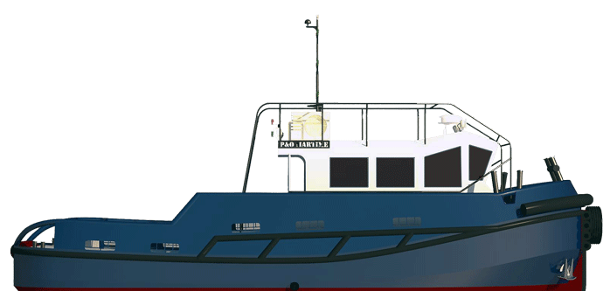
Children As Little Tugs
Children are examples of …
unfeigned faith
pure praise
humble hearts
absence of malice
Psalm 8:2; 1 Cor. 14:20; Matthew 18:1-4
Children are beings who will inhabit eternity (Matthew 19:13-14; 2 Timothy 4:7)

Slide 3
Children Tug at Parents to Fulfill their God-given Duties
To show affection (Luke 11:11-13; Romans 1:31; 2 Timothy 3:3)
To train them in the Lord’s ways (Ephesians 6:4; Deuteronomy 6:6-7)
To discipline them (Proverbs 13:24; 29:27; Colossians 3:21)
To set the right example (Proverbs 20:7)
To pray (1 Timothy 2:1; James 1:5)

