Slide 1
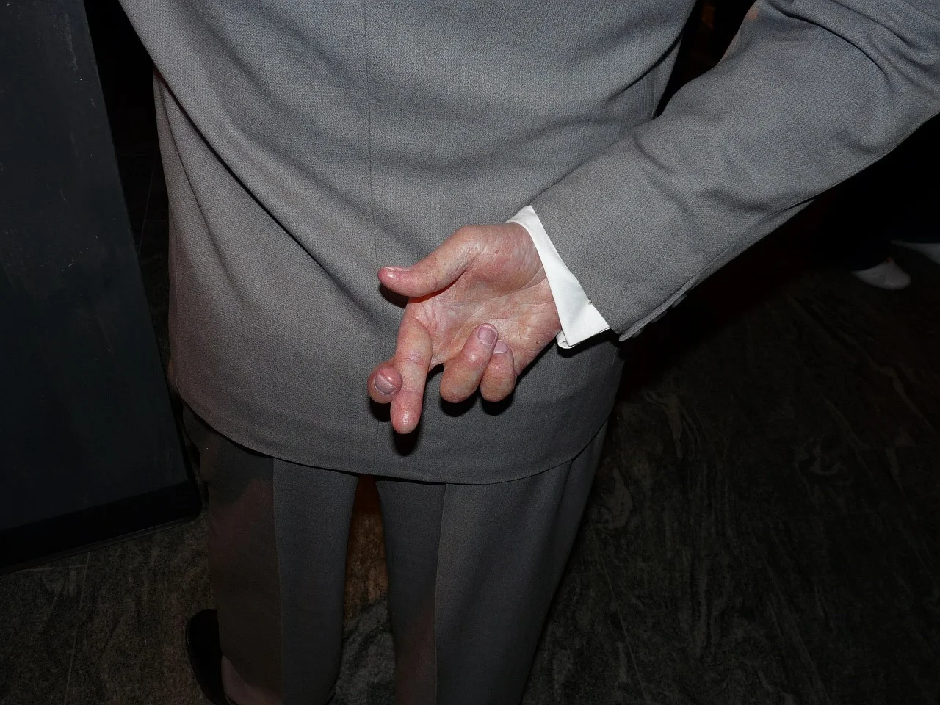

Hypocrisy Prevents Unity
Psalm 26:2-6
Notes:
As God’s people, if we walk in truth, we cannot unite with hypocrites who disrespect His authority, seek earthly glory, and promote injustice.

Slide 2
Hypocrisy regarding Authority Prevents Unity
Showing respect for authority in word but not in deed (Matthew 23:2-3).
Failing to genuinely respect God’s authority (Mark 11:27-33).
Applying God’s law unevenly (Luke 13:14-17).
Putting human traditions above God’s authority (Matthew 15:1-9).

Slide 3
Hypocrisy in our Motives Prevents Unity
When the motive for worship and service is self-glorification, there cannot be unity. (Matt. 6:5, 16; 23:2-5)
When the motive for kindness is self-serving, there cannot be unity. (Proverbs 23:6-8)

Slide 4
Hypocrisy in the Application of Justice Prevents Unity
Consistency in applying justice was of great concern to Jesus (Matthew 7:1-5).
If we follow God’s rule of law, justice is the same for everyone (Matthew 7:12).

Slide 5
Unity must be based on Truth. It flows from pure love and the pursuit of peace
Hypocrisy is inconsistency between the inner and the outer man (Luke 11:37-42).
Let us pursue peace and love without hypocrisy!
“Let love be without hypocrisy. Abhor what is evil. Cling to what is good” (Romans 12:9).
“The wisdom that is from above is first pure, then peaceable, gentle, willing to yield, full of mercy and good fruits, without partiality and without hypocrisy” (James 3:17).

Slide 6
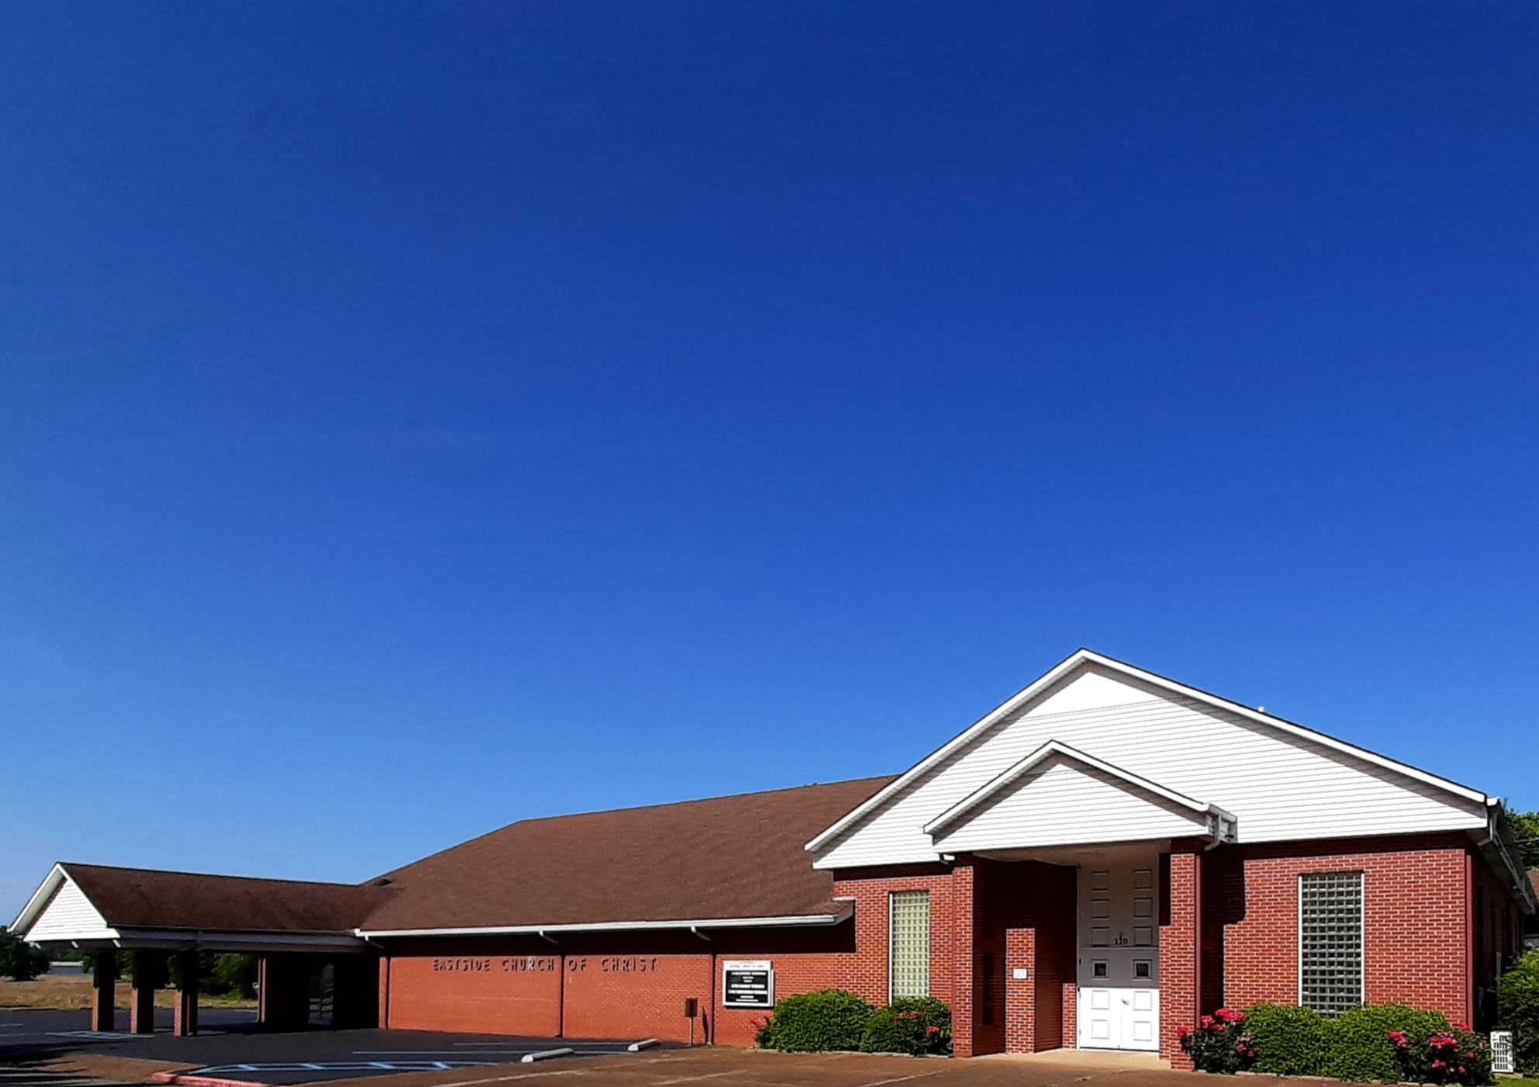
Eastside Church of Christ
Eastside-church.org

