Slide 1
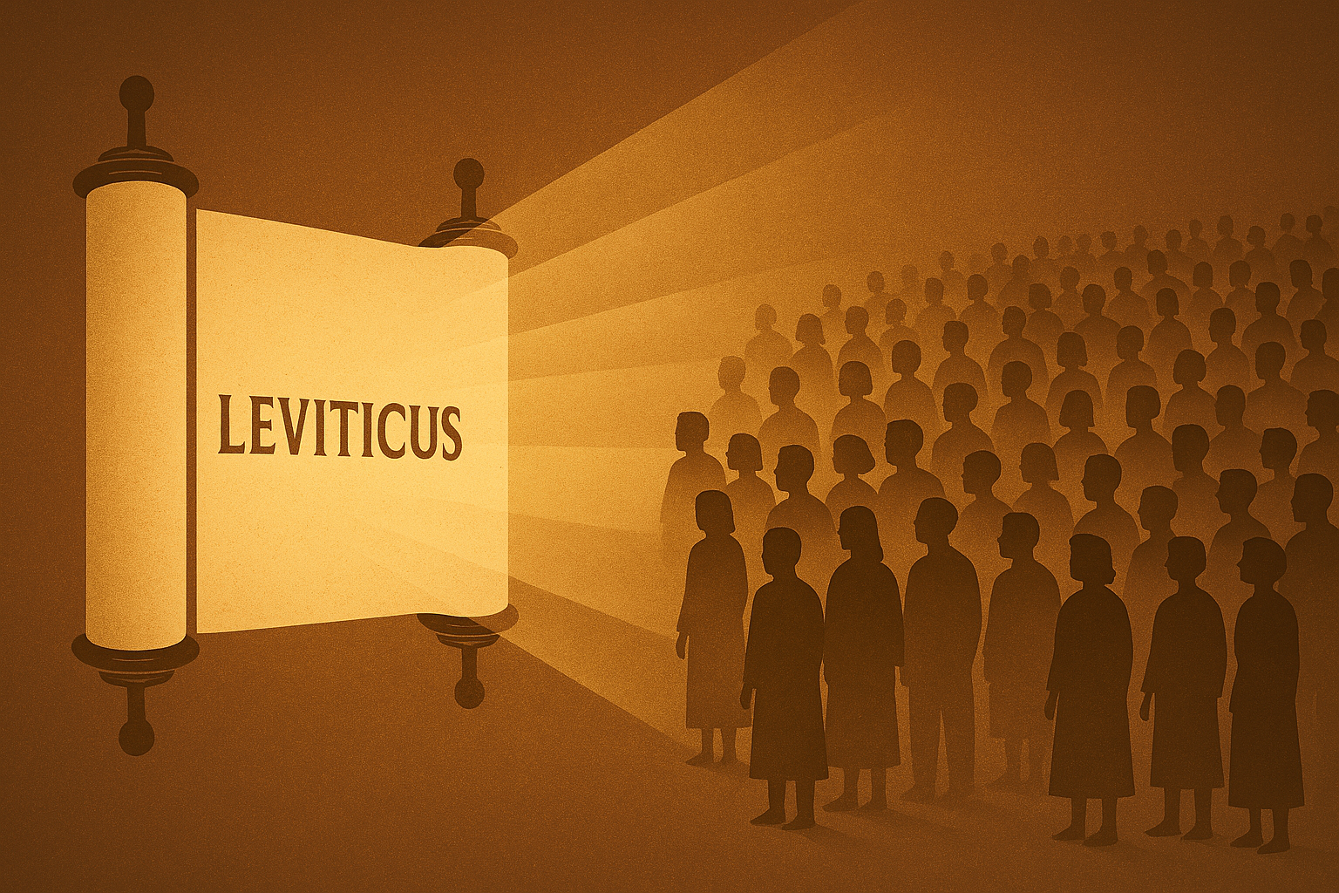
The Imperative of Obedience
“I am the Lord your God” – Leviticus 18:4
Notes:
Leviticus teaches us to obey God because He is God. Many of the regulations found in Leviticus result in obvious benefits for compliance, but some of the regulations seem to have no rhyme or reason, and don’t provide any clear benefit. Obedience is required either way because “The Lord Spoke,” and He is our God!

Slide 2
Leviticus Teaches us to Obey God Because He is God
Many Levitical laws were “sensible” and brought physical benefits to those who kept them.
Dietary laws, food safety, hygiene, quarantine, avoiding consuming blood, etc. (Leviticus 11-17).
Other rules and restrictions seem arbitrary.
Forbidding mixing fabrics or crops, unusual haircuts, and tattoos (Leviticus 19:19-28).
Priestly rituals (Leviticus 14:14-17).

Slide 3
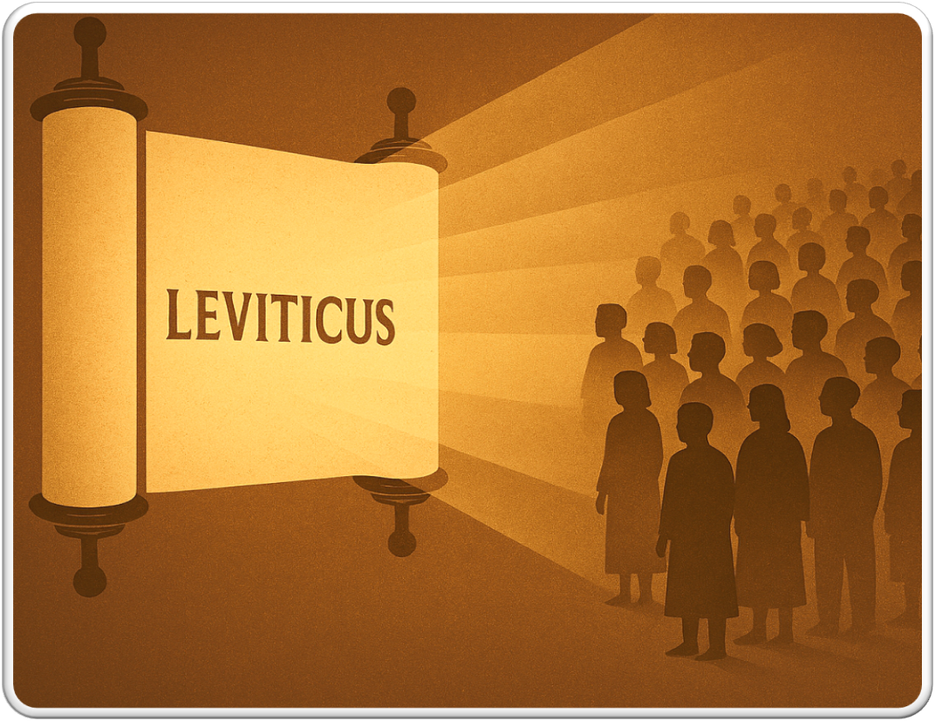
In Leviticus we Learn that we Must Do what God said because God said it!
The phrase “The Lord spoke” occurs 35 times in Leviticus.
Forty-five times, God says “I am the Lord your God” (Leviticus 11:44-45; 18:4-5; 19:37; 20:7-8).

Slide 4
Leviticus Teaches us that Love Obeys Law
“You shall love your neighbor as yourself” (Leviticus 19:17-18; Mark 12:29-31).
Keeping this one commandment fulfills the others (Romans 13:9; Galatians 5:14).

Slide 5
“I beseech you therefore, brethren, by the mercies of God, that you present your bodies a living sacrifice, holy acceptable to God, which is your reasonable service” (Romans 12:1)

