Slide 1
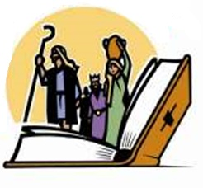
Comprehending the Bible Narrative
Appreciating the value of a thorough Bible education.
-- 2 Timothy 3:14-15
Notes:
There is great value in learning the entire Bible story – the details, the historical flow, the geography and the overall themes. A thorough understanding of Scripture will make us “wise unto salvation.” This is strong motivation for Bible class teachers, parents and children to apply themselves whole-heartedly in our Bible classes.

Slide 2
What if you knew the 17 PERIODS OF BIBLE HISTORY like the back of your hand?
BEFORE THE FLOOD -- Genesis 1-5
THE FLOOD -- Genesis 6-9
SCATTERING THE PEOPLE – Gen. 10-11
PATRIARCHS -- Genesis 12-50
EXODUS -- Exodus 1-40; Leviticus 1-27, Numbers 1-13
WILDERNESS WANDERINGS -- Numbers 13-36; Deuteronomy 1-34; Joshua 1-6
CONQUEST -- Joshua 6-24
JUDGES -- Judges 1-21, Ruth 1-4, 1 Samuel 1-7
UNITED KINGDOM -- 1 Samuel 8 -31; 2 Samuel 1-24; 1 Kings 1-11; 1 Chronicles 1-29; 2 Chronicles 1-9; Job 1-42; Psalm 1-150; Proverbs 1-31; Ecclesiastes 1-12; Song of Solomon 1-8
DIVIDED KINGDOM -- 1 Kings 12-22; 2 Kings 1-18; 2 Chronicles 10-28; Obadiah; Joel; Jonah; Amos; Hosea; Isaiah; Micah
JUDAH ALONE -- 2 Kings 18-25; 2 Chronicles 28-36; Zephaniah; Nahum; Habakkuk
JUDAH IN CAPTIVITY -- Ezekiel; Daniel; Jeremiah; Lamentations
JUDAH RELEASED FROM CAPTIVITY -- Haggai; Zechariah; Esther; Ezra; Nehemiah; Malachi
YEARS OF SILENCE -- Amos 8:11-12
LIFE OF CHRIST – The Gospel Accounts
EARLY CHURCH -- Acts
LETTERS TO CHRISTIANS – The Epistles

Slide 3
What if you could tell the story of the Bible in detail from beginning to end?
Sinai → Law of Moses
  Tabernacle, Priesthood, Sacrifices
Wilderness Wandering
Conquest of Canaan
Judges
United Kingdom
Divided Kingdom
Captivity & Return
Years of Silence
Jesus’ birth, life, death & resurrection
Establishment of the church → gospel preached to all nations.
Creation
Adam & Eve → Sin
Noah & the Flood
Tower of Babel
Abraham, Isaac & Jacob
  Jacob -> 12 Sons -> Israel
Joseph → Bondage in Egypt
Moses → Deliverance from bondage

Slide 4
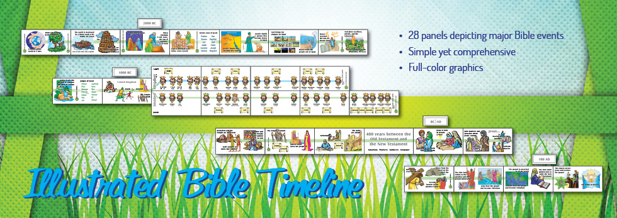
This Bible Timeline is Displayed in our Classrooms

Slide 5
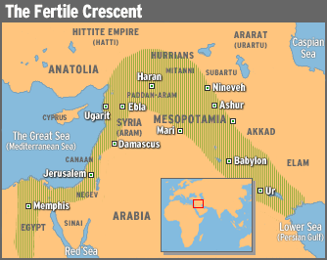
What if you had detailed knowledge of the Geography of the Bible Story?
Imagine being able to understand how geography influenced Bible events to occur as they did.
  For example, why Abraham’s journey from Ur took him to Paddan-Aram.

Slide 6
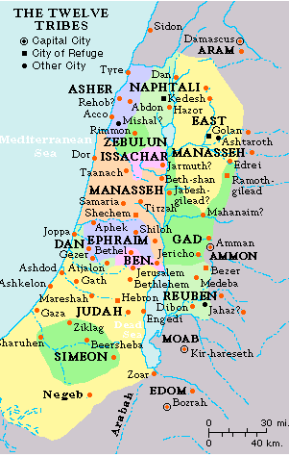
What if you had a thorough understanding of the location of Bible places?
When Bible students can understand what’s involved in journeying from Jerusalem to Jericho as easily as they understand a trip from Athens to Decatur, the Bible narrative becomes very real.

Slide 7
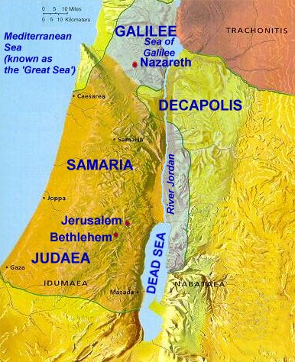
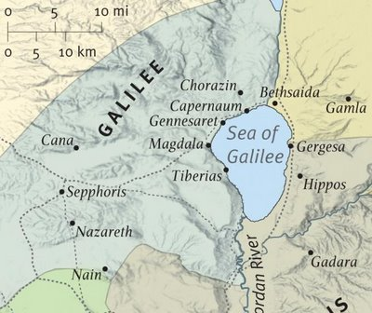
How would knowing the location of Bible places enhance your understanding of Jesus’ life?

Slide 8
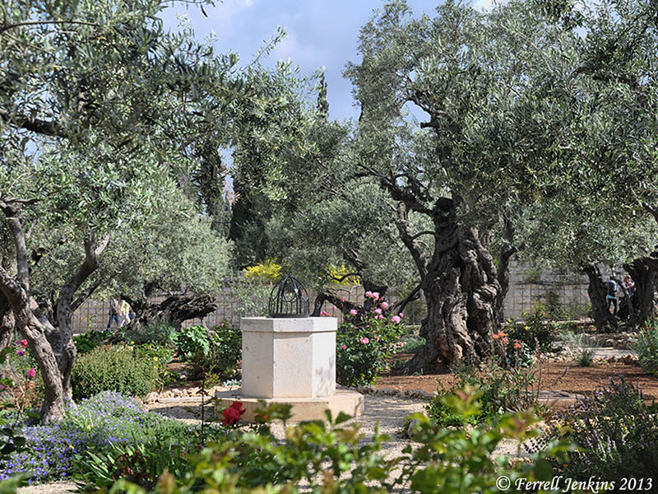
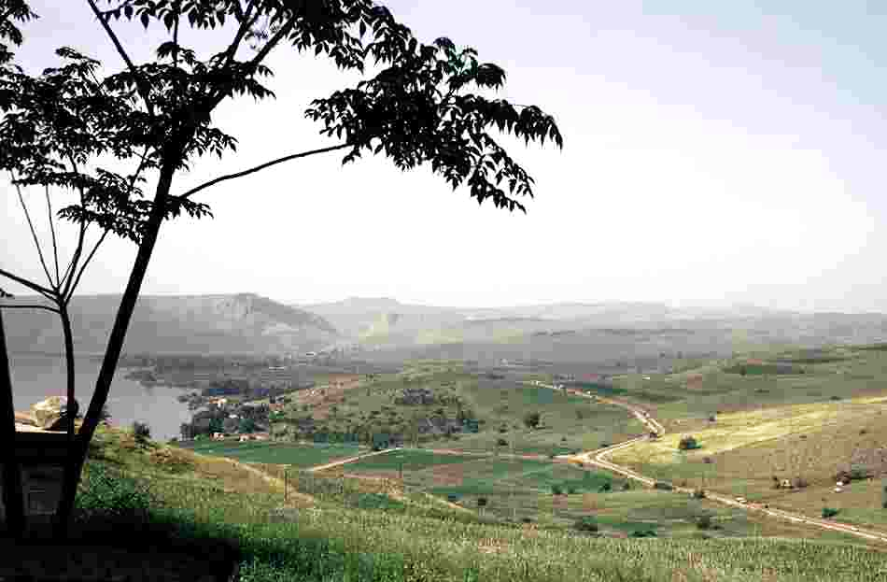
What if you knew the Geography of the Bible so well you could picture it?
Garden of Gethsemane
Imagine being able to visualize Bible characters in their proper place and time!
North Shore of the Sea of Galilee – site of feeding the 5,000

Slide 9
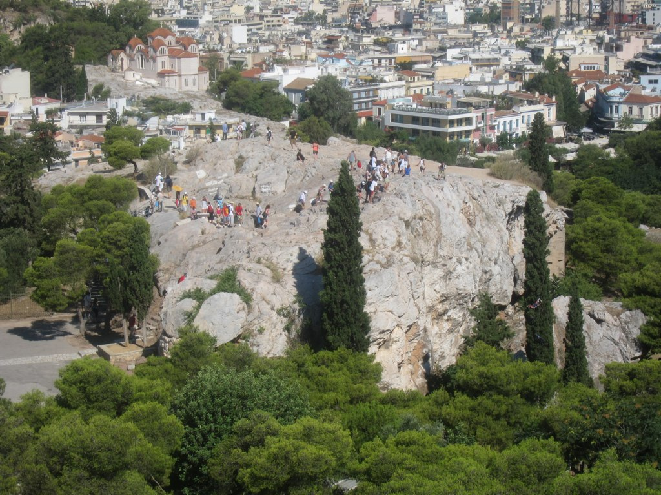
What if you knew the Geography of the Bible so well you could picture it?
Mars Hill – Athens Greece

Slide 10
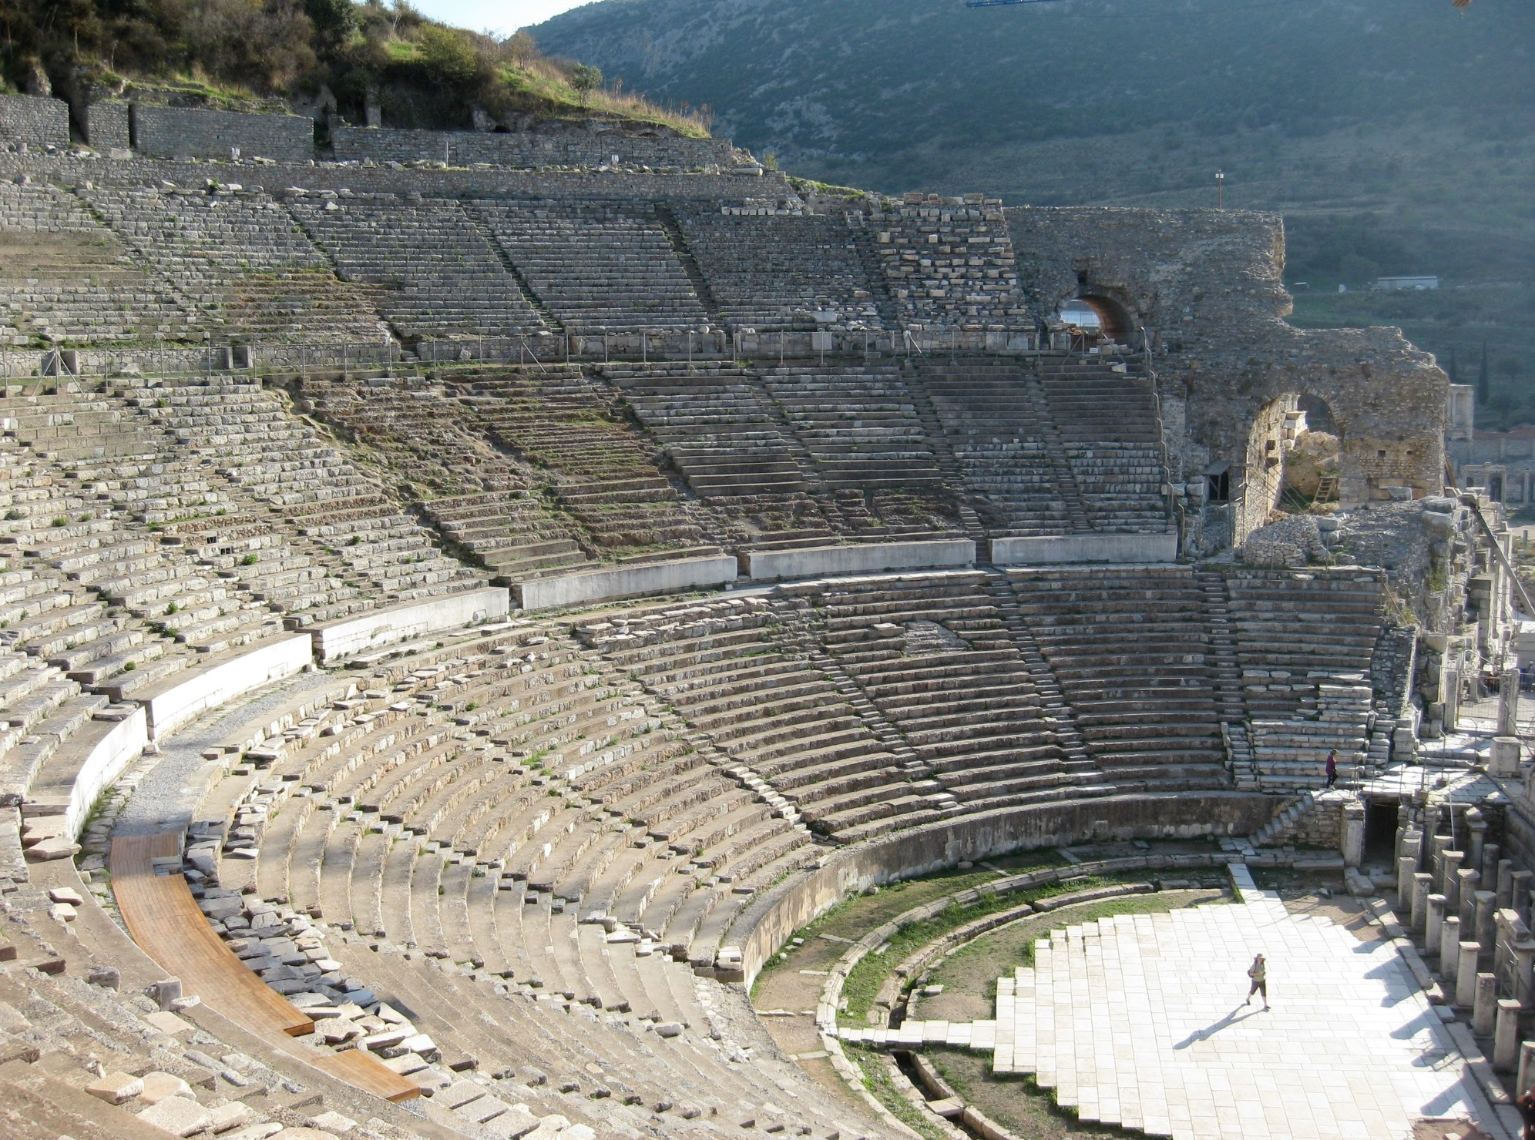
What if you knew the Geography of the Bible so well you could picture it?
Theater in Ephesus

Slide 11

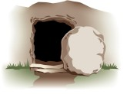
What if you could see the connections in the Bible Story?
Relationship of Old Testament events to New Testament Truths.
  Example: Genesis 1-3
  Christ the Creator (John 1:1-3; Col. 1:16-17; Hebrews 1:1-3)
  Man is to recreated in the image of God (Colossians 3:10-11)
  Social order of the sexes (1 Timothy 2:12-15)
  God’s intention for marriage (Matthew 19:1-9)
Relationship of early events to latter ones.
  Genesis 12:1-3; 17:8 – the Promises to Abraham
  Exodus 12:21-23; John 1:29; 1 Cor. 5:7 – the Passover sacrifice
  2 Samuel 7:12-13 – the Promise to David

Slide 12
What if you had the wisdom to apply every Bible story to your life? (2 Timothy 3:16-17)
What if you understood from the story of Noah…
  That man’s wickedness grieves God (Genesis 6:5-6)
  That God is always a faithful promise keeper (Genesis 6:7, 18; 7:23; 8:1)
  That God’s authority demands strict compliance (Genesis 6:22; 7:5)
  That faith works to receive promises by grace (Gen. 6:8; Heb. 11:7)
  That God appreciates thankfulness from His servants (Gen. 8:20-21)

Slide 13
What if we all had a burning desire to comprehend God’s word? (Psalm 19:7-10)
Motivation for giving our utmost as teachers.
  To thoroughly impart the Bible narrative. (Psalm 78:4-7)
  To imbed a complete understanding of Bible geography.
  To teach children how to apply the Scriptures to their lives (2 Timothy 3:16)
  To convey a deep understanding of the relationship between the Testaments.
Motivation for parents to encourage their children to actively participate. (Ephesians 6:4)
Motivation for children to apply themselves to learning.
It is an Old, Old Story, but it is worth learning, sharing, and repeating from now till the day of eternity.
We’d have Motivation!

