Slide 1
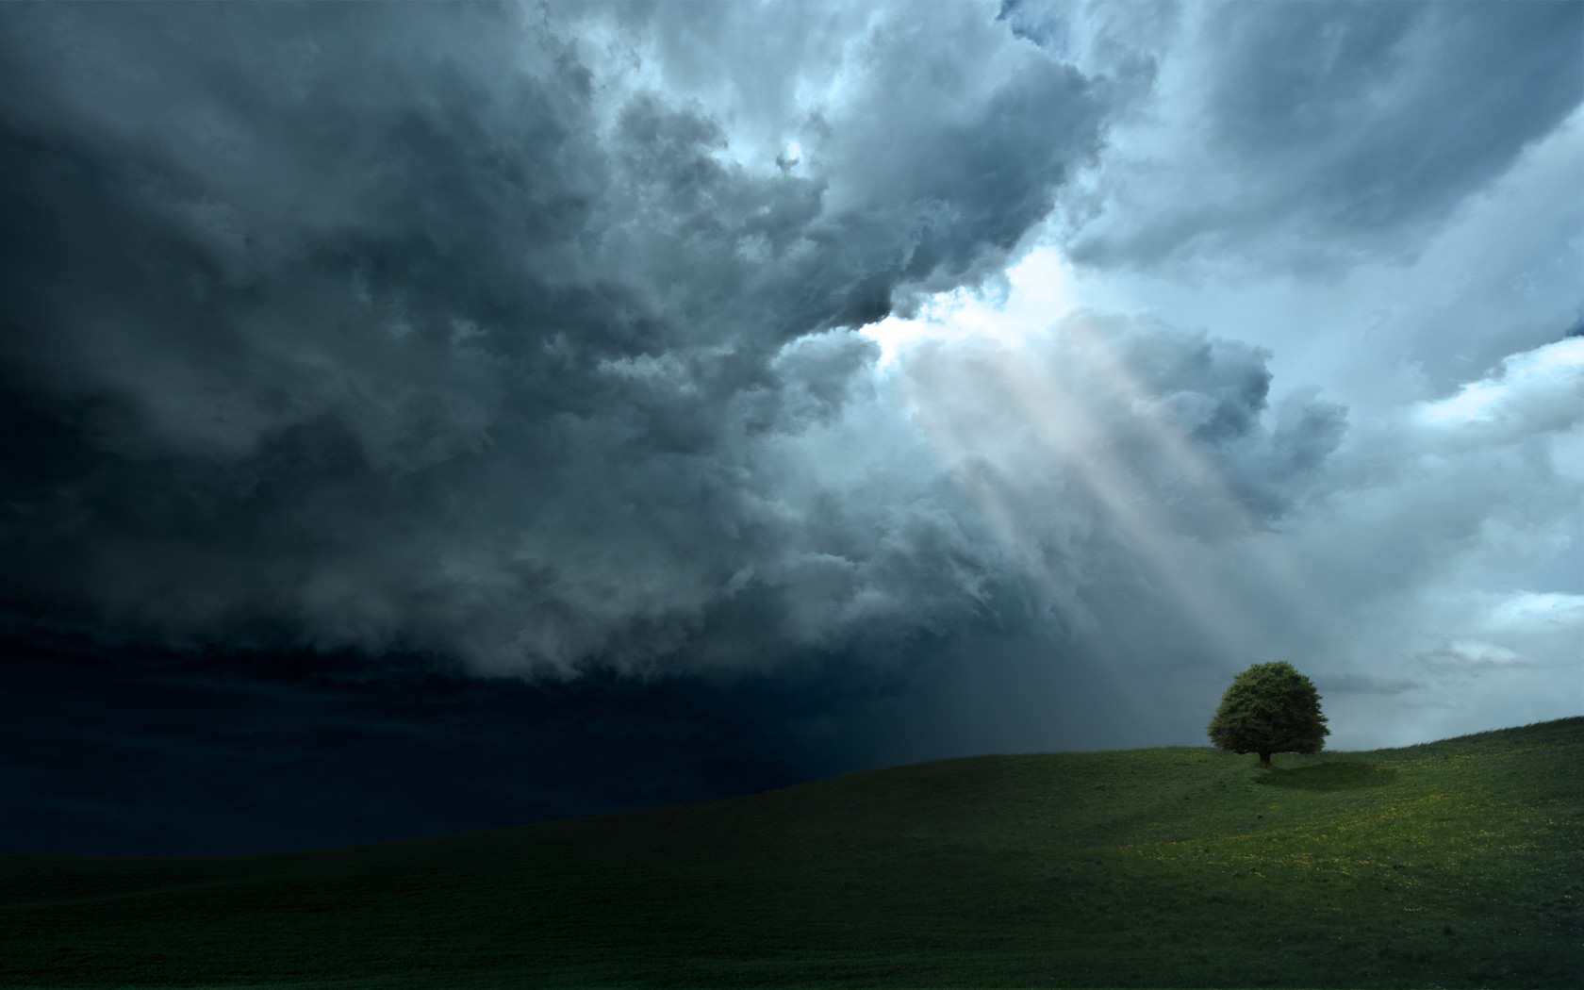
The Gathering Darkness & The Light of the World
Malachi 2:11 Proverbs 14:34 2 Timothy 3:12-13
Notes:
God considers it an abomination to profane His holy institution of marriage. The disrespect for traditional marriage and the re-definition of marriage in our culture is not morally neutral – it is a national disgrace. The world is filled with darkness (evil), and our acceptance of gay marriages indicates that it is getting darker. Christ is the light of the world. His gospel saves men from darkness. Those who are in the light will shine their lights all the brighter the darker it gets.

Slide 2
The Gathering Darkness
Men have use the cover of darkness to hide their evil deeds (Job 24:13-16)
Evil is thus associated with darkness (Proverbs 4:19)
The acceptance and practice of homosexuality results from darkened hearts (Romans 1:21-27)
A nation can get beyond repair (2 Chronicles 36:14-16)

Slide 3
The Light of the World
The Lord promised light to those in darkness (Isaiah 9:2; Matthew 4:13-16)
Christ is the light (Jn. 1:1-4; 8:12; 3:19-20)
The apostles were sent with the light of the gospel to free men from darkness (Acts 26:17-18; 2 Corinthians 4:6)
The light of Christ is on and in the people of God (Isaiah 60:1-2; Eph. 4:17-19; 5:11-13; Colossians 1:13-14; 1 Peter 2:9)

Slide 4

“But as the days of Noah were, so also will the coming of the Son of Man be.” (Matthew 24:37)

