Slide 1

“Give Attention to Reading”
1 Timothy 4:13
Notes:
We give attention to a lot of things…smart phones, television, politics, sports. But how much attention are we giving to reading God’s word? How much should we be giving and why?

Slide 2

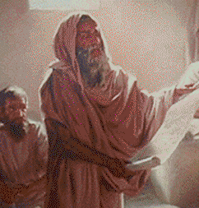
The Attention given to reading Scripture in the Old Testament
Moses at Sinai (Exodus 24:7-8)
The future king of Israel (Deuteronomy 17:18-19)
Joshua (Joshua 8:34-35)
In the days of Josiah (2 Kings 22:8-11; 23:2-3)
In the days of Ezra (Neh. 8:3-18; 9:3; 13:1)

Slide 3
The Attention given to reading Scripture in the New Testament
Jesus emphasized it (Matthew 12:3-5; 19:4; 21:16; 42; 22:31)
It was Jesus’ custom (Luke 4:16)
The Ethiopian practiced it (Acts 8:28-32)
The epistles were written to be read!(Colossians 4:16; 1 Thessalonians 5:27)

Slide 4

What is our motivation to give attention to reading God’s word?
The value of God’s word (Psalm 119:162, 14, 72, 127)
Its purity (Psalm 119:140)
Its guidance (Psalm 119:100-105)
It contains Christ! (John 5:39; 15:26; Ephesians 3:3-5)

Slide 5

My eyes fail from searching Your word, saying, “When will You comfort me?“ (Psalm 119:82)

