Slide 1


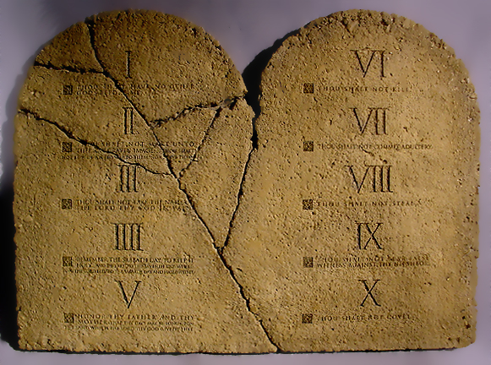
Contrasting TWO Covenants
Notes:
The two major covenants God made with His chosen people in Bible history differ dramatically. One brings bondage, the other brings liberty. One brings death, the other life. One relied on the blood of animals, the other on the blood of Christ. The sacrifices, the worship, the music, the day for assembling to worship, and the way to request forgiveness from God are all different.

Slide 2
Bible Covenants
A contract or agreement between two parties.
Often made between God and individual men:
Noah (Genesis 6:18; 9:9ff.)
Abraham (Genesis 15:18)
David (2 Chronicles 21:7)
The Bible contains two great and general covenants between God and His special people.
One through Moses with the Israelites.
One through Jesus with those saved by His blood.
These are the “Old” and “New” Covenants (Hebrews 8:8-13).

Slide 3
The New Covenant is Better (Hebrews 7:22; 8:6)
The Old Covenant was a covenant of bondage, but the New Covenant is a covenant of liberty (Galatians 4:22-31).
The Old Covenant was a covenant of death, but the New Covenant is a more glorious covenant of life (2 Corinthians 3:6-11).
The Old Covenant was dedicated with the blood of sacrificed animals, but the New Covenant with the blood of Christ (Hebrews 9:18-26; Luke 22:20).

Slide 4
Contrasting the Covenants Sacrifices for Sin
Sacrifices reminded men of sin (Hebrews 10:3-4)
One Sacrifice blotted out remembrance of sin (Heb. 10:5-17)

Slide 5
Contrasting the Covenants Place of Worship
In the tabernacle or temple (Hebrews 9:1-10)
In the church (Hebrews 9:11; 1 Peter 2:5)

Slide 6
Contrasting the Covenants Worship Music
Singing with instruments (2 Chronicles 29:25; Isaiah 38:20)
Singing (1 Corinthians 14:15)

Slide 7
Contrasting the Covenants Day for Assembling to Worship
Sabbath (Leviticus 23:3)
First Day of the Week (Acts 20:7; Colossians 2:16-17)

Slide 8

Which Covenant are YOU under?
“Stand fast therefore in the liberty by which Christ has made us free, and do not be entangled again with a yoke of bondage” -- Galatians 5:1

