Slide 1
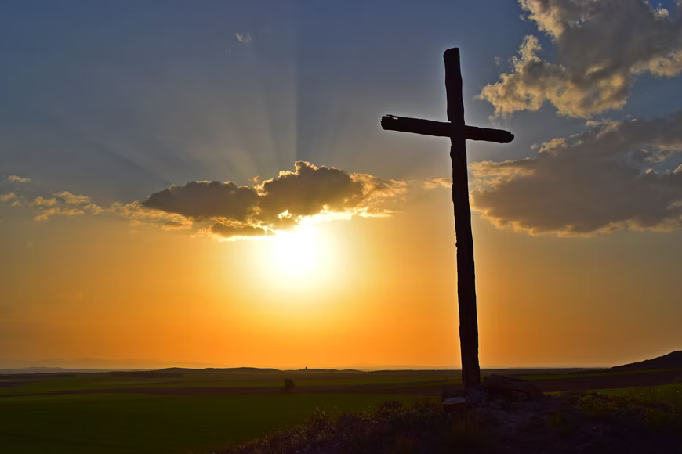
He
Endured the Cross
Hebrews 12:1-2
Notes:
Looking to Jesus as He endured the cross inspires our own endurance in the most difficult of trials and temptations.

Slide 2
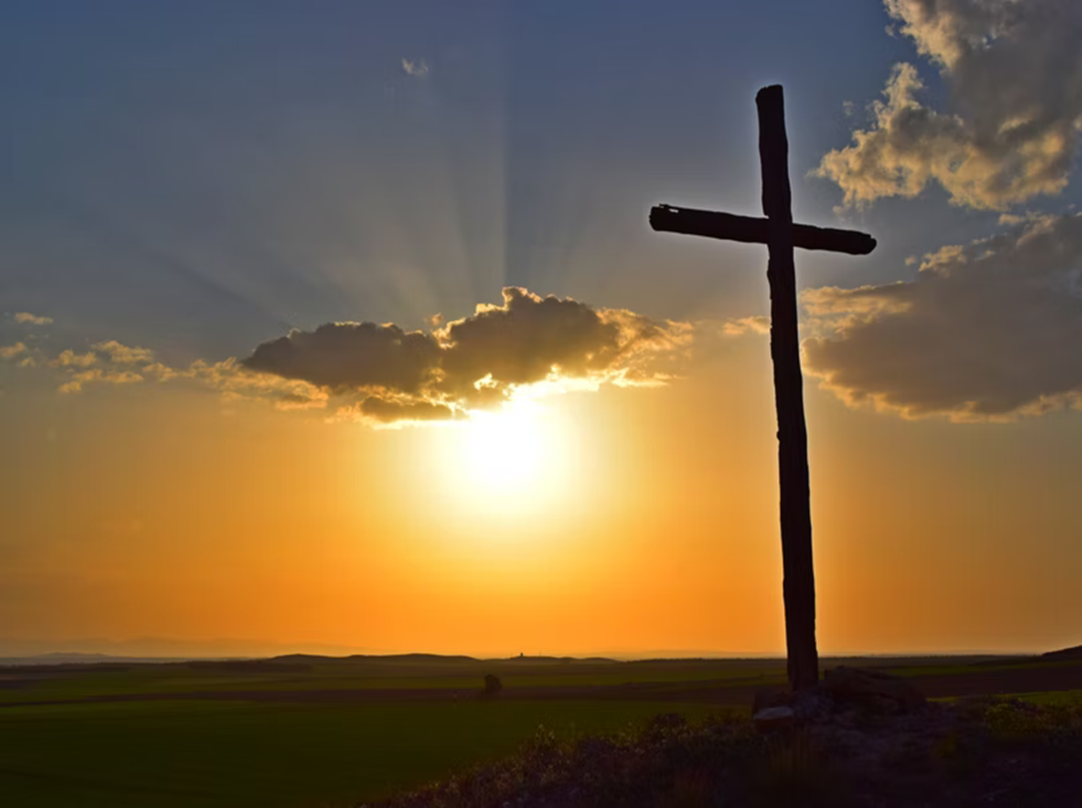
The Cross of Calvary
Jesus was crucified on a tree (Acts 5:30; 10:38-39).
He was crucified at a place called Calvary (Luke 23:33; Matt 27:33).

Slide 3
Crucifixion was Humiliation
Jesus died the death of a criminal (Gal. 3:13; Deut. 21:22-23; Isa. 53:12).
It was a painful, shameful death (Acts 8:33; Jn. 19:19-20, 38; Heb. 12:2; Luke 23:48).

Slide 4
The Cross Was God’s Plan
It was planned and prophesied (1 Cor. 2:7-8; Acts 13:28-29; Ps. 22:16-17; Zech. 12: 10; Isa 53:12; Mark 15:27-28).
Our redemption was the goal (1 Peter 2:24; 1:18-19; Col. 1:14, 20-22; Eph. 1:7; Titus 2:14).

Slide 5
The Cross Inspires Hope and Endurance
Christ died to give us a way back to the tree of life (Revelation 2:7).
If we will look to Him, we can endure like He did (2 Corinthians 3:18; Hebrews 12:1-4).

