Slide 1
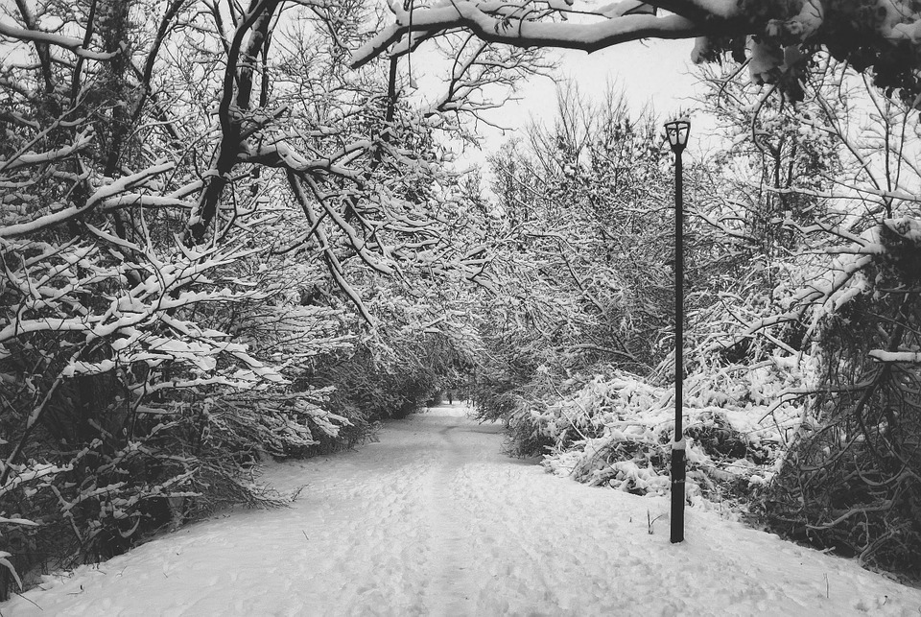
Doing the Next Right Thing
Luke 3:10-14
Notes:
Children of God practice righteousness, no matter the darkness of the day or the difficulty of the way. They pursue and do what is right even when everything is going wrong.

Slide 2
The Lord Determines What is Right
His statutes are right! (Psalm 19:8)
The wise will understand this! (Hosea 14:9 ; Psalm 119:128)
God’s word directs us to the next right thing (2 Timothy 3:16)
We must practice using it to make right choices (Hebrews 5:13-14)

Slide 3
God’s children are known for doing the next right thing
Children of God practice righteousness (1 John 2:29; 3:7, 10)
They do right when everything is going wrong (1 Kings 19)
Christ is our example and heaven is our reward (1 Peter 2:23-24; Heb. 12:3-4; Matthew 5:10)

Slide 4
Desiring and Pursuing Righteousness
If we desire to do right intensely enough, we will (Matthew 5:6)
We must PURSUE it (1 Timothy 6:11; 2 Timothy 2:22)

