Slide 1
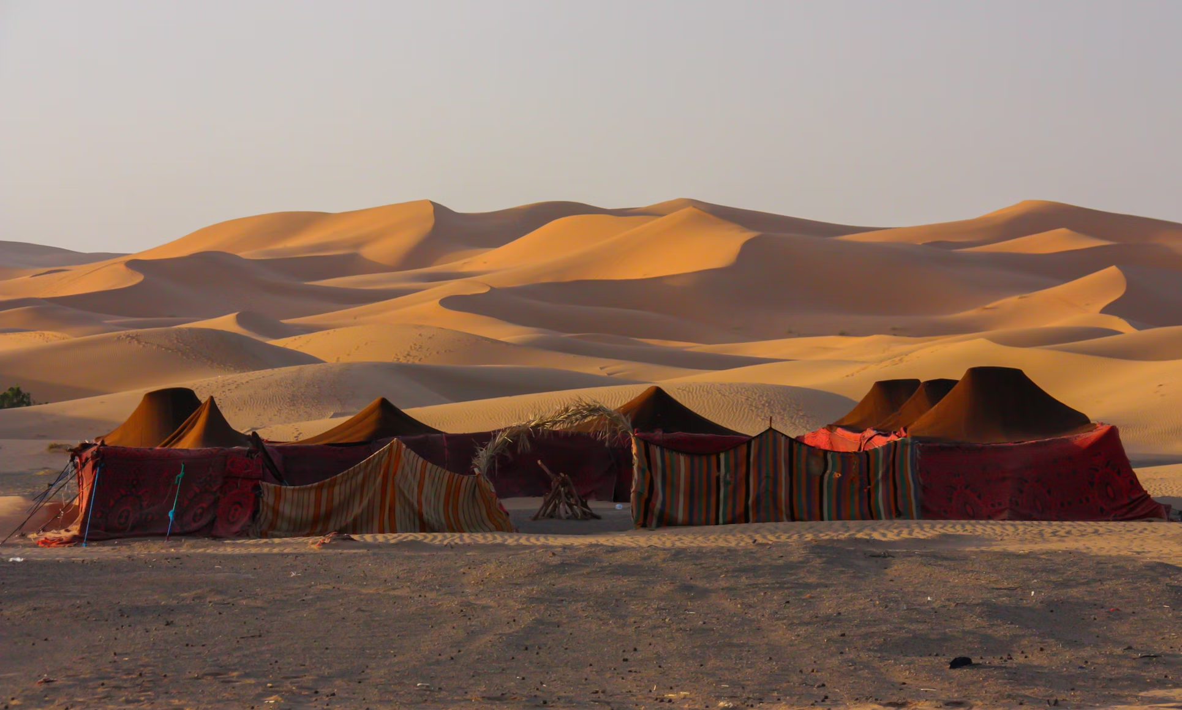
The Tents of the Righteous
“The voice of rejoicing and salvation
is in the tents of the righteous”
(Psalm 118:14-15)
Notes:
The Scriptures use the concept of the righteous dwelling in tents to illustrate their spiritual priorities, willingness to work, and preparation for eternity

Slide 2

The righteous dwelt in tents – “this world is not our home.”
Our life is nomadic. Hebrews 11:8-9; 1 Peter 2:11; Proverbs 14:11
We are seeking and waiting for our homeland. Hebrews 11:9-10, 13-16; 13:14

Slide 3
The righteous pitched their tents – indicating preferences & priorities
What are our priorities?
Are we pitching our tents toward Sodom? Genesis 13:1-13; cp. 26:24-25
Our affections must be above! 1 John 2:15-17; Colossians 3:1-2

Slide 4
The righteous made tents – indicating their willingness to work.
Paul exemplifies a willingness to work. Acts 18:3
He commands others to do so.
1 Thess. 4:11-12
2 Thess. 3:10
Ephesians 4:28

Slide 5
The righteous knew their tents were temporary -- they were mortal
Peter knew he would “put off” his tent. 2 Peter 1:12-14
Paul knew that when this happened, he would have a better habitation. (2 Cor. 5:1-2)

Slide 6
The Lord has a BIG TENT for all the righteous
Isaiah 54:1-3

