Slide 1
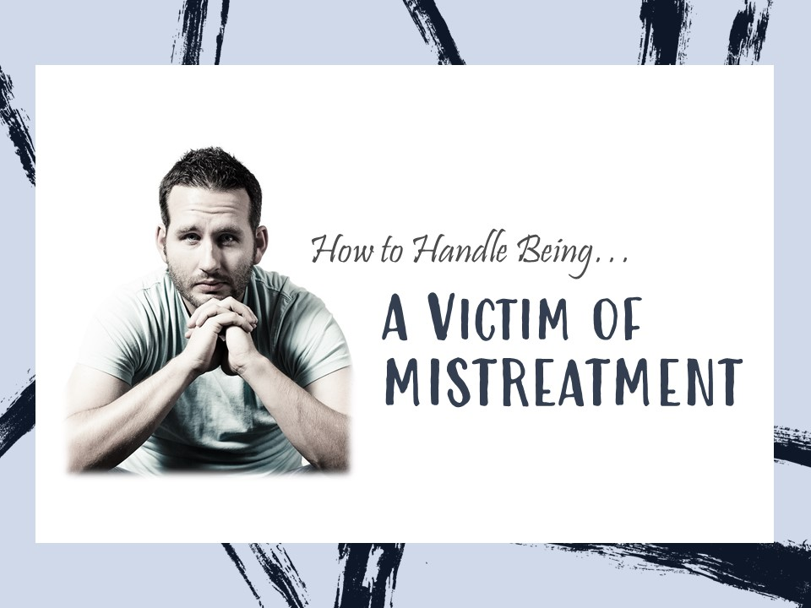
Notes:
All of us feel that we are mistreated from time to time. The Lord expects us handle mistreatment like His Son did.

Slide 2

The Lord’s View of Your Mistreatment
He expects you to react like His Son did (1 Peter 2:21-23).
He considers how you’ve been treated, but your standing before Him depends upon YOUR behavior (Psalm 25:19-22; 119:157; 2 Corinthians 5:10).

Slide 3
How Should You React to Mistreatment?
Ask God to be with you and strengthen you (Psalm 38:18-22).
Consider it a Blessing (Matthew 5:10-12; 1 Peter 4:16).
Allow God to take vengeance (Psalm 5:8-10; 94:1-6, 23; Romans 12:19).
Love and pray for those who mistreat you (Luke 6:27-28; Romans 12:14).
Return good for evil (Luke 6:29-30, 35; Rom. 12:20-21).
Consider God’s purpose (Gen. 50:20; 2 Sam. 16:11-12).

Slide 4
Keep these truths in your heart!
The Lord will not judge you by how others treated you, but by how you treated others! (Matthew 25:34-46).
Bitterness will defile you. Be better, not bitter (Hebrews 12:15).

Slide 5
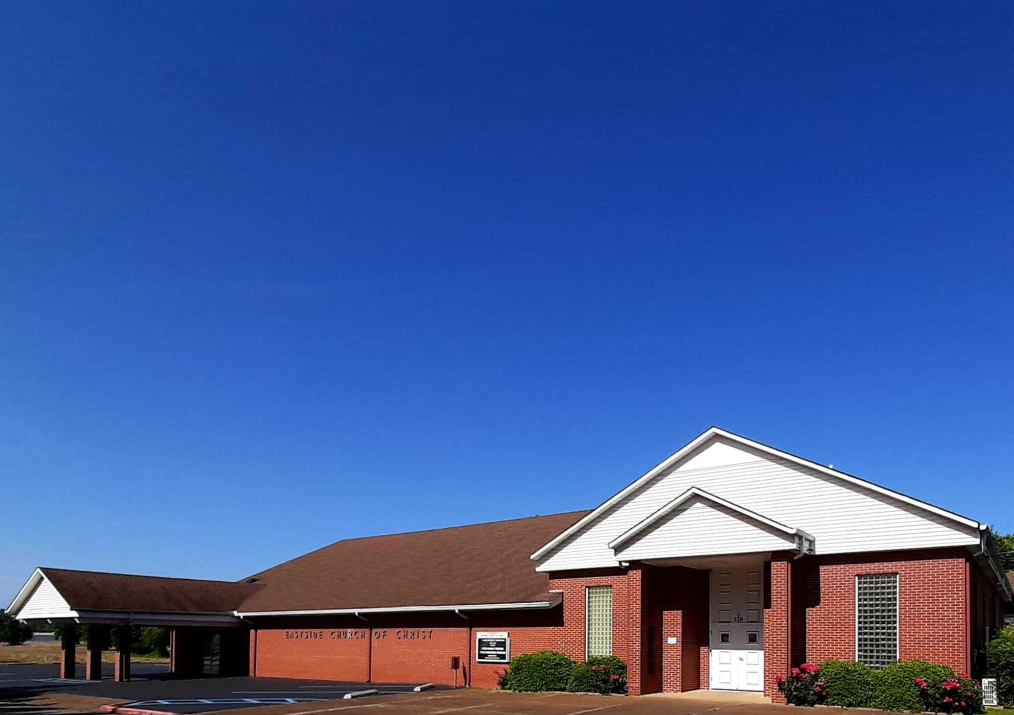
Eastside Church of Christ
Eastside-church.org

