Slide 1
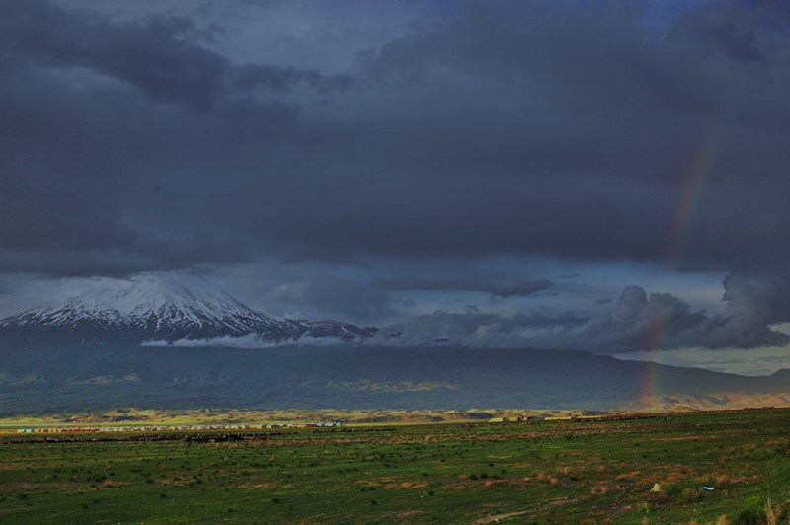
Faithfulness
Colossians 1:21-23
Notes:
Faithfulness is a key quality of every person who pleases God. God Himself demonstrates faithfulness, as do many great Bible characters. Faithfulness is a “till death” commitment. It is exhibited in many areas of life – worship, prayer, Bible study & application, resisting Satan and the use of our possessions.

Slide 2
God Demonstrates Faithfulness
God is faithful to help us and protect us from evil (2 Thess. 3:3; 1 Cor. 10:13)
God is faithful to keep His covenant and His promises (Deuteronomy 7:9)
God is faithful to bless us every day (Lamentations 3:23)
His faithfulness compels our faithfulness (Hebrews 10:23)

Slide 3
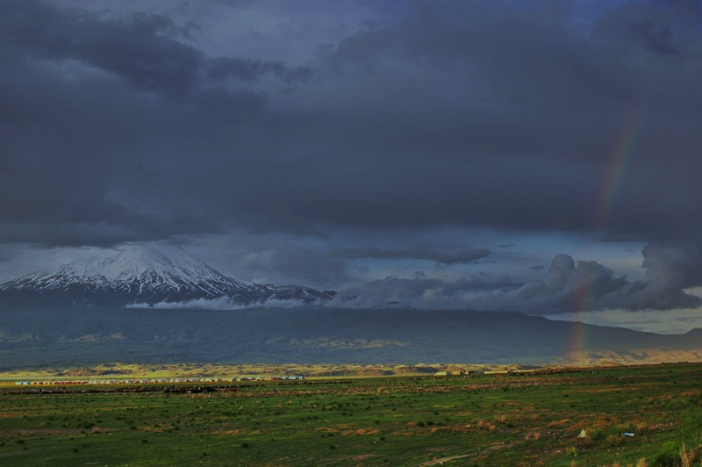
Examples of Faithfulness
Hezekiah (2 Chronicles 31:20—32:1a)
Daniel (Daniel 6:4)
Moses (Hebrews 3:1-2, 5-6)
Christ (John 17:4; 8:28-29; 10:17-18)

Slide 4

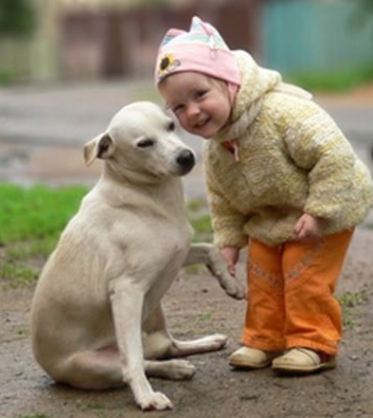
Be Faithful
Unto death (Revelation 2:10)

Slide 5
Be Faithful
And exhibit it in life!
In worship (Acts 2:42)
In prayer (Colossians 4:2)
In Bible study & application (James 1:25)
By resisting Satan (1 Peter 5:4-9)
With your possessions (1 Corinthians 4:2; Luke 16:10-12)

Slide 6
“These will make war with the Lamb, and the Lamb will overcome them, for He is Lord of lords and King of kings; and those who are with Him are called, chosen, and faithful.”
(Revelation 17:14)

