Slide 1

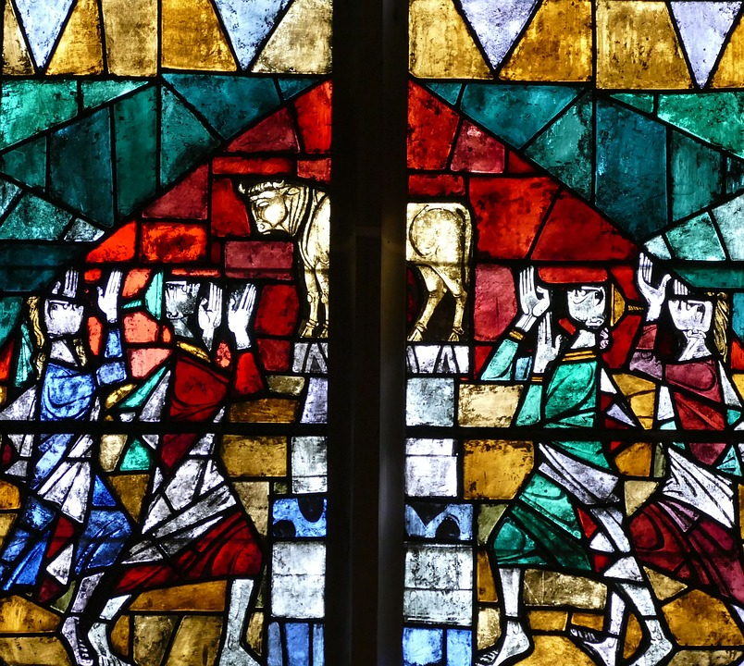
Whose Side are You On?
Exodus 32:26
Notes:
This world is a battleground between the forces of good and evil. We must choose between light and darkness. That choice will not only determine where we stand on the moral and social issues of our day but also serve to guide our personal conduct.

Slide 2
There are Two Sides
The forces of evil and of good are in opposition.
If we are not on the enemy’s side, we are on Jesus’ side (Mark 9:38-41; 2 John 10-11; 3 John 8; Phil. 1:18).
If we are not on Jesus’ side, we are on the enemy’s side (Matt. 12:28-30; 7:21-23; Rom. 8:31).
There are two sides to choose between (Matthew 6:24).

Slide 3
Choosing Light or Darkness
The kingdom of Jesus is a kingdom of light (Colossians 1:13; Acts 26:18).
Citizens of that kingdom live in the light (Romans 13:12-14; 1 Thess. 5:5-8; Ephesians 5:8).
Light exposes darkness (Ephesians 5:11-17; John 3:19-20).
Light isn’t vulnerable to darkness. Darkness is vulnerable to light. (Matthew 6:22-23).

Slide 4
Whose side are you on?
When it comes to…
Foul language/misusing God’s name (Ephesians 4:29-30; 5:3-5)
Sexual immorality/adultery (Ephesians 5:3-5)
Gambling/covetousness (Eph. 5:3-5)
Pornography/lust (Matthew 5:28-29)
Appearance/Apparel/Modesty (1 Timothy 2:9-10; 1 Peter 3:2-3)
Social drinking (1 Peter 4:3)

