Slide 1
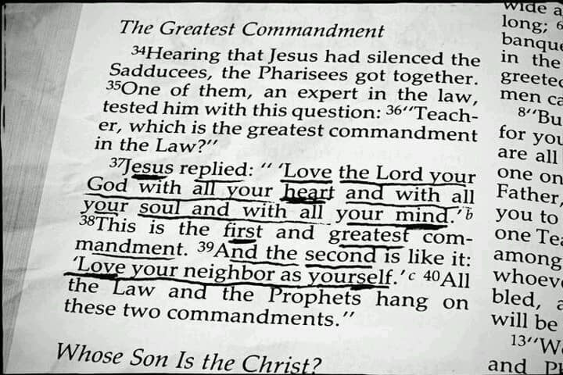
The Two Greatest Commands
Loving God and your Neighbor in this Present Distress
Notes:
How can we show love for God and love for our neighbor in a situation where we endanger the lives our neighbors by keeping God’s commands? By giving God our lives and striving to glorify Him while sharing His love, we can find His guidance for making these difficult decisions.

Slide 2
The Two Greatest Commands and the Preservation of Life
David was a man after God’s own heart – a courageous man of faith.
And yet, we often find him fleeing for his life rather than standing to fight. (1 Samuel 19:12-18; 21:10-15; 22:1; 24:1-13)
David desired his life to be preserved that he might serve and glorify God! (Psalm 86:1-13)

Slide 3
The Two Greatest Commands and the Preservation of Life
The apostle Paul loved God intensely and hazarded his life for the gospel.
His words reveal his deep love for God. (Acts 20:22-24; 25:11)
When Paul had the choice to glorify God by death or live on to help his brethren, he chose to live on. (Philippians 1:21-25)
Loving God and his neighbor occasionally required self-preservation. (2 Cor. 11:23-33; Acts 17:1-14; 1 Thessalonians 2:17-18)

Slide 4
Loving God and Man by Preserving Life
The isolation of lepers preserved life. (Leviticus 13:45-46, 4-8; Romans 15:4)
Many things that caused a person to be “unclean” were literally sickening. (Leviticus 5:2-3; 11:4-30; 15:1-15, 25-33)
An unclean person could not come to the tabernacle to worship. (Leviticus 15:31)

Slide 5
Loving God and Man
We should earnestly desire spiritual and physical health for our neighbors (3 John 2).
If we don’t show love for our brother, we can’t have love for God (1 John 4:20).
God’s love is perfected in us when we love one another (1 John 4:12).
The two greatest commandments are harmonious (Matthew 22:36-40).

