Slide 1
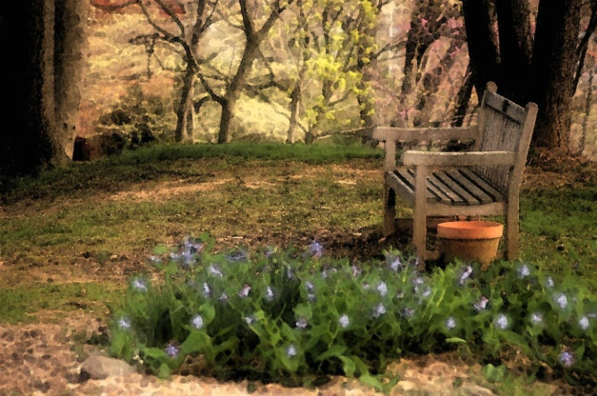
The Secrets of a Christian’s Happiness
1 Thessalonians 4:16 Philippians 4:4
Notes:
The Christian is happy, not as a result of seeking happiness as an end in itself, but because of a perspective on life that gives him purpose and orders his priorities. He is consistent, he has a loving God, he does what is right, he understands that there is a reason for tribulation, he is not possessed by possessions, and he knows that he is saved.

Slide 2

The Faithful Christian is Happy…
Because he’s consistent (Romans 14:22)
Because God is His God (Psalm 144:15; Proverbs 16:20)
Because he does what is right (John 13:17; Prov. 29:18; 28:14; Psa.1:1-2)

Slide 3
The Faithful Christian is Happy…
Because he knows there is a purpose for his troubles (1 Peter 1:6-7; 2:21; 4:13; Romans 5:3-4; James 1:2-4; Phil. 4:11)
Because he knows that possessions don’t bring happiness (Acts 20:35; Luke 12:15)
Because he is saved (1 Peter 1:8-9; Romans 5:2; 12:12; Acts 8:39)

