Slide 1
…
Notes:
In Revelation, John sees the throne of God. By inspiration, he paints a word picture that is a Divine Masterpiece. We see the glory of God along with His omniscience, omnipotence and holiness. Before God’s throne, our prayers are heard, and God is praised for all He does for the saints. And there is the tree of life and the river of life, which symbolize everlasting life given to God’s servants. Before His throne they serve Him, the see Him, they belong to Him, and they reign forever. The scene conveys the special place that we as God’s servants have before His throne.

Slide 2

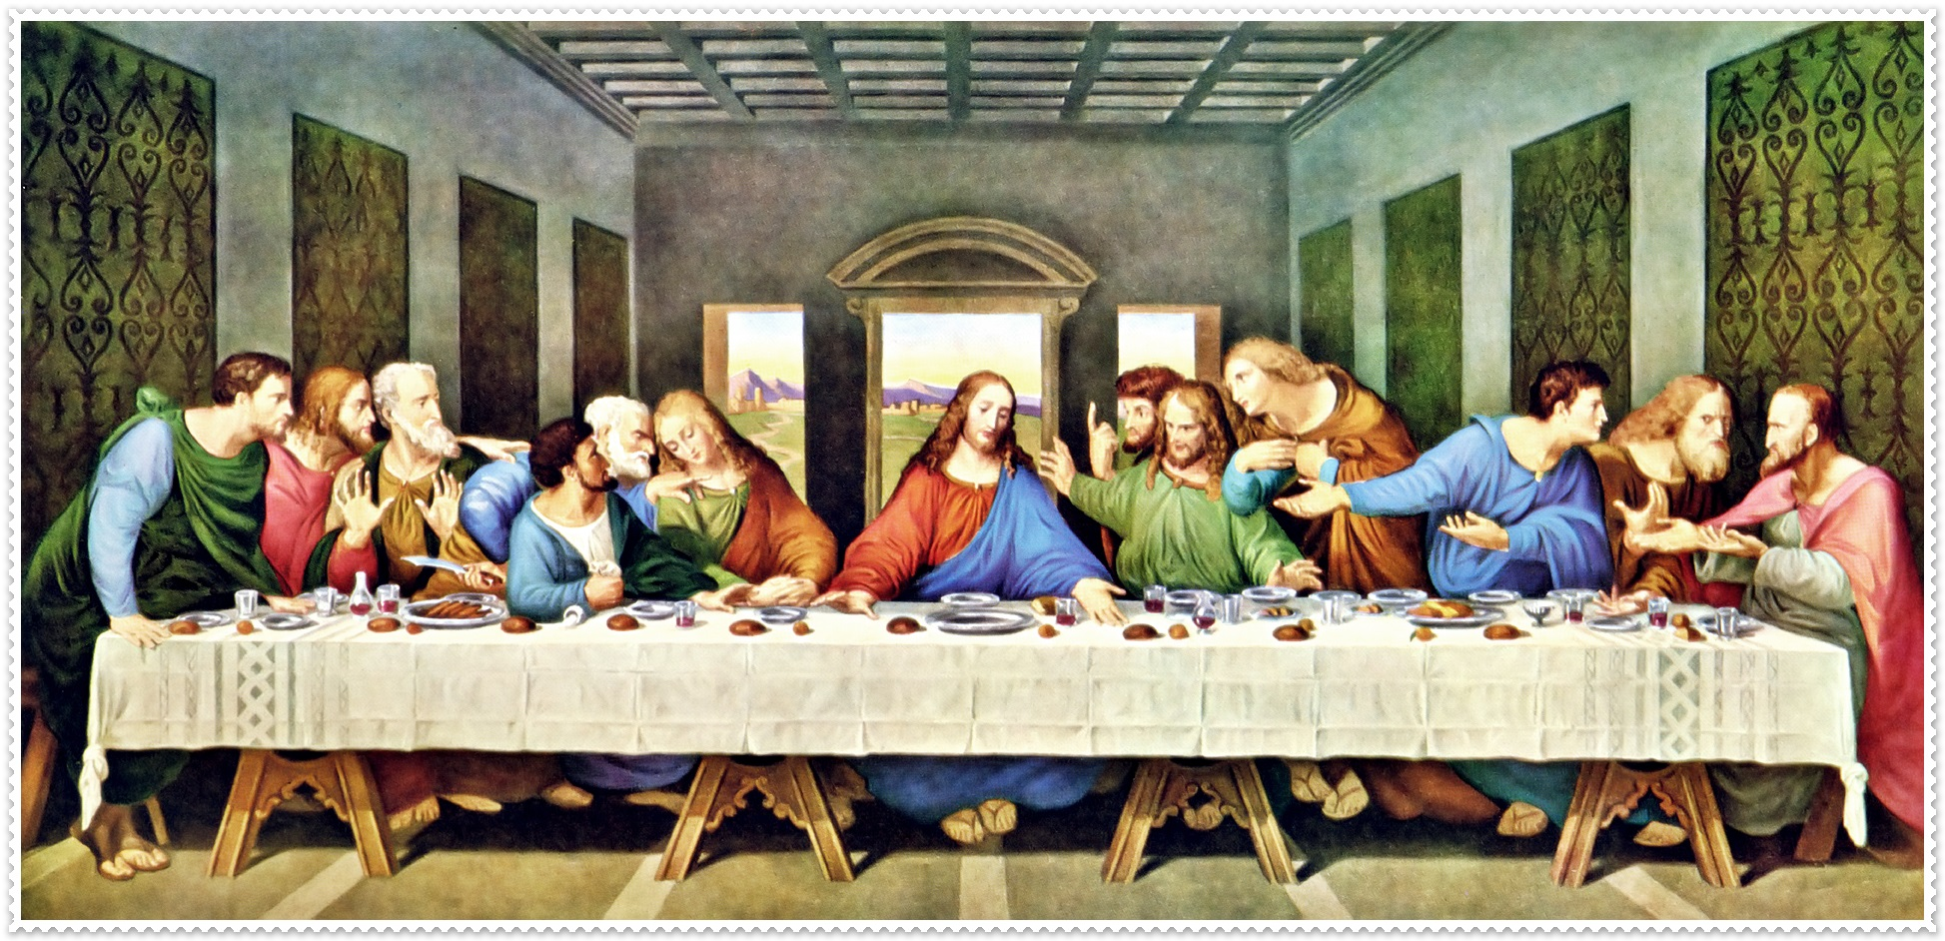
Da Vinci’s The Last Supper

Slide 3
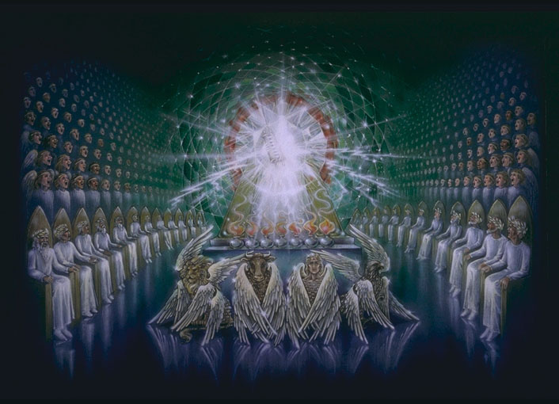
Before the Throne
Now and Forever in the Presence of God
Revelation 4 Revelation 21-22

Slide 4
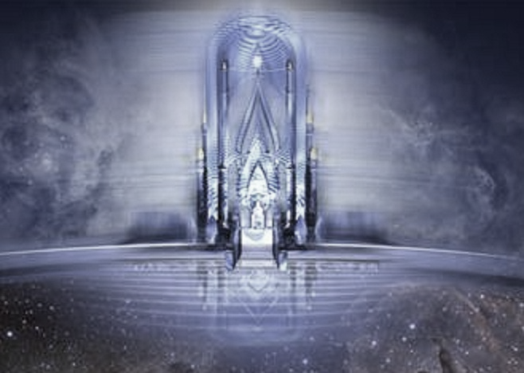
“Before the Throne”
The prayers of the saints (Revelation 8:3-4)
The praise of saints who have been protected and preserved (Revelation 14:1-5; 15:2-3; 7:9-10)

Slide 5
“Before the Throne”
Revelation 22:1-5
A Tree by a River
The tree of life (Genesis 3:22-24)
The river of life (John 4:14; Rev. 21:6; 7:17; 22:17)

Slide 6
“Before the Throne”
Revelation 22:1-5
God’s Servants
They “Shall Serve Him”
They will “see Him face to face”
(John 1:18; 1 John 4:12; 3:2; Exodus 33:20)

Slide 7
“Before the Throne”
Revelation 22:1-5
God’s Servants
They will have “His Name on their Foreheads”
(Revelation 7:3; 3:12)
They “Shall Reign Forever and Ever”

