Slide 1

Declining Church Membership
Implications for Evangelism
Notes:
Membership in churches is on the decline. This opens up evangelistic opportunities for those willing to use wise Biblical approaches for taking the gospel to the world.

Slide 2
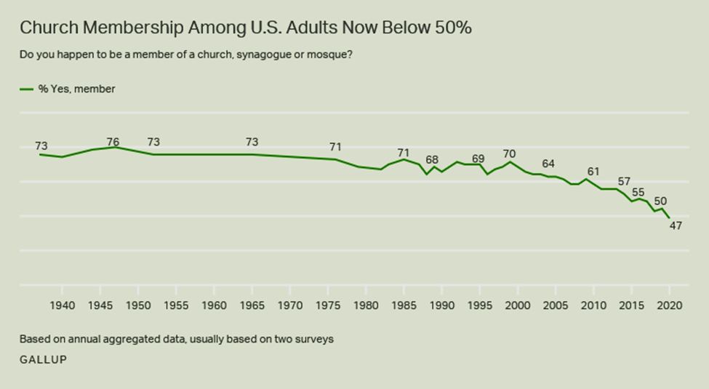
Church Membership has Declined Twenty percent in two decades

Slide 3

Declining Church Membership Implications for Evangelism
We may need to alter our starting point.
Evangelism must be more than bringing people out of denominationalism (Colossians 4:5-6).
We must understand how far each person is from the kingdom (Mark 12:28-34).

Slide 4
Declining Church Membership Implications for Evangelism
Consider the approach of evangelists in the N.T.
Philip started where the Eunuch was -- a believer in God and in the prophetic Scriptures (Acts 8:30-35).
Paul’s starting point for Jews was different than his starting point for gentiles.
With Jews, he often began with Scripture or Jewish history (Acts 9:20-22; 13:14-30; 17:2-3)
With Gentiles, he often began with the nature of God (Acts 14:8-18; 17:22-31)
We must take a person’s religious and cultural background into account.

Slide 5
Declining Church Membership Implications for Evangelism
The appeal is to the gospel of Christ.
Carnal appeals will not bring people to Christ (2 Timothy 3:4; Romans 14:17).
The word of the Lord saves and results in members being added to His church (Acts 2:41; 2 Thess. 3:1; Acts 19:17-20).

