Slide 1
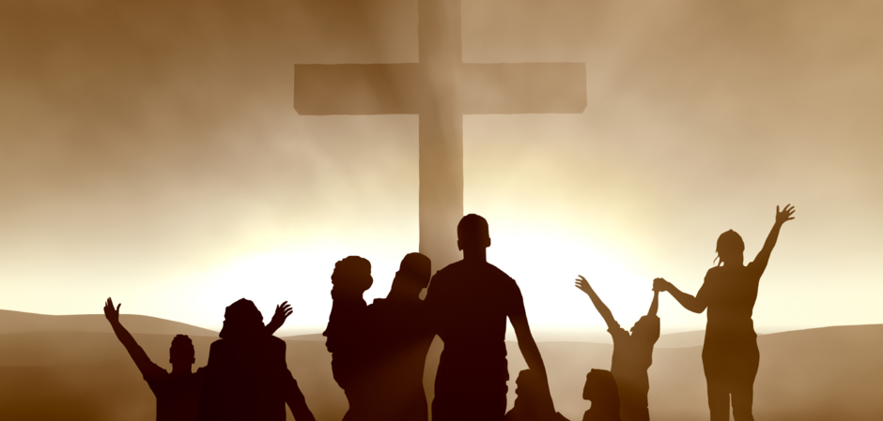
If The FIRST FAMILY is FIRST…
Notes:
Following up on last Sunday morning’s lesson, what are the practical consequences of giving the church/family first priority in our lives? If the first family is first, then our Father’s truth will prevail and be supported at all cost. Our spiritual family will take precedence of physical family. There will be a commitment to sharing, caring, and associating. We will be focused on one another, and we will use our gifts for the benefit of our family!

Slide 2

If The FIRST FAMILY is FIRST…
Our Father’s truth will prevail!
We will support the truth at all costs!
(Matthew 12:50; 1 Timothy 3:15)

Slide 3
If The FIRST FAMILY is FIRST…
It will have precedence over physical family.
First Family relationships come first!
(Luke 9:59-62; 14:20, 24; Mark 10:29-30; 1 Corinthians 5:1; 2 Corinthians 7:12)

Slide 4
If The FIRST FAMILY is FIRST…
There will be a commitment to sharing, caring and associating.
Both in the assembly and outside of it.
(Acts 2:44-47; Hebrews 10:24-25; Galatians 6:10; 1 Peter 3:8-9)

Slide 5
If The FIRST FAMILY is FIRST…
There is a commitment to “one another.”
Rom.12:10,,16; 13:8; 14:19; 15:7, 14; 16:16; 1 Cor. 12:25; Gal. 5:13; Eph. 4:2, 32; 5:21; Col. 3:13; 1 Thess. 4:18; 5:11, 15; Heb. 10:24; James 5:16; 1 Peter 4:9-10; 5:5; Rom. 14:13; Gal. 5:26; Col. 3:9; James 4:11; 5:9

Slide 6
If The FIRST FAMILY is FIRST…
We will use our abilities, energies and gifts for the church/family.
Everybody can do something!
(Ephesians 4:16; 1 Peter 4:10-11; Romans 12:4-8)

Slide 7
IF the FIRST FAMILY is FIRST, we need to commit!
Say, “I Do!”

