Slide 1
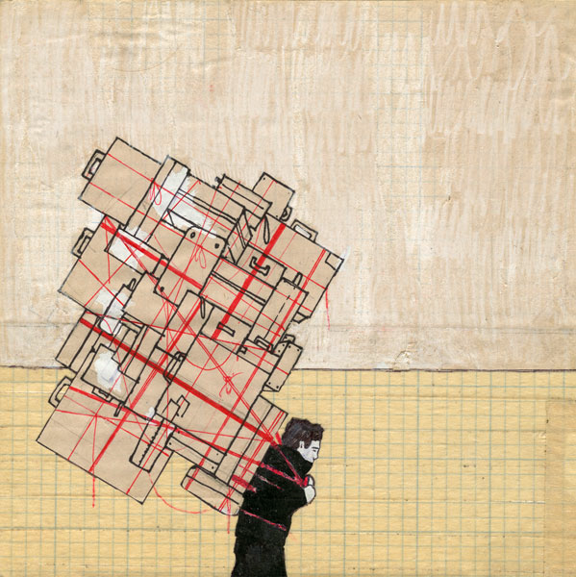
Unloading our BURDENS on the LORD
Psalm 38:4 Luke 21:34
Notes:
We all have burdens. Our sins and the cares of this life are some of the heaviest and most common burdens we carry. Christ died to bear our burdens. The Lord wants us to give Him our burdens, and we actually burden Him when we don’t!

Slide 2

BURDENS
Christ died to bear the burden of our sins (Isaiah 53:4, 11-12; 1 Peter 2:24)
The Lord wants us to give Him our burdens (Psalm 55:22; 1 Peter 5:7)
He bore burdens for Israel! (Deuteronomy 1:31; 33:27)
No one can bear burdens like God! (Isaiah 46:1-7)

Slide 3
BURDENS
Even though the Lord wants us to give Him our burdens, He does not want us to burden Him!
We Burden the Lord when we pile sins on ourselves and refuse to let Him help us (Isa. 43:24-25; 65:2-5; Amos 2:11-13; Eph. 4:30)
By giving God your burdens you lighten both your load and His!

Slide 4
Give Your Burden to God
Cast your burden on the LORD, and He shall sustain you -- Psalm 55:22

