Slide 1
…

Slide 2
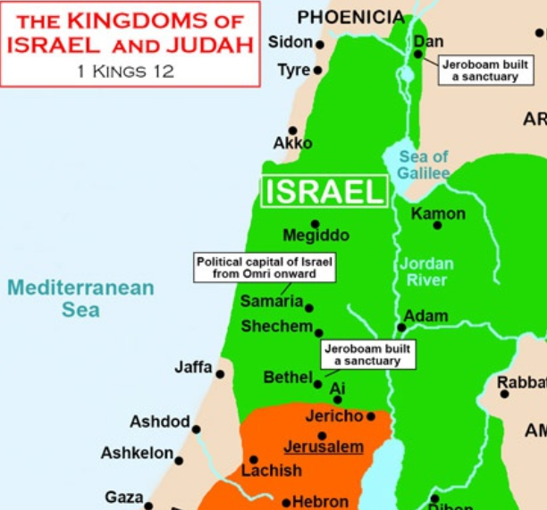

Slide 3

Lessons the Man of God Learned Too Late – 1 Kings 13:1-24
God had finished speaking
Jude 3; 2 Timothy 3:16-17; Galatians 1:6-8
The Devil had camouflages
Matthew 7:15; 2 Corinthians 11:12-15
1 John 4:1; 1 Thessalonians 5:21
Acts 17:11

Slide 4
Lessons the Man of God Learned Too Late – 1 Kings 13:1-24
Feelings deceive
Jeremiah 17:9; Proverbs 28:26;
John 8:31-32; 1 John 5:2-3
Believing a lie condemns
Matthew 15:13-14; Matthew 7:21-23
Partial obedience is not enough
James 2:10

Slide 5
Lessons the Man of God Learned Too Late – 1 Kings 13:1-24
God had finished speaking
The Devil had camouflages
Feelings deceive
Believing a lie condemns
Partial obedience is not enough

Slide 6
…

