Slide 1
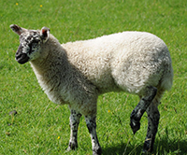
Lame Sacrifices
Malachi 1:7-9
Notes:
The Lord is not honored by sacrifice or service that is less than our best. Our prayers, songs, gifts, good works, study, and evangelism efforts should be the best that we can do.

Slide 2
Lame Sacrifices
The letter of the Law required that animals sacrificed to God be without defect (Deut. 15:19-21; Lev. 22:19-22).
God’s concern was not primarily for the condition of the animal, but for the condition of the heart of the one who sacrificed it (Psalm 51:16-17; 50:8-15; Micah 6:6-8; John 4:24).

Slide 3
Characteristics of Lame Sacrifices
Formal and half-hearted (Luke 11:42)
Inferior quality that dishonors God (Malachi 1:10-14)
David’s attitude was correct!
  “…nor will I offer burnt offerings to the LORD my God with that which costs me nothing” (2 Samuel 24:24).

Slide 4
Are our Sacrifices Lame?
When we pray? (1 Cor. 14:15)
When we sing? (Hebrews 13:15; Psalm 104:33)
When we give? (2 Cor. 9:7)
When we do good works? (Galatians 6:9; Titus 3:8, 14)
When we study? (2 Tim 2:15, Acts 17:11)
When we teach others? (2 Cor. 5:10-11)

Slide 5
God Sacrificed His Perfect Lamb
We were redeemed with “the precious blood of Christ, as of a lamb without blemish and without spot” (1 Peter 1:19).
Jesus is the Worthy Lamb! (Rev. 5:12).
“Love so amazing, so divine, demands my life, my soul, my all!”

Slide 6
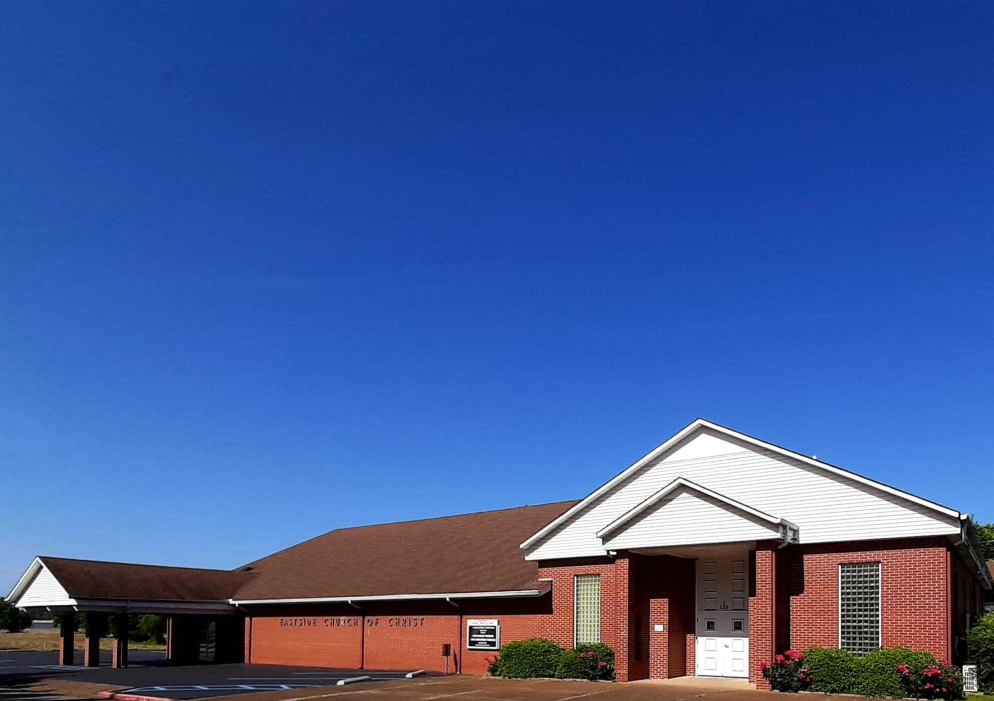
Eastside Church of Christ
Eastside-church.org

