Slide 1
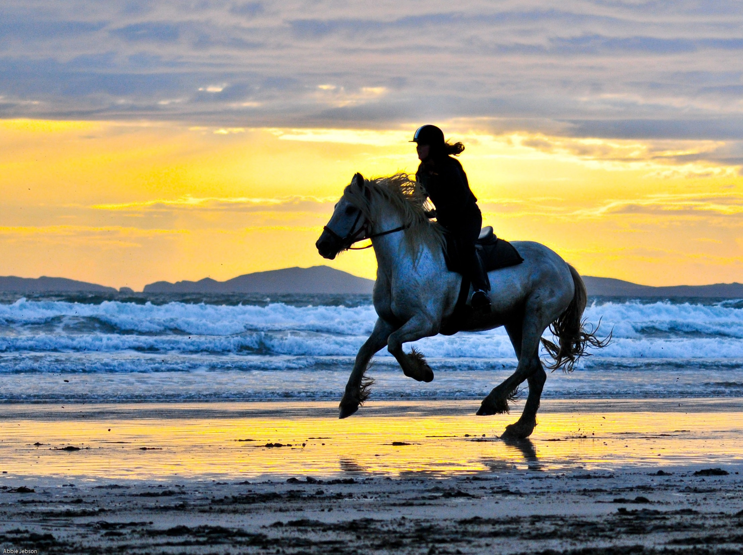
The Power of Meekness
Matthew 11:29; 1 Timothy 6:11
Notes:
Meekness it neither weak nor indecisive. It is power under control. It enables submission to God, requires humbling oneself, and demonstrates itself in gentleness to others. Meekness is what empowers power and secures for its possessor the sum of all blessings.

Slide 2
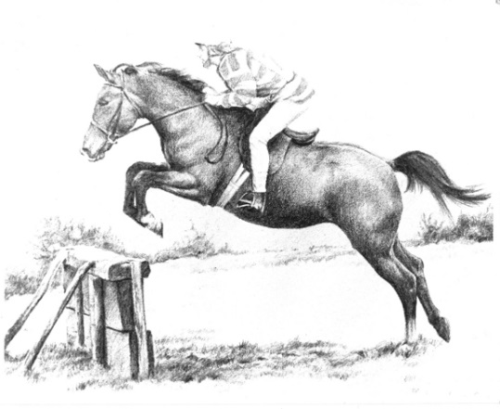
Meekness Involves Submission to God
His expressed will (James 1:21; Psalm 25:9; Zephaniah 3:12)
His dealings with us through others (2 Samuel 15:5-12; 1 Peter 2:18-20)
His dealings with us through circumstances (Job 13:15)

Slide 3
Meekness Requires Humility
It is associated with humility (Ephesians 4:2; Colossians 3:12)
It involves seeing oneself as God does.

Slide 4
Meekness Demonstrates Itself in Gentleness
“Gentle” is a synonym for “meek”
Gentleness shows meekness (Titus 3:2)
It exhibits itself when teaching, correcting or answering others (Galatians 6:1; 2 Timothy 2:24-25)

Slide 5
The Power of Meekness
It empowers power -- harnessing it to its maximum effectiveness!
It secures the sum of all blessings.
  “Blessed are the meek, For they shall inherit the earth.” (Matthew 5:5)
  “They shall inherit the land forever, the branch of My planting, the work of My hands, that I may be glorified.” (Isaiah 60:21)

