Slide 1
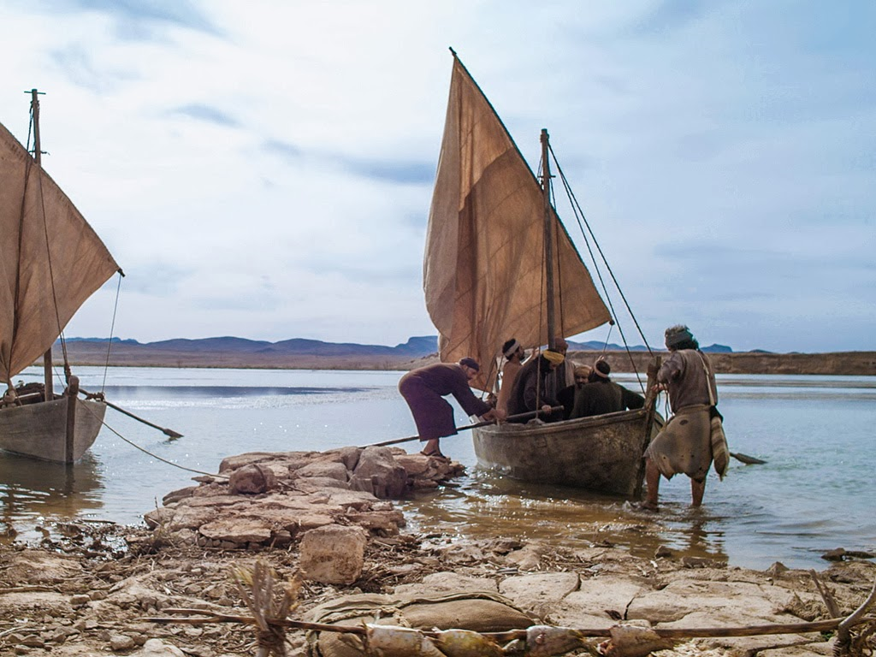
Your Calling
Luke 14:25-33
Mark 1:16-20
Notes:
Jesus call us to be His disciples, much like He called four fishermen long ago. We are called to follow Him, to give our lives for Him, and to receive precious promises from Him. Ultimately, we are called touch others with His love by living extraordinary lives of compassion, service, and selflessness.

Slide 2
We have been called!
We are all called by Jesus (Romans 1:5-6).
As were four fishermen (Mark 1:16-20; 10:28-30).
Our calling does not depend on who we are or what we’ve done (Luke 5:8; 2 Timothy 1:8-9; 1 Corinthians 1:26).
We are called by God’s grace (2 Timothy 1:9; Galatians 1:6).

Slide 3

To what have we been called?
To fellowship with Christ (1 Corinthians 1:9).
To praise the One who called us from darkness into light (1 Peter 2:9).
To the rule of God’s peace in our hearts (Col. 3:15)
To be sanctified and preserved (Jude 1).
To eternal glory (1 Peter 5:10 Hebrews 9:15; 3:1; 2 Thessalonians 2:13-14; 1 Timothy 6:12).

Slide 4
Your Calling
You are called to touch others with God’s love by living an extraordinary life of compassion, service, selflessness, and holiness. (1 Peter 1:15; 3:8-9; Eph. 4:1-3; Phil. 3:14)
“Therefore, my beloved brethren, be steadfast, immovable, always abounding in the work of the Lord, knowing that your labor is not in vain in the Lord.” (1 Corinthians 15:58)

Slide 5
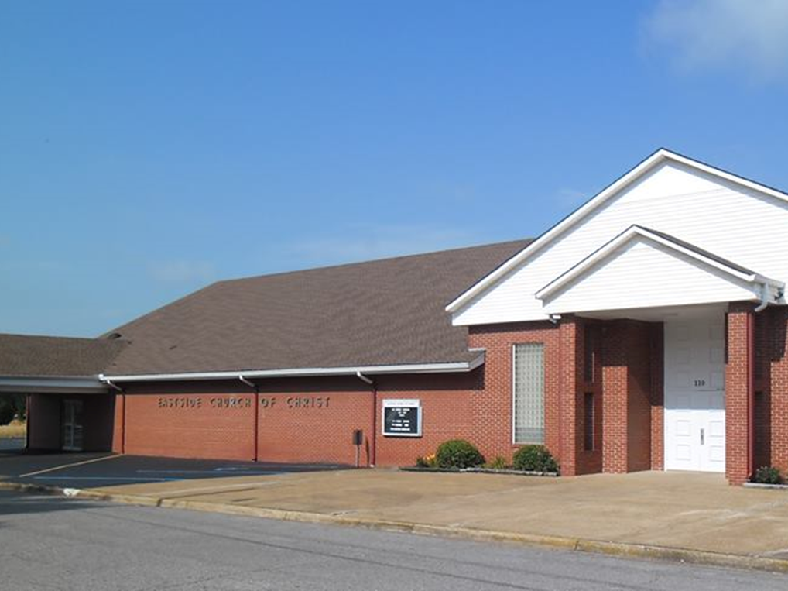
Eastside Church of Christ
Eastside-church.org

