Slide 1
…
Notes:
The choice of Lot to live in Sodom affected his family. Sodom lived in Lot’s family. Lot was not respected. His family was reluctant to flee evil, and earthly desires were stronger than the desire to obey God. God’s people today live in the world, but we must not allow the world to live in us.

Slide 2
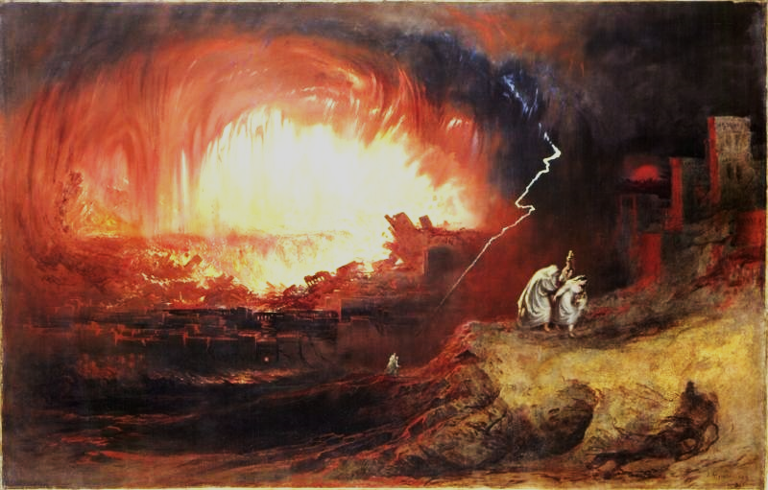
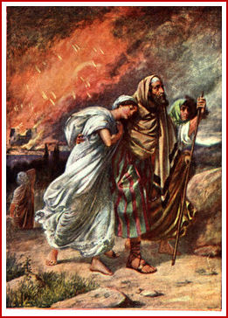
When Sodom Lived
in Lot’s Family
Genesis 13 & 19
Jude 7
2 Peter 2:6-8

Slide 3
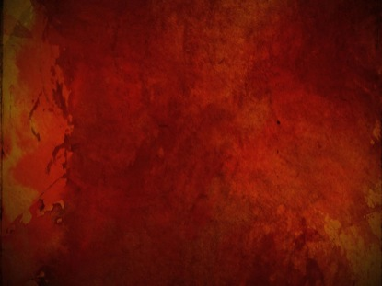
When Sodom Lived in Lot’s Family
Respect for a righteous parent declined Genesis 19:14; Leviticus 20:9; Proverbs 30:11-13
There was reluctance to flee evil Genesis 19:15-16; John 3:19; Romans 1:24-28
Earthly desires were stronger than the desire to obey God Genesis 19:26; Luke 17:32

Slide 4
Keeping the World out of our Families
Respect parents Ephesians 6:1-2; Proverbs 23:22-25
Flee evil 1 Corinthians 6:18; 10:14; 1 Timothy 6:10-11; 2 Timothy 2:22
Guard your heart 1 John 2:15-17
Expose Error Ephesians 5:11

Slide 5
Jesus prayed…
“I do not pray that You should take them out of the world, but that You should keep them from the evil one.” -- John 17:15

