Slide 1
Revelation 8:6-13
The First Four Trumpets Sound
Revelation
The angels prepare to sound their trumpets (8:6)
The first trumpet brings hail & fire mingled with blood to the earth. 1/3 of the vegetation is burned (8:7)
The second trumpet reveals a burning mountain thrown into the sea. 1/3 of the sea turns to blood, and 1/3 of sea creatures and ships are destroyed. (8:8-9)
The third trumpet reveals a star named Wormwood falling on the rivers, making them bitter and resulting in the death of many men (8:10-11)
The fourth trumpet darkens a third of the sun, moon and stars (8:12-13)
An angel pronounces 3 woes on the inhabitants of the earth because the 3 remaining trumpets are about to sound.

Slide 2
Revelation 8:6-13
Symbolism in the First Four Trumpets
Revelation
Another angel pronounces three “woes” upon the inhabitants of the earth because of the three remaining trumpets. (8:13)

Slide 3
Revelation 9:1-21
The Final 3 Trumpets bring Woes upon the Wicked
Revelation
Fifth trumpet:
A star falls from heaven with the key to the bottomless pit (9:1)
  The bottomless pit is the residing place of of evil beings (9:11; 11:7; 17:8; 20:3)
When he opens the pit, smoke ascends and darkens the sun and the air, and out of the smoke come locusts (9:2-3)
  Plagues of locusts were commonly used by God to chastise the wicked (Exodus 10:3-20; Deut. 28:37-38; Joel 1-2)

Slide 4
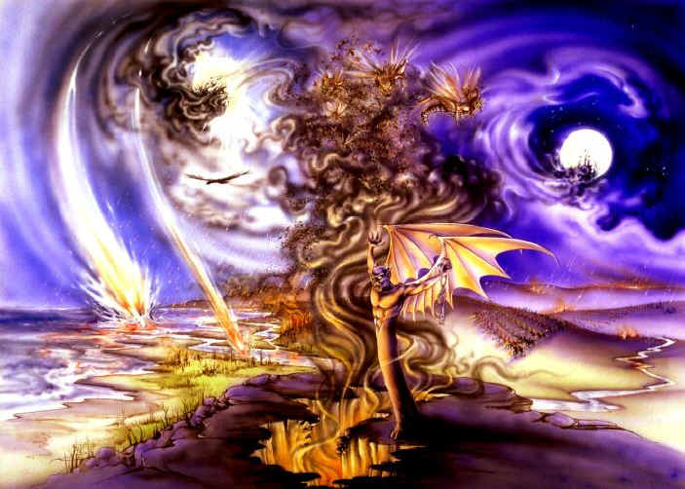

Slide 5
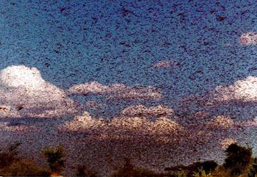
Sun & Air Darkened by Smoke
Revelation

Slide 6
Revelation 9:1-21
The Final 3 Trumpets bring Woes upon the Wicked
Revelation
The Fifth Trumpet:
The locusts…
  Were given power as scorpions (9:3)
  They were only to harm those who did not have the seal of God (9:4; cf. 7:3)
  The locusts torment men 5 months (9:5-6)
  The locusts are evil forces that bring extreme misery upon ungodly men. They could represent any number of spiritual, physical or emotional miseries experienced by the wicked.

Slide 7
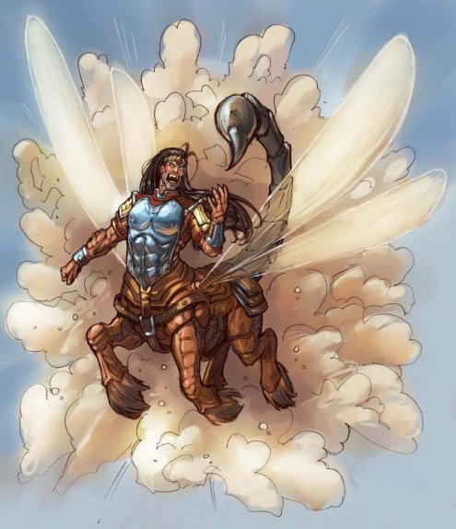
Revelation 9:7-10
The Shape of the Locusts
like horses prepared for battle
crowns of something like gold
faces like the faces of men
hair like women's hair
teeth like lions‘ teeth
breastplates like iron
the sound of their wings was like the sound of chariots with many horses running into battle
tails like scorpions -- stings in their tails

Slide 8
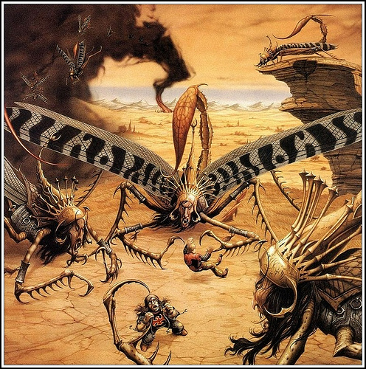

Slide 9
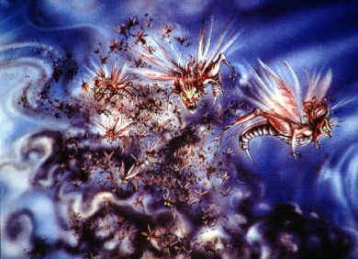
Their king was the Destroyer -- Abaddon (Heb.) or Apollyon (Gr.)

Slide 10
Revelation 9:1-21
The Final 3 Trumpets bring Woes upon the Wicked
Revelation
The Sixth Trumpet (2nd woe) :
A voice from the altar commands “release the 4 angels who are bound at the…river Euphrates”
The prepared angels are released, unleashing an army of 200 million to kill 1/3 of mankind.
  The riders had breastplates of bright colors
  Heads like lions
  Fire smoke and brimstone out of their mouths; plagues which killed 1/3 of mankind
  Tails like serpents with heads to do harm

Slide 11
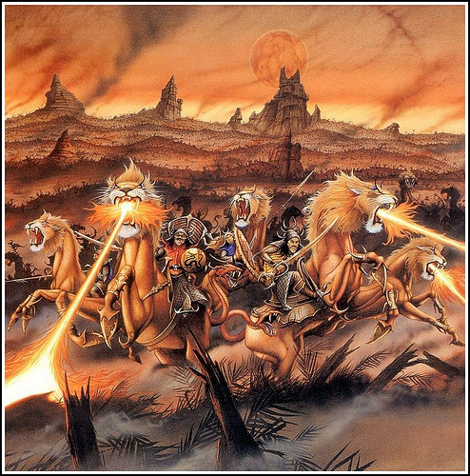

Slide 12
Revelation 9:1-21
The Final 3 Trumpets bring Woes upon the Wicked
Revelation
Reaction of the Wicked to the Plagues
of the Sixth Trumpet (9:20-21)
They did not repent!
They continued to worship demons and idols
They continued to engage in murder, sorcery, sexual immorality and theft

Slide 13
Revelation 9:1-21
The Final 3 Trumpets bring Woes upon the Wicked
Revelation
Symbolism of the 5th and 6th trumpets
The Roman Empire is plagued with problems from within and without.
The problems bring considerable suffering and misery to those who are not God’s people
  These things are likely the consequences of sin which was institutionalized in the Roman Empire (idolatry, immorality, and dishonesty)

