Slide 1

The Sovereignty of the God Who Sees Me
Genesis 16:1-16
Notes:
Our God is So BIG. He knows everything about us and sees everything that happens to us. His plans for His people will stand. These thoughts generate faith and comfort us in any situation.

Slide 2
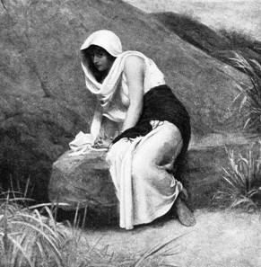
God Sees All
He sees all there is of every one of us (Psalm 139:1-3; Matthew 10:29-30).
It does not matter who you are or where you go (Psalm 139:7-10; Proverbs 15:3; Jeremiah 23:24).
He sees our lives individually (Job 23:8-10; Psalm 33:13-15).

Slide 3
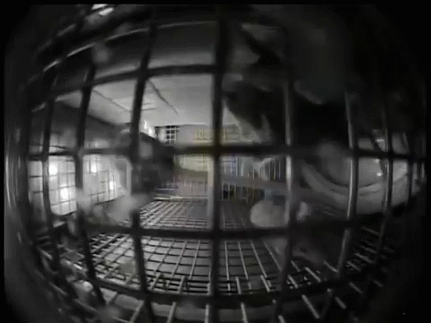
Mice in a cage on the International Space Station.
God’s Plans and Purposes Prevail! He is Sovereign!

Slide 4
God’s Plans & Purposes Prevail
The God who sees is able to plan the future for His creation (Isaiah 46:10; Psalm 33:6-11; Proverbs 19:21).
God has purposes and plans for His children (Ephesians 1:3-4).
His plans are beyond our comprehension (Isaiah 55:8-9).
God’s sovereignty compels man’s humility and trust (1 Cor. 1:27-29; James 4:13-16).

