Slide 1

“A Very Present Help”
Psalm 46:1-2
Notes:
Our God is So BIG! Is human achievement solely the result of human endeavor? What credit does God get for it? Is mankind self-sufficient, or are we reliant on a God who deserves our thanks and praise for everything?

Slide 2

God is All-seeing, All-Powerful, and Ever-Present
God is omniscient (Job 24:31)
God is omnipotent (Jeremiah 32:17)
God is omnipresent (Psalm 46:1-2; 139:7-10)

Slide 3
God is Above Us and Beside Us
He fills our hearts with food and gladness (Acts 14:17; Job 38:41; Matthew 6:26-30)
He heals our diseases (Psalm 103:2-5)
Every good gift comes from Him (James 1:17; Acts 17:25, 28; Psalm 103:22)

Slide 4
God Works in Concert with His Creation
God and Pharaoh hardened Pharaoh’s heart (Exodus 4-14)
God works in and through us (Isaiah 26:12)
Human ingenuity is from God (Job 35:10-11)

Slide 5
“In Him All Things Consist”
All things were made through Christ (John 1:1-3)
He upholds all things by His word (Hebrews 1:3)
In Him all things hold together (Colossians 1:16-17)

Slide 6
“What Hath God Wrought?”
“You are worthy, O Lord, to receive glory and honor and power; for You created all things, and by Your will they exist and were created.“ (Revelation 4:11)

Slide 7
“Be still, and know that I am God; I will be exalted among the nations, I will be exalted in the earth! The LORD of hosts is with us; the God of Jacob is our refuge.” (Psalm 46:10-11)

Slide 8
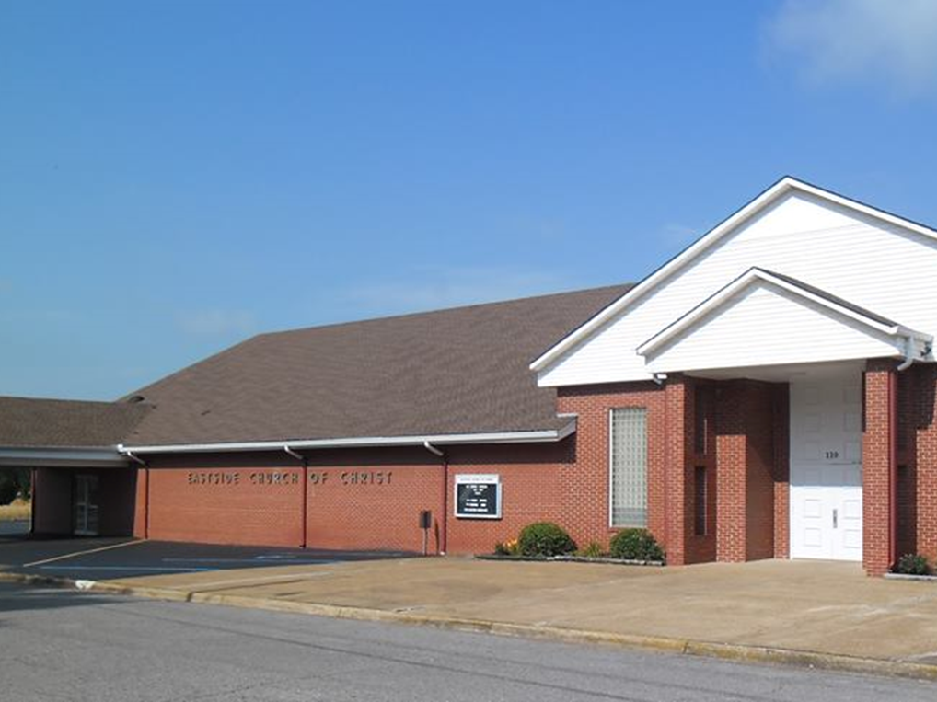
Eastside Church of Christ
Eastside-church.org

