Slide 1
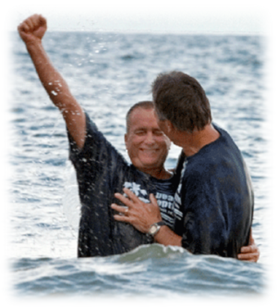
Immediate Obedience
“Behold, now is the accepted time;
behold, now is the day of salvation”
(2 Corinthians 6:2)
Notes:
In the New Testament, the gospel stirred multitudes to immediately obey the command to be baptized for the remission of their sins. Many today delay obedience because they fail to see the importance of baptism, or think they don’t know enough, or feel that they can’t live the life of a Christian. The devil delights in delayed obedience for he knows that it becomes disobedience. We must “make haste” to obey.

Slide 2
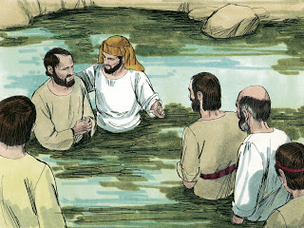
The Gospel Stirred Immediate Obedience to the Command to be Baptized
3,000 obeyed the gospel “that day” (Acts 2:38-41).
The Ethiopian asked to be baptized (Acts 8:35-38).
Peter commanded Cornelius’ household to be baptized (Acts 10:47-48).
The Philippian jailor was baptized immediately (Acts 16:33).
Ananias asked Saul, “Why are you waiting” (Acts 22:16)?

Slide 3

Why do so many Delay Obedience?
They may think they don’t know enough!
Yet many who obeyed immediately in Acts had heard only one sermon.
It is easy to understand your need for a Savior, God’s plan to save you, and the steps to obey.
Believe in Jesus as the Christ (Acts 8:37; 10:43; 16:31).
Repent of your sins (Acts 2:38; 3:19; 17:30-31).
Confess your faith in Christ (Rom. 10:9-10; Acts 8:37).
Be baptized for the remission of your sins (Acts 2:38; 22:16; 1 Peter 3:21, Mark 16:16).

Slide 4
Why do so many Delay Obedience?
They may think that they need to be able to live a perfect life as a Christian first.
They need a more accurate concept of the life of a Christian!
It is a process of growth! (2 Peter 3:18; 1 Cor. 3:1-4; Colossians 1:10-12)
To serve righteousness a person must first be freed from sin! (Romans 6:17-18)
You cannot live the life of a Christian without Christ in your life! (2 Peter 1:3-4; Ephesians 3:16)

Slide 5
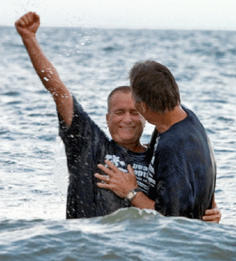
What Motivates Immediate Obedience?
Respect for God's power and authority (Matthew 28:18-20; Psalms 93:1-2).
Acknowledging God's wisdom (Prov. 3:5-7).
The joy of obedience (Acts 8:39; 16:34).

Slide 6
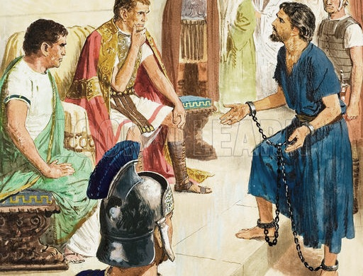
There is Danger in Delaying Obedience!
Not everyone who heard the gospel in Acts obeyed immediately (Acts 24:25).
The consequences of not obeying the gospel are horrendous (1 Peter 4:17; 2 Thess. 1:8).
The devil delights to delay obedience. Procrastination is one of his greatest weapons!

Slide 7

“I thought about my ways and turned my feet to Your testimonies. I made haste and did not delay to keep Your commandments.” (Psalm 119:59-60)

