Slide 1
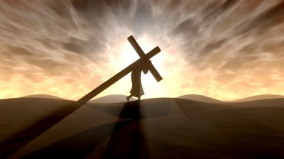
Self-Sacrifice The Core of Christianity
Notes:
To be disciples of Jesus Christ we must sacrifice ourselves because that is what He did. Self sacrifice enables us to be freed from sin, empowers us to fight sin, and motivates our service to others. It is the core of Christianity.

Slide 2
The Self-Sacrifice of Jesus Christ
Jesus came to sacrifice Himself (Mark 10:45; Philippians 2:7)
He was given a body to sacrifice (Hebrews 10:5-12; John 1:29)
He gave it willingly (John 10:17-18; Matthew 26:52-53)

Slide 3
The Self-Sacrifice of Jesus Christ
Christ gave Himself for…
ALL (1 Timothy 2:5-6; 1 John 2:2)
US (Ephesians 5:2, 25; Romans 5:8; Titus 2:13-14)
OUR SINS (Galatians 1:3-4)
ME (Galatians 2:20)

Slide 4
The Self-Sacrifice of Christians Matthew 16:24-25; Romans 12:1
How self sacrifice relates to…
FREEDOM FROM SIN (Romans 6:3-7)
FIGHTING SIN and TEMPTATION
Denying worldly lusts (Titus 2:11-12)
Resisting to bloodshed (Hebrews 12:3-4)
Not loving our lives (Revelation 12:11)
Crucifying passions and desires (Galatians 5:24)
SERVING OTHERS (Hebrews 13:15-16)

Slide 5
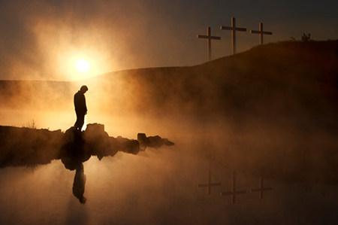
Hill of Calvary! I go to thy scenes of fear and woe There behold His agony suffered on the bitter tree See His anguish, see His faith Love triumphant still in death Then to life I turn again Learning all the worth of pain Learning all the might that lies In a full self-sacrifice

