Slide 1
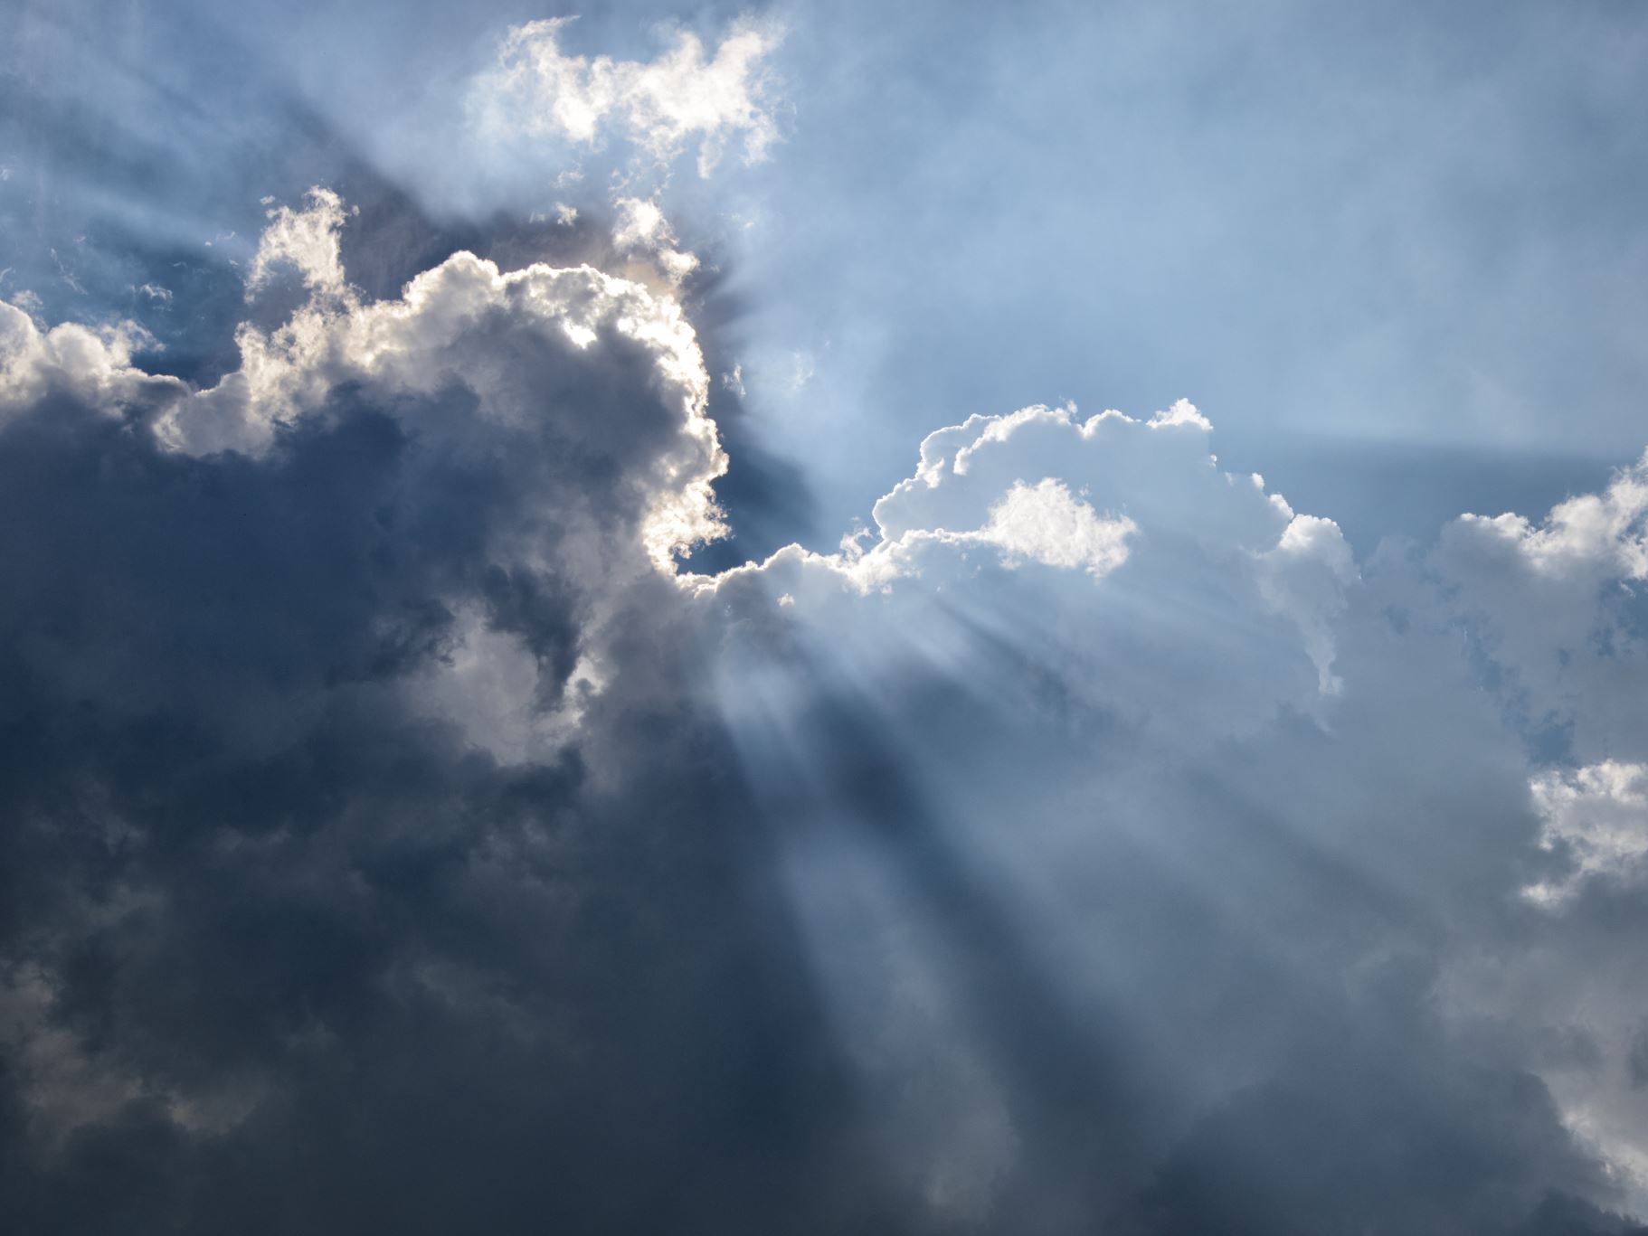
When Heaven Rejoices
Maintaining a Heavenly Perspective of Earthly Events
Notes:
Citizens of heaven should view events on earth from a heavenly perspective. Repentance and justice cause rejoicing in heaven and should cause joy in the hearts of Christians as well.

Slide 2

The Impact of Earthly Events in Heaven
Joy is created in heaven when a sinner repents (Luke 15:1-10)
Heaven has a vested interest in earth, because the inhabitants of earth were created to populate heaven (Ephesians 1:3-4; Matthew 25:34; Romans 8:29; 1 Peter 1:12).

Slide 3
Heaven Rejoices for Repentance!
The world was distressed when Jesus associated with sinners (Luke 5:30-32; 7:36-50; 19:10)
Jesus came to save the lost because of His heavenly perspective (Luke 5:32).
Repentance alters heaven and earth.

Slide 4
In Heaven There is Joy for Justice!
There was joy in heaven when “Babylon” was judged and punished (Revelation 18:2-24; Jeremiah 51:47-48).
God in heaven is aware when His people suffer injustice and oppression (Psalms 14:2-4).
Rejoicing is the appropriate response when God delivers justice (Isaiah 49:13; Psalm 96:11-13).

Slide 5
The Lord will not forsake His saints. Justice will prevail!
Psalms 37:28
“For the LORD loves justice and does not forsake His saints; They are preserved forever, but the descendants of the wicked shall be cut off.”

Slide 6
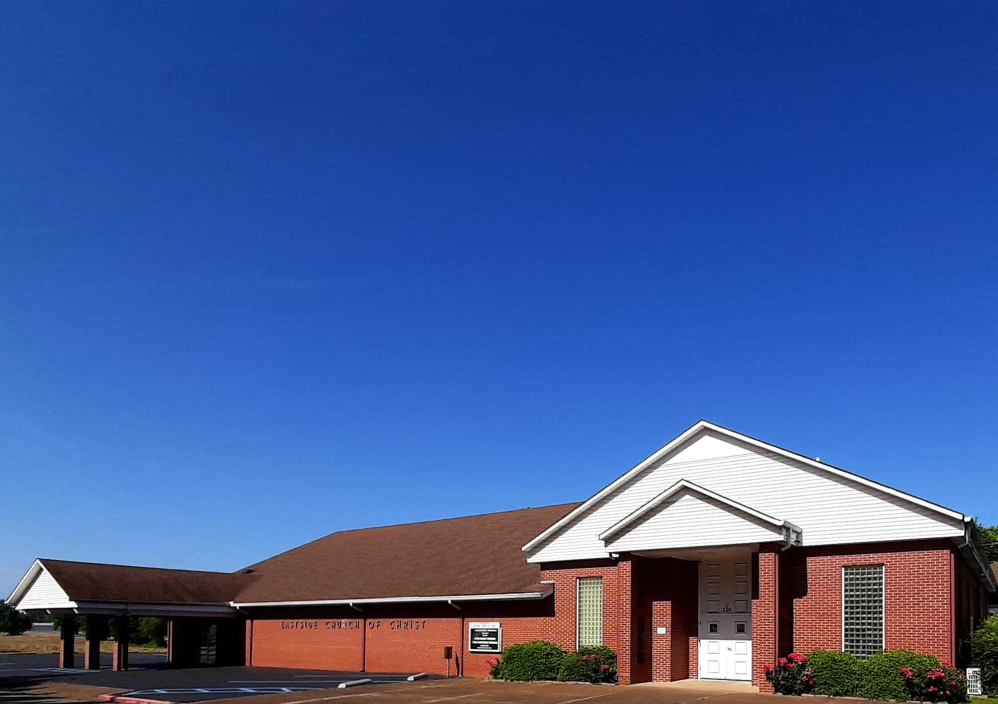
Eastside Church of Christ
Eastside-church.org

