Slide 1
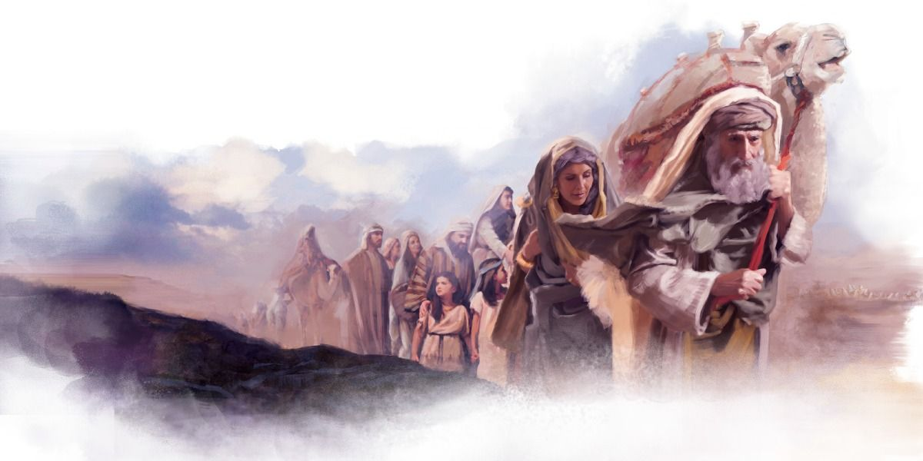
Courageous Faith
Notes:
Abraham’s faith in God enabled him to make courageous choices. Our faith in Christ can do the same for us.

Slide 2
Courageous Faith
Abraham Believed God
Genesis 15:6; Romans 4:3; Galatians 3:6; James 2:21-23

Slide 3
Courageous Faith
Faith Motivated Abraham’s Actions
Genesis 12:1; Hebrews 11:8

Slide 4
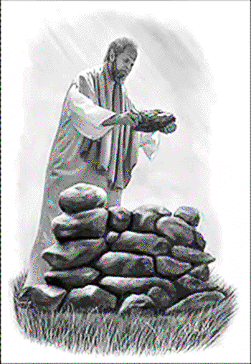
Courageous Faith
Abraham Acknowledged God’s Presence
Genesis 17:1; 12:6-8; 13:17-18; 22:9; 15:1

Slide 5
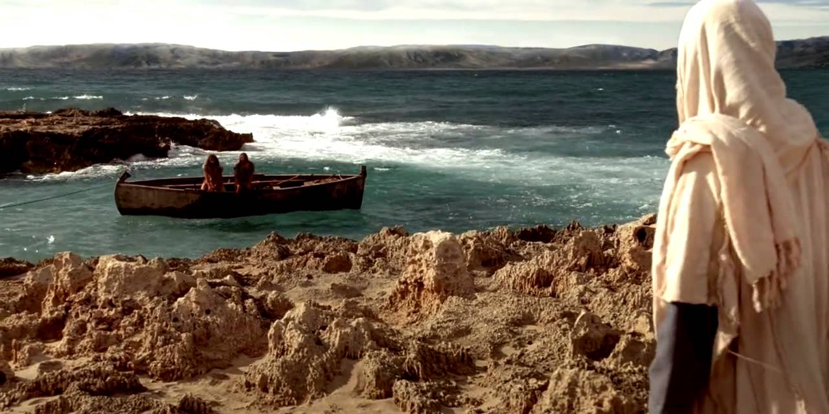
Courageous Faith
Jesus Calls us to Follow Him
Luke 14:26-33; 18:24-30; Matthew 28:18-20

