Slide 1
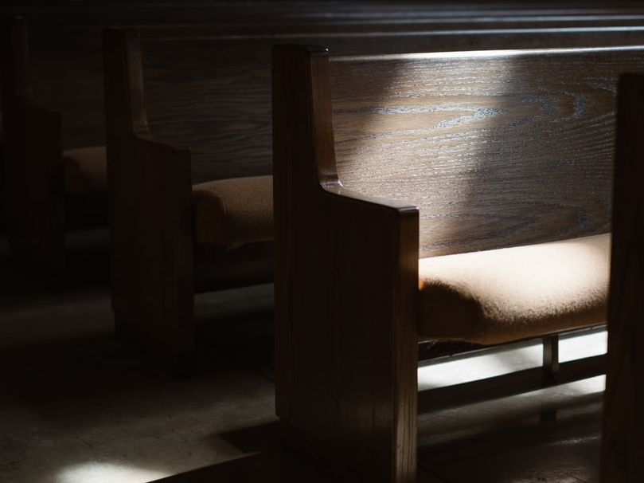
Coming Together for the Better
1 Corinthians 11:17-22
Notes:
God has designed the local church to come together for the better as we engage in worship like the Lord’s supper with the proper Spirit. We come together for the worse if we come with selfish interests, a spirit of divisiveness, or a lack of concern for others.

Slide 2
The Lord’s Supper and Unity
(1 Corinthians 10:16-17)
“The cup of blessing which we bless, is it not the communion of the blood of Christ? The bread which we break, is it not the communion of the body of Christ? For we, though many, are one bread and one body; for we all partake of that one bread.”

Slide 3
Coming Together for the Worse
(1 Corinthians 11:17-22)
What causes coming together “for the worse?”
Selfish interests (James 3:16-17; Phil. 2:3-4).
Divisiveness (1 Corinthians 12:25; Galatians 5:20).
Lack of concern for others (1 Corinthians 11:27-34).

Slide 4
Coming Together for the Better
(1 Corinthians 11:23-26)
Coming together for the better involves…
Remembering the Lord and proclaiming His death in untarnished fellowship with members of His body!
Worshiping God together is a privilege! (cf. Ezra 6:15-22; 1 Kings 8:62-63)
“I was glad when they said to me, ‘Let us go into the house of the LORD’” (Psalm 122:1)

