Slide 1
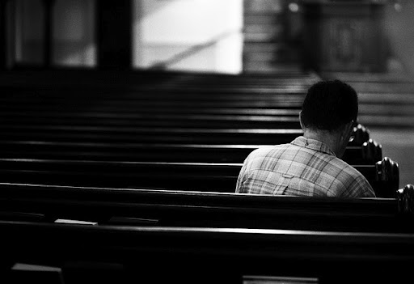
Seeking Motivation to Worship
Psalm 96:4-13
Notes:
What is our motivation to worship God in spirit and in truth? What will compel us to do the right things, think the right things and feel the right things in worship? Psalm 96 provides 5 great motivations for worship: God saves, created us, is present among us, is perfectly holy, and judges us!

Slide 2
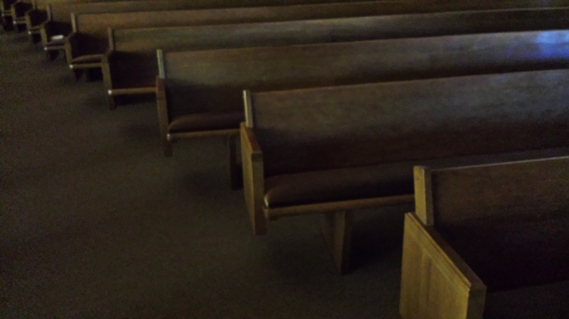
Psalm 96 focuses on motivations for worship
In Psalm 96 these motivations are given:
God has saved us (v. 2)
God is the Creator (v. 5)
God’s presence fills His temple (v. 6)
God is majestic and holy (v. 9)
God is the Judge (10-13)

Slide 3
Motivation to Worship God
He saves us
(Matthew 8:2; 9:13; 15:25; Psalm 106:56)

Slide 4
Motivation to Worship God
He is our Creator
(Acts 17:24-28; Revelation 4:11; Romans 1:20-25; Nehemiah 9:6; Psalm 95)

Slide 5
Motivation to Worship God
He is Present
(Exodus 33:9-10; 2 Chronicles 7:2-3; Habakkuk 2:20; 1 Corinthians 3:16; 14:25; Matthew 18:20)

Slide 6
Motivation to Worship God
He is Holy
(Revelation 4:8-10; Isaiah 6:1-5; Psalm 99:2-3)

Slide 7
Motivation to Worship God
He is our Judge
(Revelation 15:4; 20:11-12)

