Slide 1
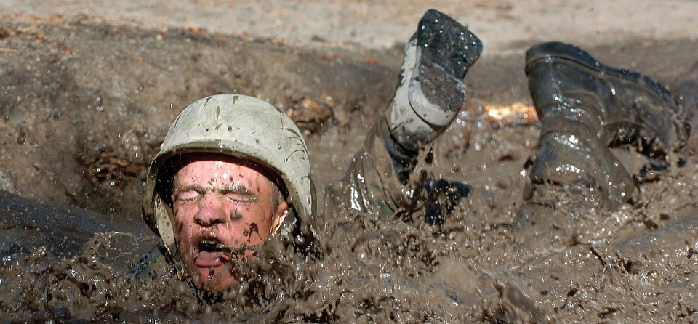
The Power of
Proven Character
Romans 5:3-4  Philippians 2:19-22
Notes:
Character that has been proven through trial is genuine and powerful. It unites God’s people in true compassion and consistent service. It provides powerful testimony to those outside of Christ.

Slide 2
Proven Character has been tested in trial!
We are perfected through trial! (James 1:2-4; 2 Corinthians 2:9)
True character does the right thing no matter the form of the test! (Hebrews 11:25-26; Romans 12:19; Prov. 30:8-9)

Slide 3
Timothy’s Proven Character Demonstrated Itself…
In Compassion (Philippians 2:19-22; 2:1-4; 1 Corinthians 13:5)
In Consistent Service (2 Timothy 1:8; James 2:18; Proverbs 20:11; Titus 2:7-8; Romans 12:17)

Slide 4

The proven character of Christians can sway even the most antagonistic unbelievers
“Keep your conduct among the Gentiles honorable, so that…they may see your good deeds and glorify God on the day of visitation.” (1 Peter 2:12)
“Let your light so shine before men, that they may see your good works and glorify your Father in heaven.” (Matthew 5:16).
“God is more concerned with your character than He is with your comfort.”
We must be more concerned about what glorifies Him than what gratifies us.

