Slide 1
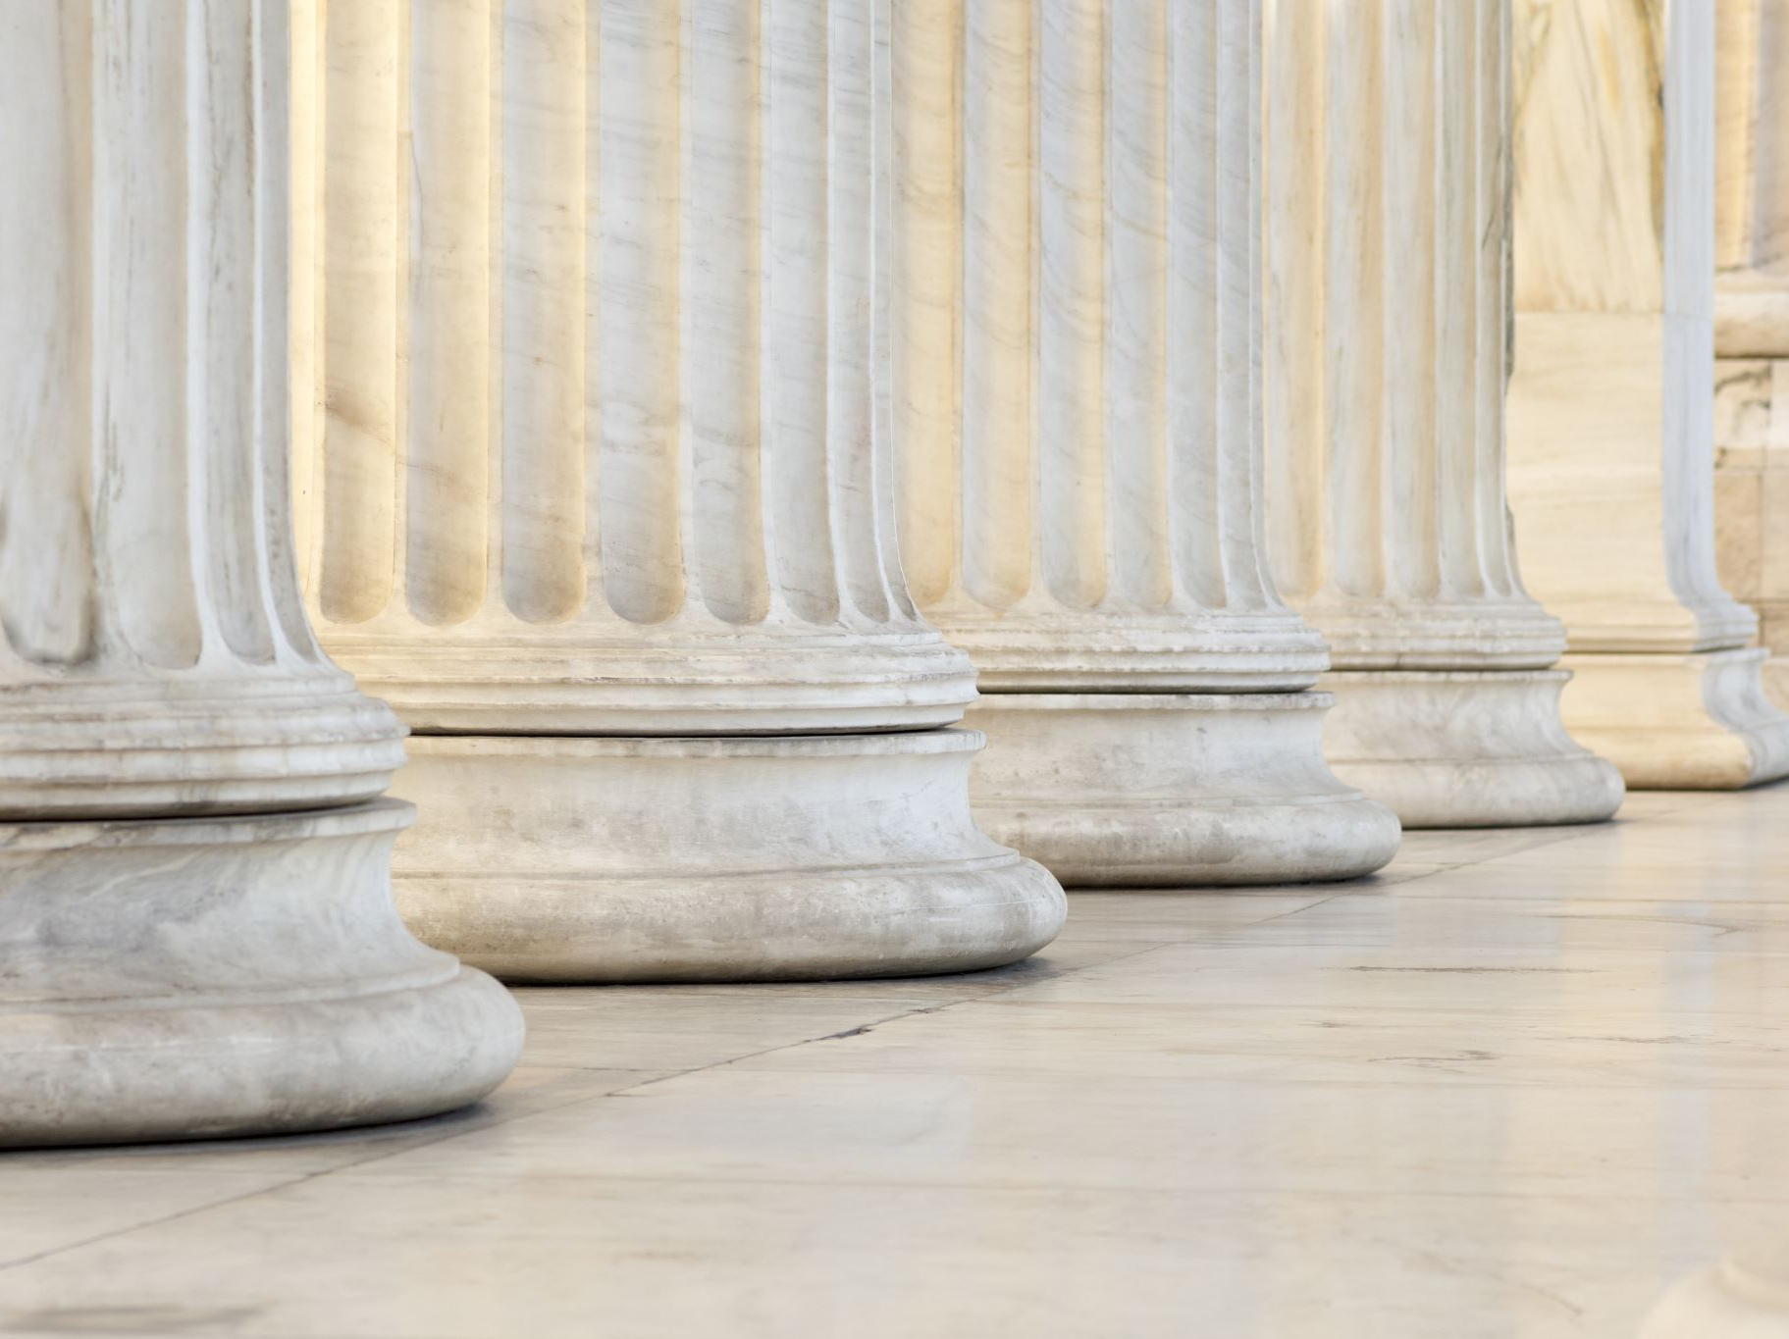
Our Just Deserts
What do we really deserve?
Notes:
Humans can be easily deceived into thinking we “deserve” finer things and greater status in this life.
The truth is that all have sinned and deserve punishment, not blessings. But God is merciful, and by His grace does not give His children the punishment they deserve. These truths lead us to humility and thanksgiving.

Slide 2

DESERVING OF PUNISHMENT
Deserving of death (Deuteronomy 17:6, Romans 1:27, 32).
Deserving of a beating (Deuteronomy 25:1-3; Luke 12:48).
Deserving of eternal punishment (2 Thessalonians 1:6-9).
Deserving of punishment as a nation (Joel 3:12-13; Ezekiel 7:27).

Slide 3
But God is Merciful
He punished the remnant less than they deserved (Ezra 9:13).
He looks on the heart as He rewards according to our works (Romans 2:4-11; Psalm 28:2-5).
He commends doing good to those who do good (Proverbs 3:27; Luke 7:2-4).
He holds us accountable to give fair wages to those who work (James 5:4).

Slide 4
What do we deserve?
Being richly blessed does not mean we “deserve” a life of pleasure and ease (Luke 12:15-21).
The best of us are just unprofitable servants (Luke 17:7-10).
What God gives us in Jesus is NOT what we truly deserve (Titus 3:5).
The wages of sin is death, but the gift of God is eternal life in Christ Jesus our Lord (Romans 6:20-23).

