Slide 1
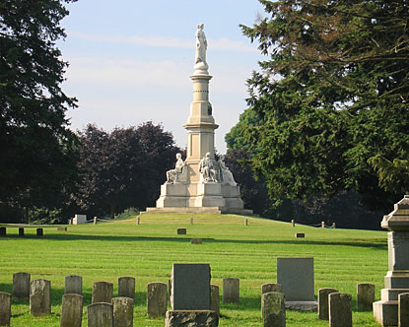
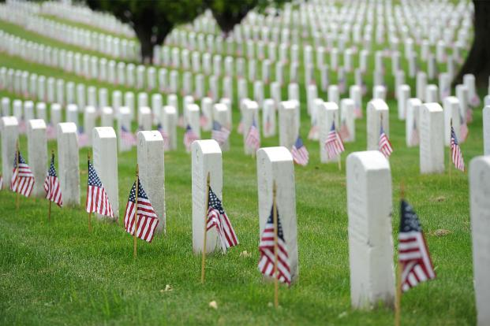
What Are These Stones?
Gettysburg National Cemetery & Arlington National Cemetery
Notes:
The stones that Joshua set up after Israel crossed the Jordan served as powerful reminders and teaching tools for future generations. The Lord’s supper serves in a similar way to help us teach our children and be reminded of what God has done for us.

Slide 2
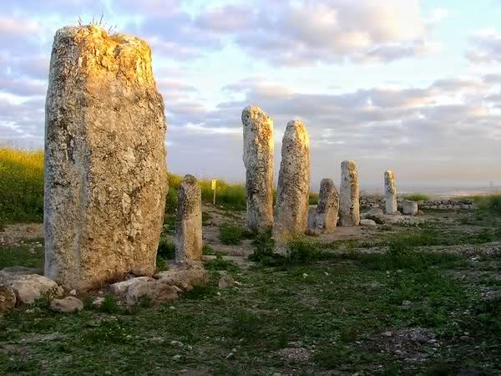
What Are These Stones?
Standing stones at Gezer, Israel

Slide 3
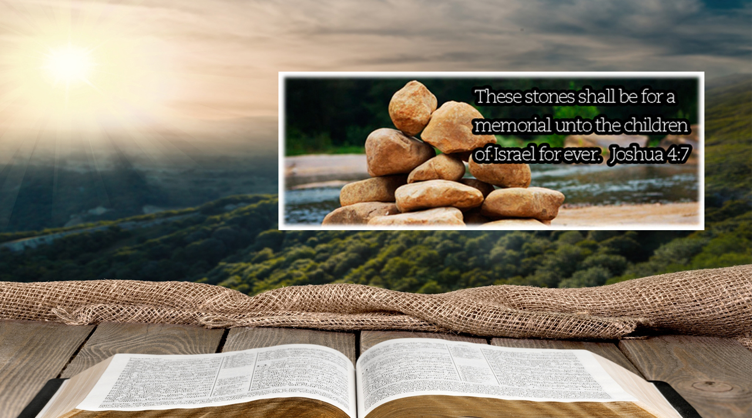
“What Are These Stones?”
A Lesson in the Meaning of Memorials
Notes:
The stones that Joshua set up after Israel crossed the Jordan served as powerful reminders and teaching tools for future generations. The Lord’s supper serves in a similar way to help us teach our children and be reminded of what God has done for us.

Slide 4
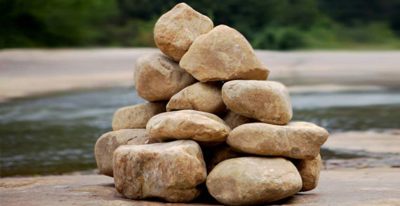
What are these stones?
They reminded parents to teach their children about God (Joshua 4:21-22; Deut. 6:1-9; Psalm 78:4-6; Ephesians 6:4).
They reminded the Israelites that the Lord provided a way to fulfill His promises (Joshua 4:23; Genesis 12:7; Exodus 14:10ff.; Numbers 13:33-34; Joshua 3-4).
They reminded all men of God’s power and the need to fear Him (Joshua 4:24; 2:10).

Slide 5
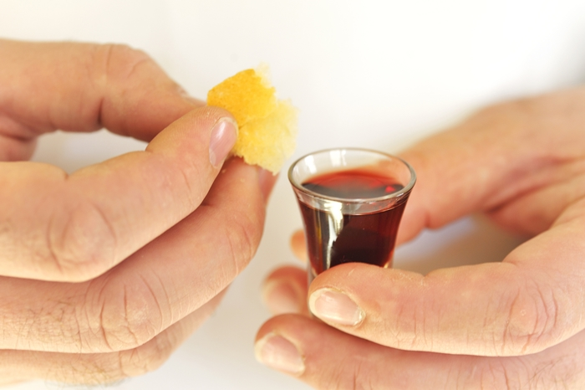
What are these emblems?
1 Corinthians 11:24-26
They can be used to teach our children.
They remind us that the Lord has provided a way for us to receive His promises (Ezekiel 16:62-63).
They proclaim the power of Jesus’ death and the hope of His coming.

