Slide 1
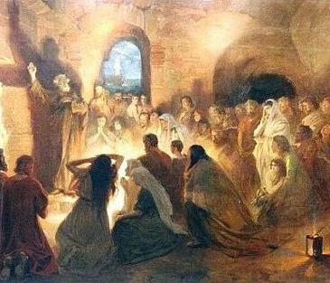
“The Disciples Came Together”
Acts 2:46-47; 20:7; 1 Corinthians 14:23; Psalm 122
Notes:
As the pandemic lessens, we are given more opportunities to come together for worship. Let us be motivated by joy to assemble together to honor God and encourage one another.

Slide 2
The Joy of Assembling with Saints
Opportunities to worship with God’s people should make us glad (Psalm 122:1).
The experience of worship produces emotion (Psalm 42:4; Jeremiah 33:11; Acts 13:52; Phil. 4:4-5)

Slide 3
Assemblies are Ordained to Worship God
We come together for worship (Psalm 122:4; Hebrews 10:24-25; 1 Corinthians 14:23; John 4:24).
God deserves our worship (Ps. 100:4-5).
Peace promotes praise (Ps. 122:6-9; Romans 15:5-6).

