Slide 1
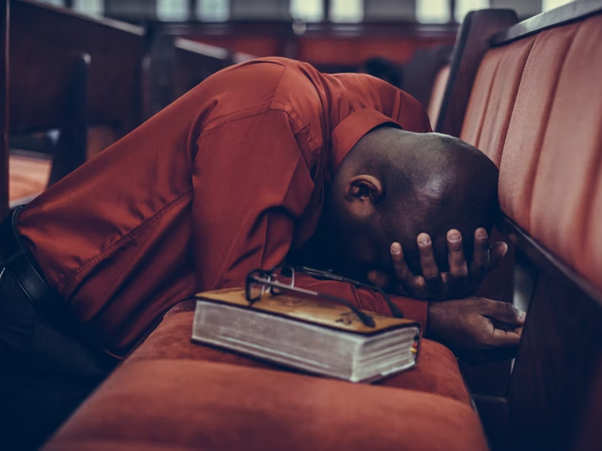
Becoming A Man of God
Notes:
Our world desperately needs men of God – Christlike men who are devoted to God and who courageously fulfill their roles in the home, in the church, and in society.

Slide 2

Timothy Was “A Man of God”
Timothy was to flee ungodliness, pursue righteousness, and fight the good fight (1 Timothy 6:11-12).
Timothy was to rely on Scripture for everything (2 Timothy 3:16-17).
Timothy was a man of proven character who sincerely cared about others (Phil. 2:19-22).
Timothy was told to pray and study (1 Timothy 2:8; 2 Timothy 2:15).

Slide 3
David was “A Man after God’s Own Heart”
David charged Solomon to prove himself a man (1 Kings 2:2-3).
David was “a man” after God’s own heart who served his generation (Acts 13:22, 36).

Slide 4
Cornelius was a Man whom God Chose
Cornelius was chosen to be the first Gentile to hear and believe the gospel (Acts 15:7-8).
Cornelius was devout; he feared God, gave alms, and prayed always (Acts 10:1-2).
Cornelius took the lead in bringing his family to hear God’s word taught (Acts 10:24, 33; Ephesians 6:4; 5:25; 1 Corinthians 14:35).

Slide 5
A Man of God fulfills his role in the Home, in the Church, and in Society with
COURAGE
“Watch, stand fast in the faith, be brave, be strong. Let all that you do be done with love.” (1 Corinthians 16:13-14)

