Slide 1
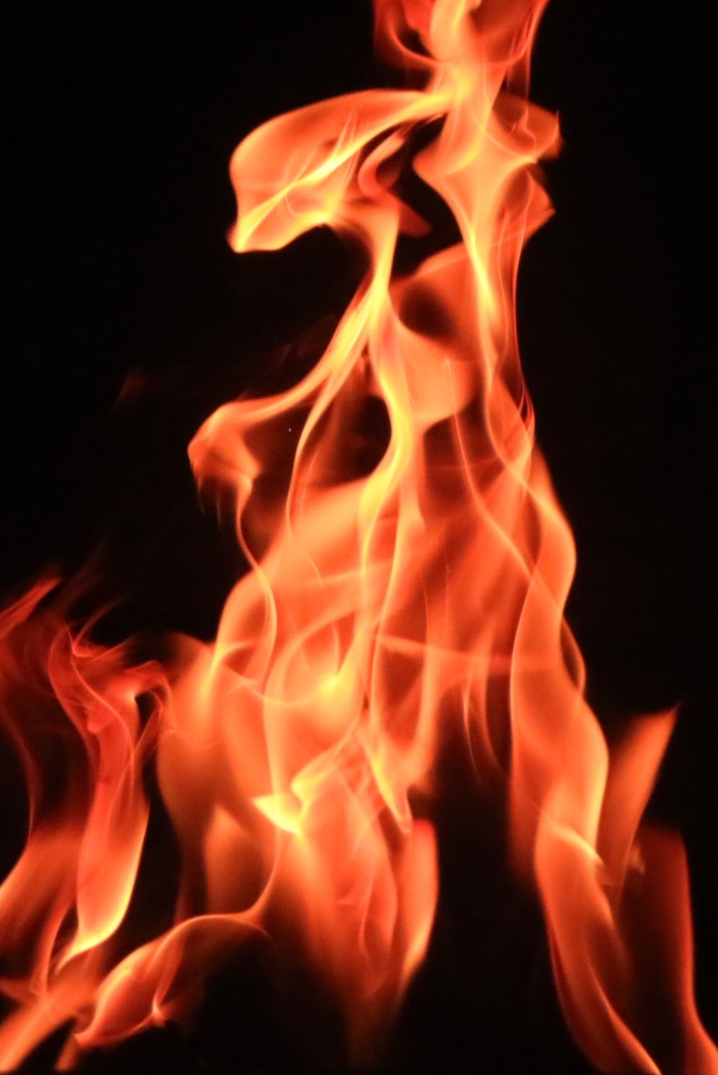
Pursuing Zealous Worship
Psalm 69:9

Slide 2
What is Zeal?
Defined as “excitement of mind, ardor in embracing, pursuing, defending anything”
Zeal is excitement, fire, pursuit, and defense of anything
Zeal can enhance worship and bring us closer to God

Slide 3
Zealous Worship in Scripture
Salvation produces zealous worship
  (Gen. 8:20; Ex. 12:27)
Blessings produce zealous worship
(1 Sam. 2:1-2,10)
Godly worship produces zealous worship
(2 Sam. 6:14-22a; Ezra 3:11- 13; Jn. 2:13-14)
Need produces zealous worship
(2 Sam. 12:20; Acts 16:25- 30)

Slide 4
Zealous Worship Today
We sing about…
  Our Creator
  Our savior
  Heaven
  Life without Christ
  Inviting sinners to Christ
We pray…
  Thankful
  Worshipful
  Sorrowful
  For strength and patience
  For Jesus to return

Slide 5
God’s Zeal Isaiah 59:15-17
  So truth fails, and he who departs from evil makes himself a prey. Then the LORD saw it, and it displeased Him that there was no justice. He saw that there was no man, and wondered that there was no intercessor; therefore His own arm brought salvation for Him; and His own righteousness, it sustained Him…

Slide 6
God’s Zeal Isaiah 59:15-17 Cont.
  For He put on righteousness as a breastplate, and a helmet of salvation on His head; he put on the garments of vengeance for clothing, and was clad with zeal as a cloak.

