Slide 1

Love Your Enemies
Luke 6:27
Notes:
We are to love our enemies. To do that, we must understand two things: How love behaves and who our enemies are.

Slide 2
Love Your Enemies
The behaviors of love apply to the way we treat our enemies (1 Corinthians 13:4-8).
Love involves active goodwill (Romans 12:14-21; Proverbs 24:17-18).

Slide 3
Who is Your Enemy? Luke 6:27-31; Matthew 5:38-48
Someone who hates you (Psalm 69:4).
Someone who curses you (2 Sam. 16:5-13).
Someone who insults you (Ps. 102:8; Lk. 23:34).
Someone who hurts you (Ps. 41:5-6).
Someone who persecutes you (Ps. 38:19-20).
Someone who takes something valuable from you.

Slide 4
Your Enemy may be Near to You
A family member (Matthew 10:34-36)
A fellow Christian…
To whom you’ve told a painful truth (Gal. 4:16).
With whom you are at odds over something material (1 Corinthians 6:1-9).
With whom you are to be united (1 Peter 3:8-9).

Slide 5
To Love Like God Does, Love Your Enemy
“But I say to you, love your enemies…
that you may be sons of your Father in heaven; for He makes His sun rise on the evil and on the good, and sends rain on the just and on the unjust…
Therefore you shall be perfect, just as your Father in heaven is perfect.” (Matthew 5:44-48)

Slide 6
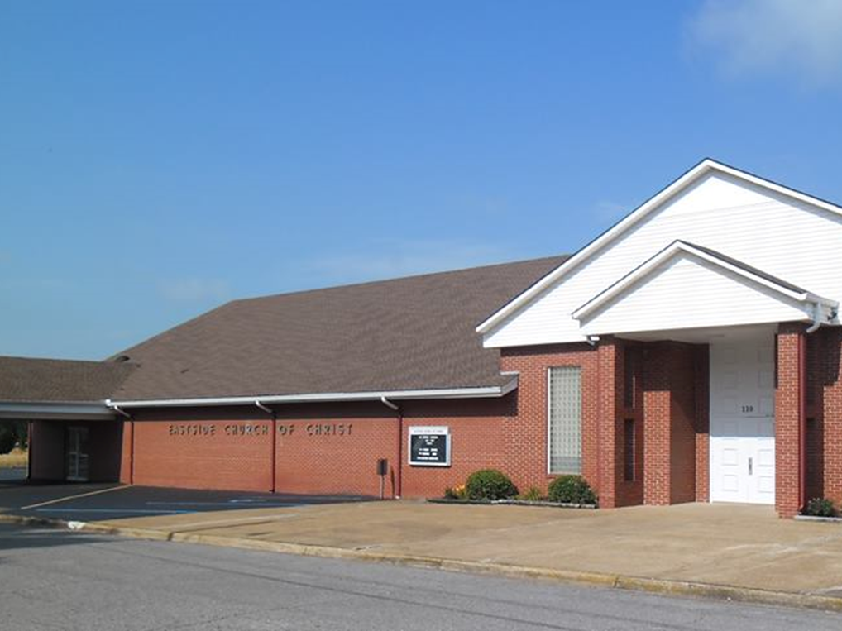
Eastside Church of Christ
Eastside-church.org

