Slide 1
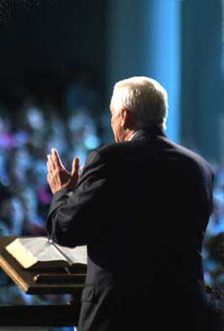
Preachers & Churches that Please God
1 Thessalonians 4:1
Notes:
As individuals, we should all strive to please God in our daily walk. Preachers and churches have particular duties to fulfill and qualities to develop in order to be pleasing to God. Preachers must have faith in God, do and teach good works, rely on God’s ways, focus on spiritual things, and preach the unadulterated gospel. Churches should consider what pleased and displeased the Lord in the 7 churches of Asia in Revelation 2 and 3.

Slide 2
Preachers that Please God…
Have faith in God – They trust God’s way and adhere to His rules (Hebrews 11:5-6; 10:38; Matthew 8:5-10; 2 Timothy 2:3-5)
Do and teach “good works” in accordance with God’s word (2 Timothy 3:16-17; Heb. 13:20-21)
Do not rely on human strength or methods (1 Corinthians 1:26-29; 2:1-13; 2 Corinthians 10:4-5; Psalm 147:10-11; 44:6)
Focus on spiritual things, not fleshly (2 Timothy 4:10; 2:21; Romans 8:5-8)
Preach the unadulterated gospel (Gal. 1:8-10; 1 Thess. 2:4; 2 Corinthians 2:17; 2 Timothy 4:2-5)

Slide 3
Churches that Please God… Colossians 1:9-10; Revelation 2 &3
What pleased the Lord in the 7 churches?
Ephesus – Testing false teachers, perseverance & untiring labor, hating the deeds of those in error
Smyrna – Poor but rich
Pergamos – Holding fast to Christ’s name & remaining faithful even in the face of persecution and death
Thyatira – Increasing in works
Sardis – A few remaining pure even when many did not
Philadelphia – Keeping Jesus’ word; being conservative
Laodicea – Nothing

Slide 4
Churches that Please God… Colossians 1:9-10; Revelation 2 &3
What displeased the Lord in the 7 churches?
Ephesus – They left their first love
Smyrna – Nothing
Pergamos – Allowing members to hold false beliefs or false doctrines
Thyatira – Tolerating immorality
Sardis – Relying on reputation instead of vigilance and hard work
Philadelphia – Nothing
Laodicea – Trusting in material things while failing to possess the true spiritual riches

Slide 5
In John 8:29, Jesus said,
“The Father has not left Me alone, for I always do those things that please Him.”
Let us strive to please the Father the way Jesus did!

