Slide 1
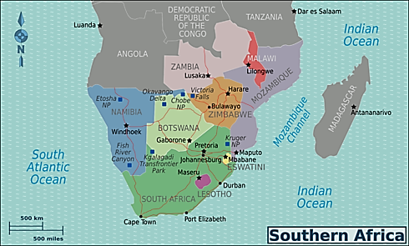

Slide 2

Supported to Preach
Rights and Responsibilities of Preachers Supported to Preach the Gospel and of those who Support them.
Notes:
The relationship between churches and the preachers they support is a joyous fellowship that comes with rights and responsibilities.

Slide 3
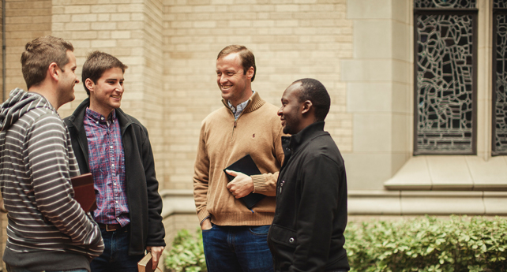
Supporting a faithful preacher deepens mutual love and fellowship (Philippians 1:3-5; 4:15-16; 2:25-30)

Slide 4
Men who give their lives to preaching have a right to be supported (1 Corinthians 9:9-14)
They have a right to refrain from secular work (9:6)
This right is based on long established truths
Those who work at a task may enjoy its fruits (9:7)
The ox that treads the grain may eat it (9:9-10)
The principle of sowing and reaping applies (9:11)
Those who minister the holy things of the temple ate of the holy things (9:13)
One may choose not to exercise this right (9:15-19)
A preacher must be willing to work with his hands if need be (Acts 18:3; 20:34-35; 1 Thess. 3:7-10)

Slide 5
Men who are supported to preach must have pure motives
They must not preach FOR the money!
Those mentioned in 3 John were not out to get every dollar they could from whatever source (3 John 5-8)
Those who merely preach for money will say anything! (2 Peter 2:3; Titus 1:11)
They have a responsibility to be content in any state
Consider the instructions to Timothy (1 Timothy 6:3-11)
Consider Paul’s example (Philippians 4:10-20)

Slide 6
Men who are supported to preach must have honesty and integrity
Be transparent & trustworthy (2 Corinthians 8:18-21)
“Transparent" means "allowing something to be clearly seen."
If handling funds on behalf of others, be faithful (1 Corinthians 4:2)
Never try to justify dishonesty (Acts 5:1-11)
One should not expect to be supported to preach if he does not handle money honestly (Luke 16:10-12)

Slide 7
Suggestions for the Supported
Work to Communicate -- Thoroughly and clearly!
Check your English!
When requesting help, be clear!
What is the need?
Why is it needed?
What efforts have been made to meet the need?
Who else has been contacted about the need?
HOW MUCH IS NEEDED!!!!!!!
Do your work and report it!
Report your support transparently!

Slide 8
Sample Financial Monthly Report
BELOW IS THE REPORT FOR THE MONEY RECEIVED IN [MONTH] 2019:
Monthly Support
EASTSIDE CHURCH.................................$250.00
[DIFFERENT CHURCH NAME].................$100.00
[DIFFERENT CHURCH NAME].................$100.00
Individual (monthly).................................$75.00
Individual (monthly)…………………..............$25.00
TOTAL Monthly Support............................................$550.00
One-Time Support (this month)
EASTSIDE CHURCH…………………………………... $1200 (Mealie Meal and Oil for [Congregation Name1] and [Congregation Name2])
[DIFFERENT CHURCH NAME] ..…….. $400 (Mealie Meal and Oil for [Cong. Name3]
Individual ……………………………………. $125 (Medical needs)
TOTAL One-Time.......................................................$1600.00

Slide 9
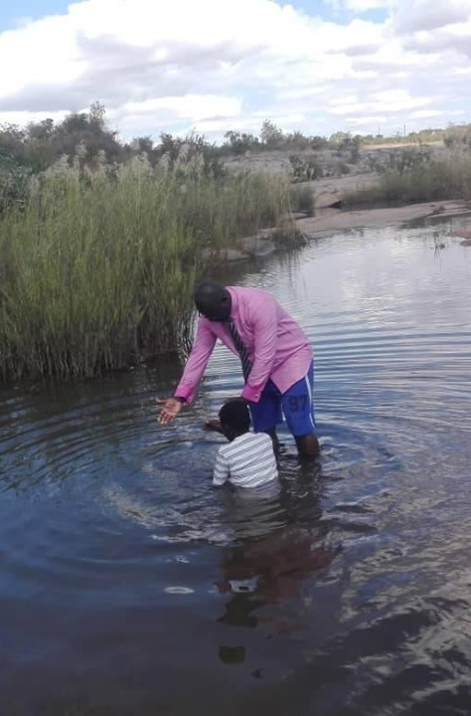
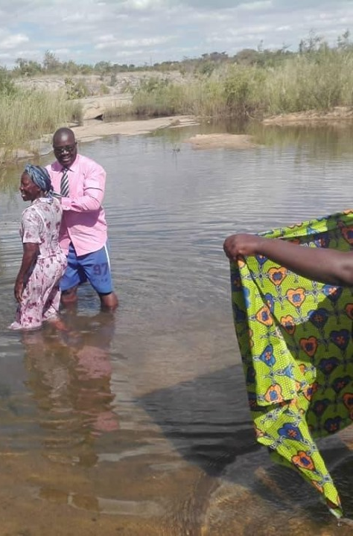
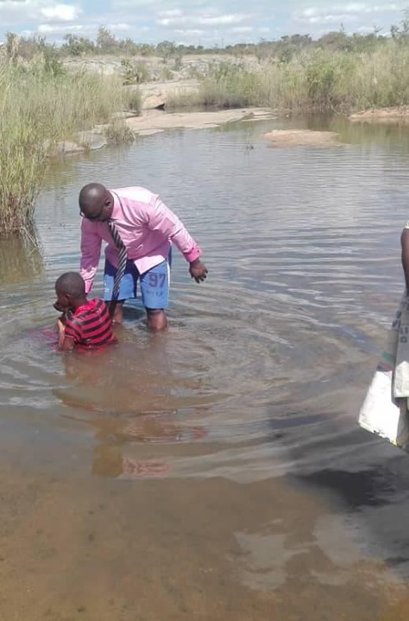
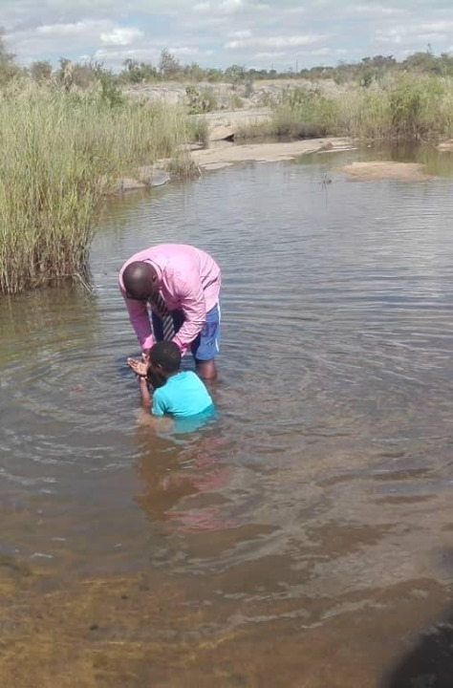
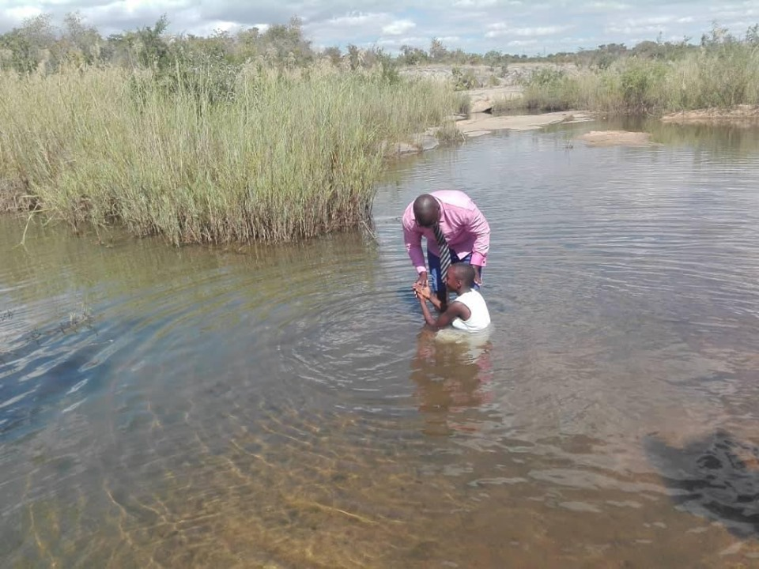
Reason Marara baptizing five souls into Christ today at Shavanhowe, Zimbabwe

