Slide 1
…

Slide 2
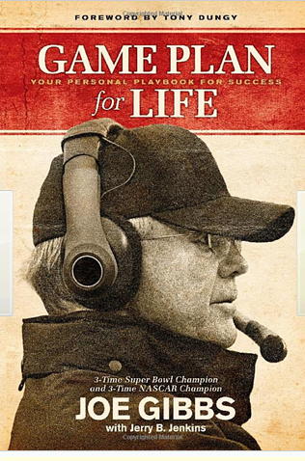

Slide 3
Acts 13:36
For David, after he had served his own generation by the will of God, fell asleep, was buried with his fathers
1 – David served God’s purpose

Slide 4
David and Us
In his daily activities
Primary reason for existing was to serve God
The same is true for us
We are here to serve God, not to serve our own pleasure

Slide 5
Matt 6:19-21
19 "Do not lay up for yourselves treasures on earth, where moth and rust destroy and where thieves break in and steal;
20 "but lay up for yourselves treasures in heaven, where neither moth nor rust destroys and where thieves do not break in and steal.
21 "For where your treasure is, there your heart will be also.

Slide 6
Luke 12:15-21
Had so much in earthly possession he didn’t know what to do with all his ‘stuff’
Build bigger barns
Soul, take your ease; eat, drink, and be merry
Fool!! …then whose will those things be?
21 "So is he who lays up treasure for himself, and is not rich toward God."

Slide 7
What does God want me to do?
1 Sam 22:10 "And he inquired of the LORD for him [for David],
1 Sam 23:2 Therefore David inquired of the LORD
1 Sam 23:4 Then David inquired of the LORD once again
1 Sam 30:8 So David inquired of the LORD

Slide 8
What does God want me to do?
2 Sam 2:1 It happened after this that David inquired of the LORD
2 Sam 5:19 So David inquired of the LORD
2 Sam 5:23 Therefore David inquired of the LORD
2 Sam 21:1 Now there was a famine in the days of David for three years, year after year; and David inquired of the LORD

Slide 9
Put to Use
David was not perfect
His life was to fulfill God’s purpose
Sand
Value comes in how it is used
Our value comes when we truly and totally submit ourselves to the Lord and allow Him to use us for His purpose

Slide 10
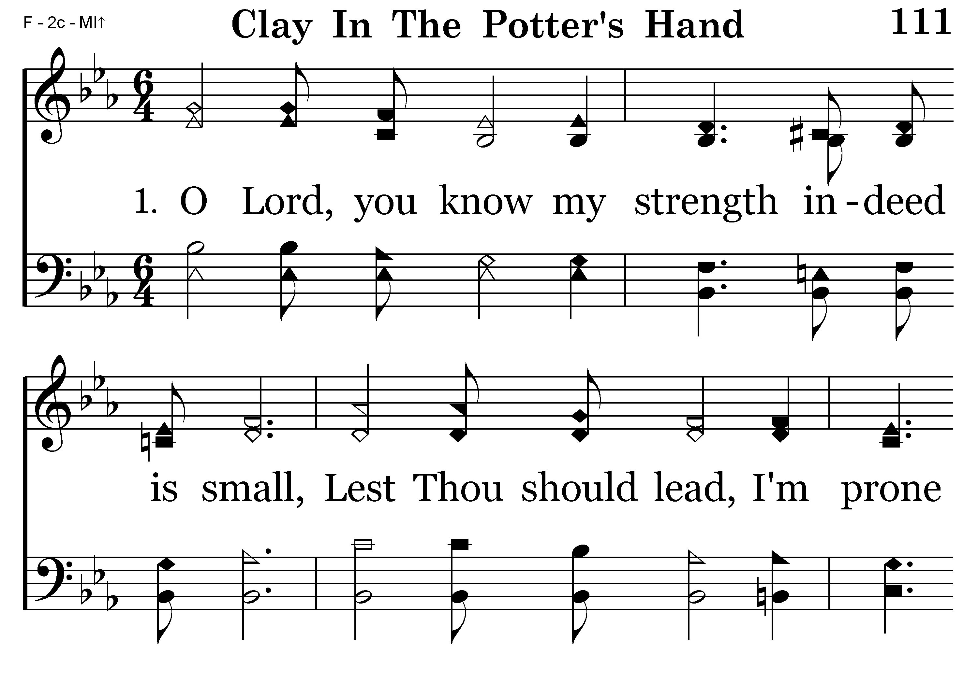
111 - Clay In The Potter's Hand - 1.1

Slide 11
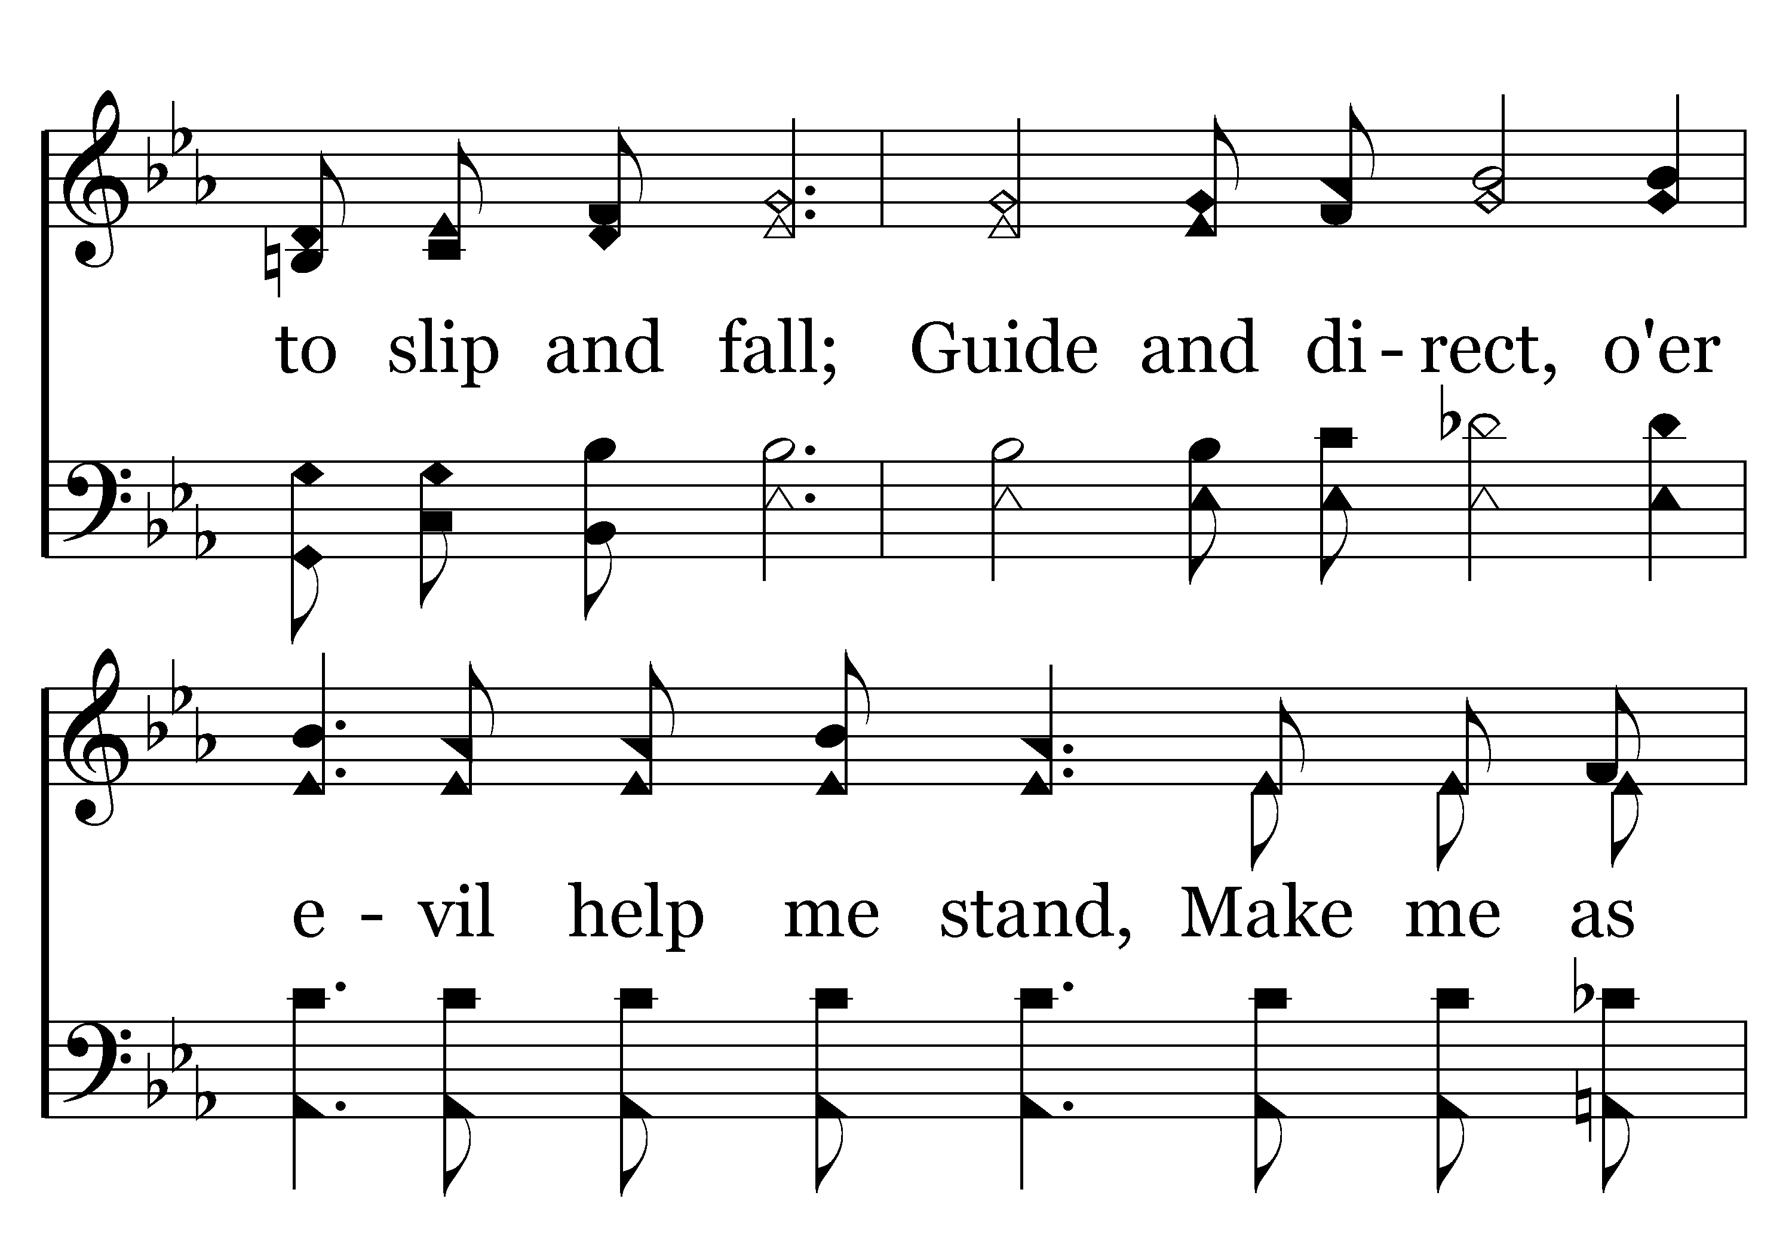
111 - Clay In The Potter's Hand - 1.2

Slide 12
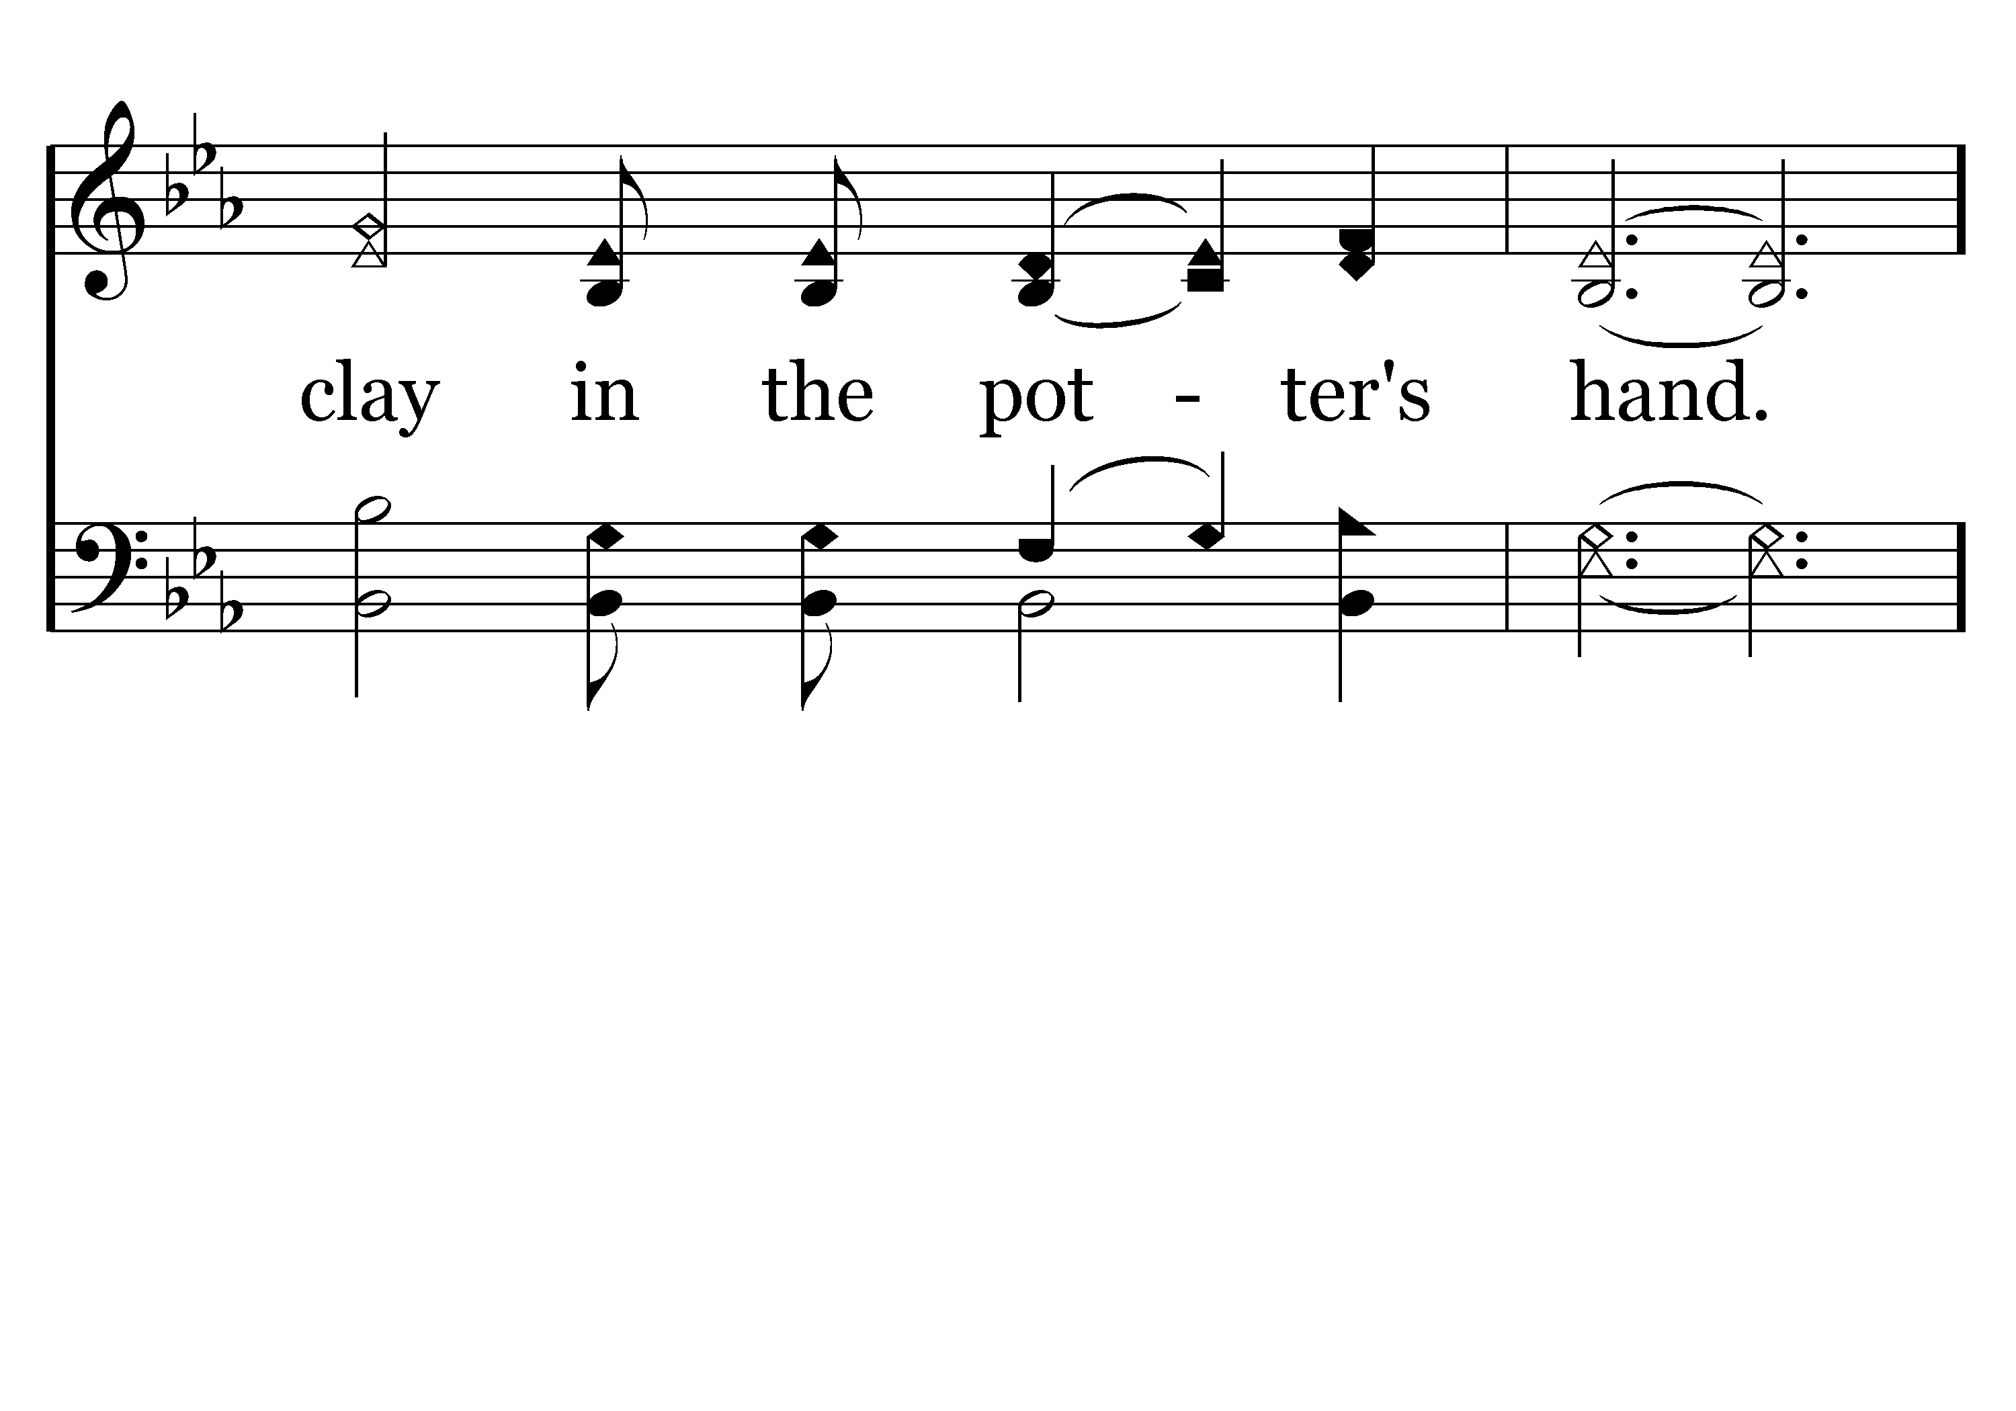
111 - Clay In The Potter's Hand - 1.3

Slide 13
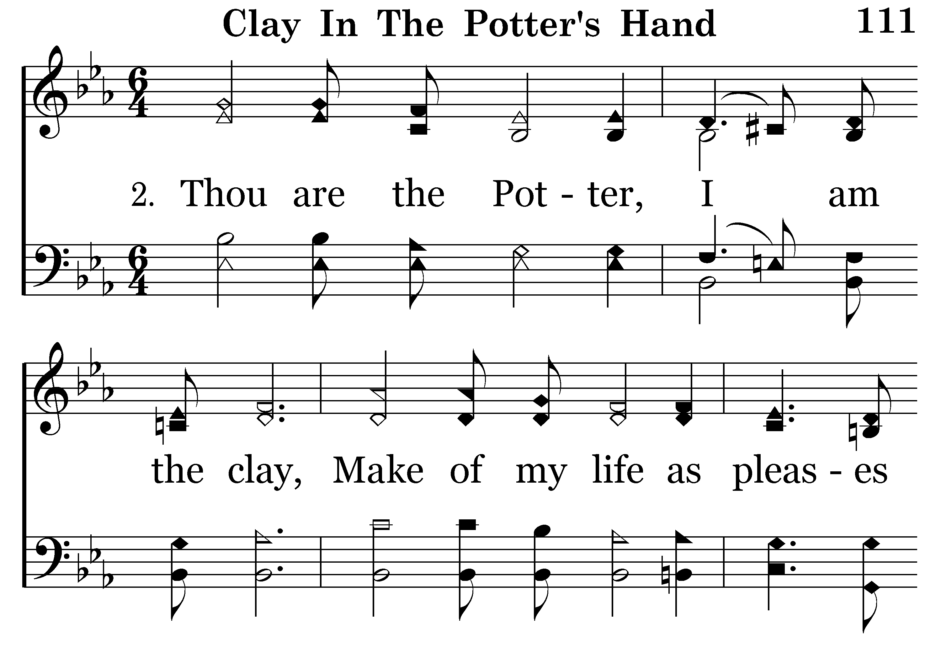
111 - Clay In The Potter's Hand - 2.1

Slide 14
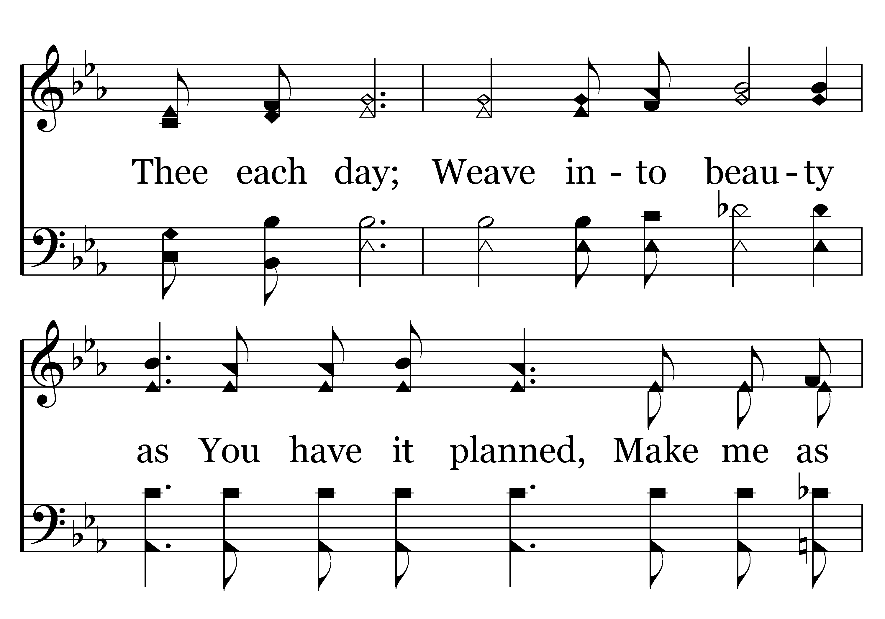
111 - Clay In The Potter's Hand - 2.2

Slide 15
111 - Clay In The Potter's Hand - 2.3

Slide 16
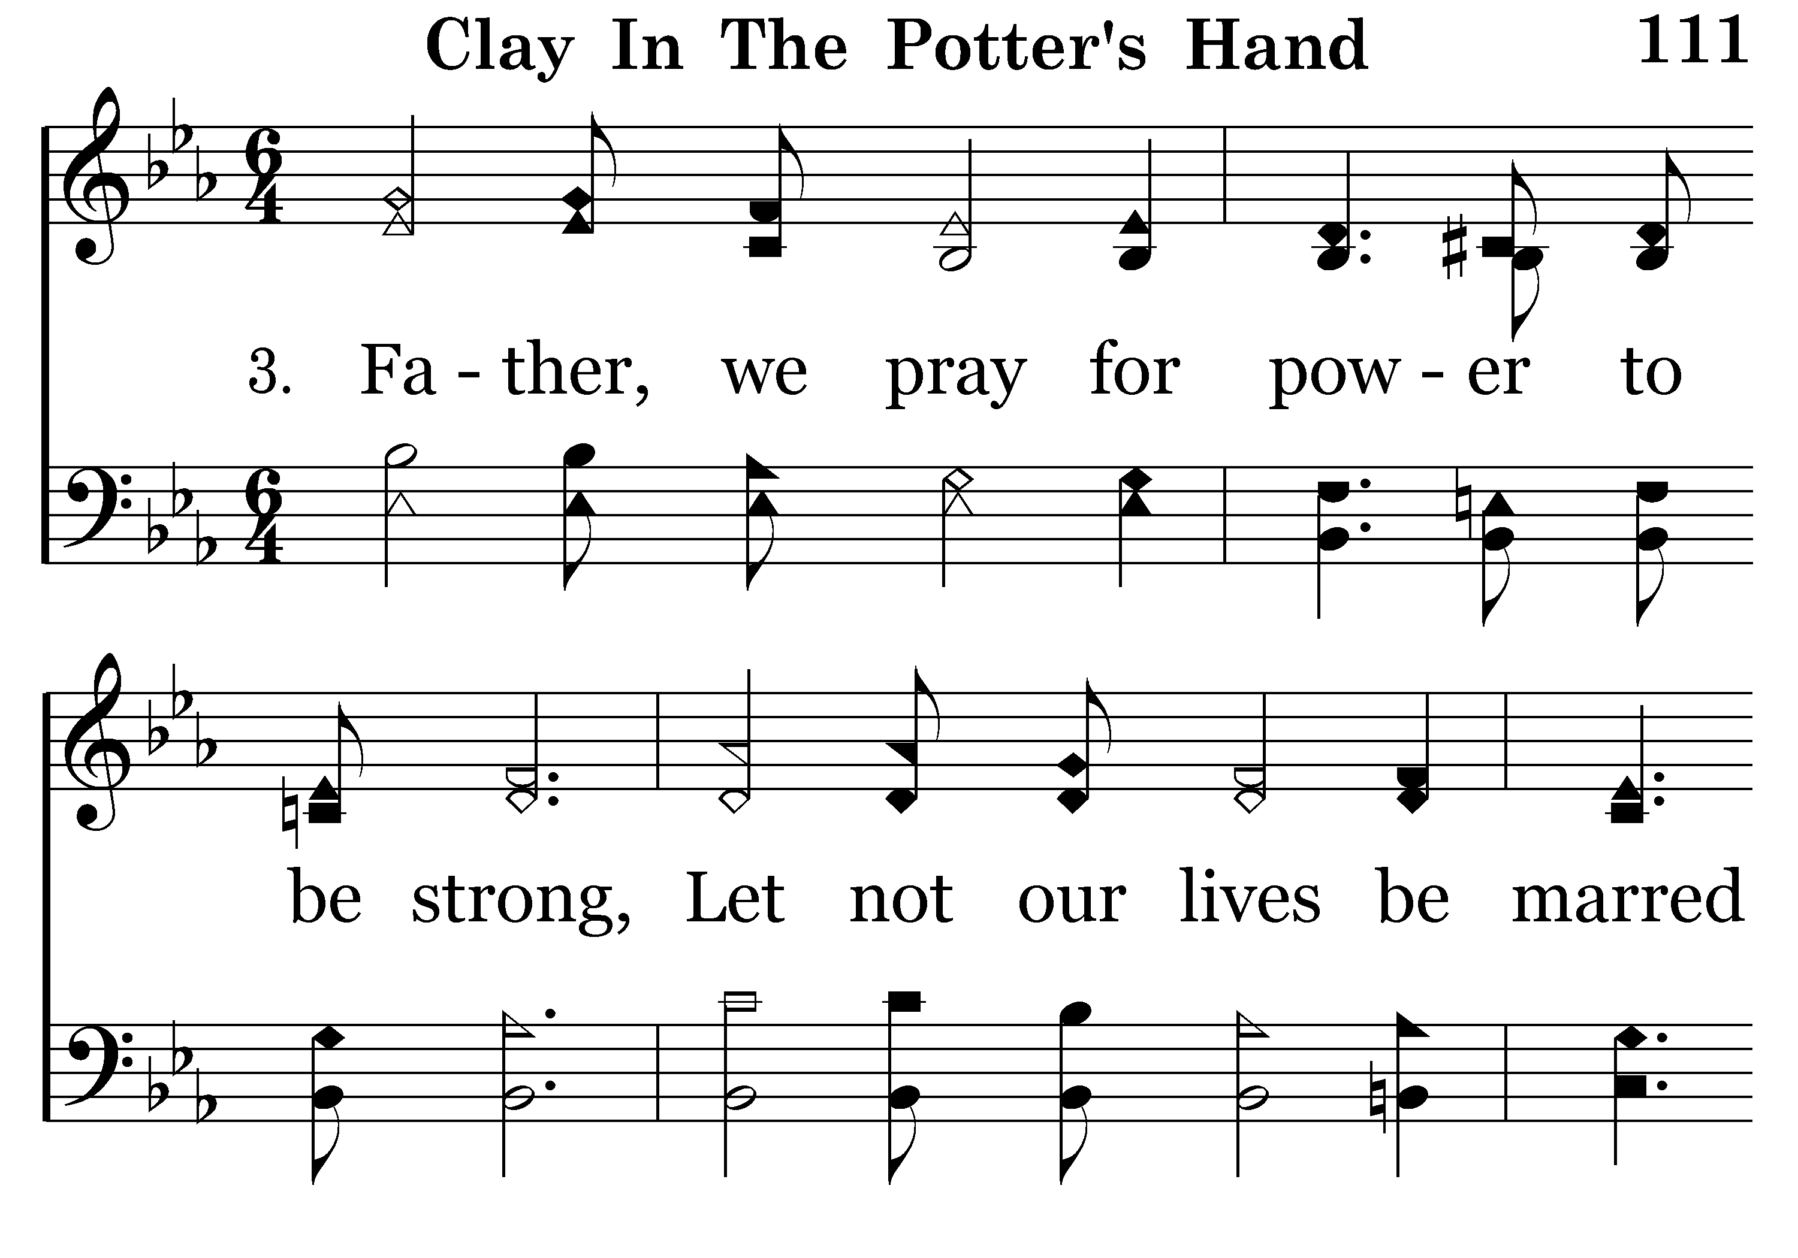
111 - Clay In The Potter's Hand - 3.1

Slide 17
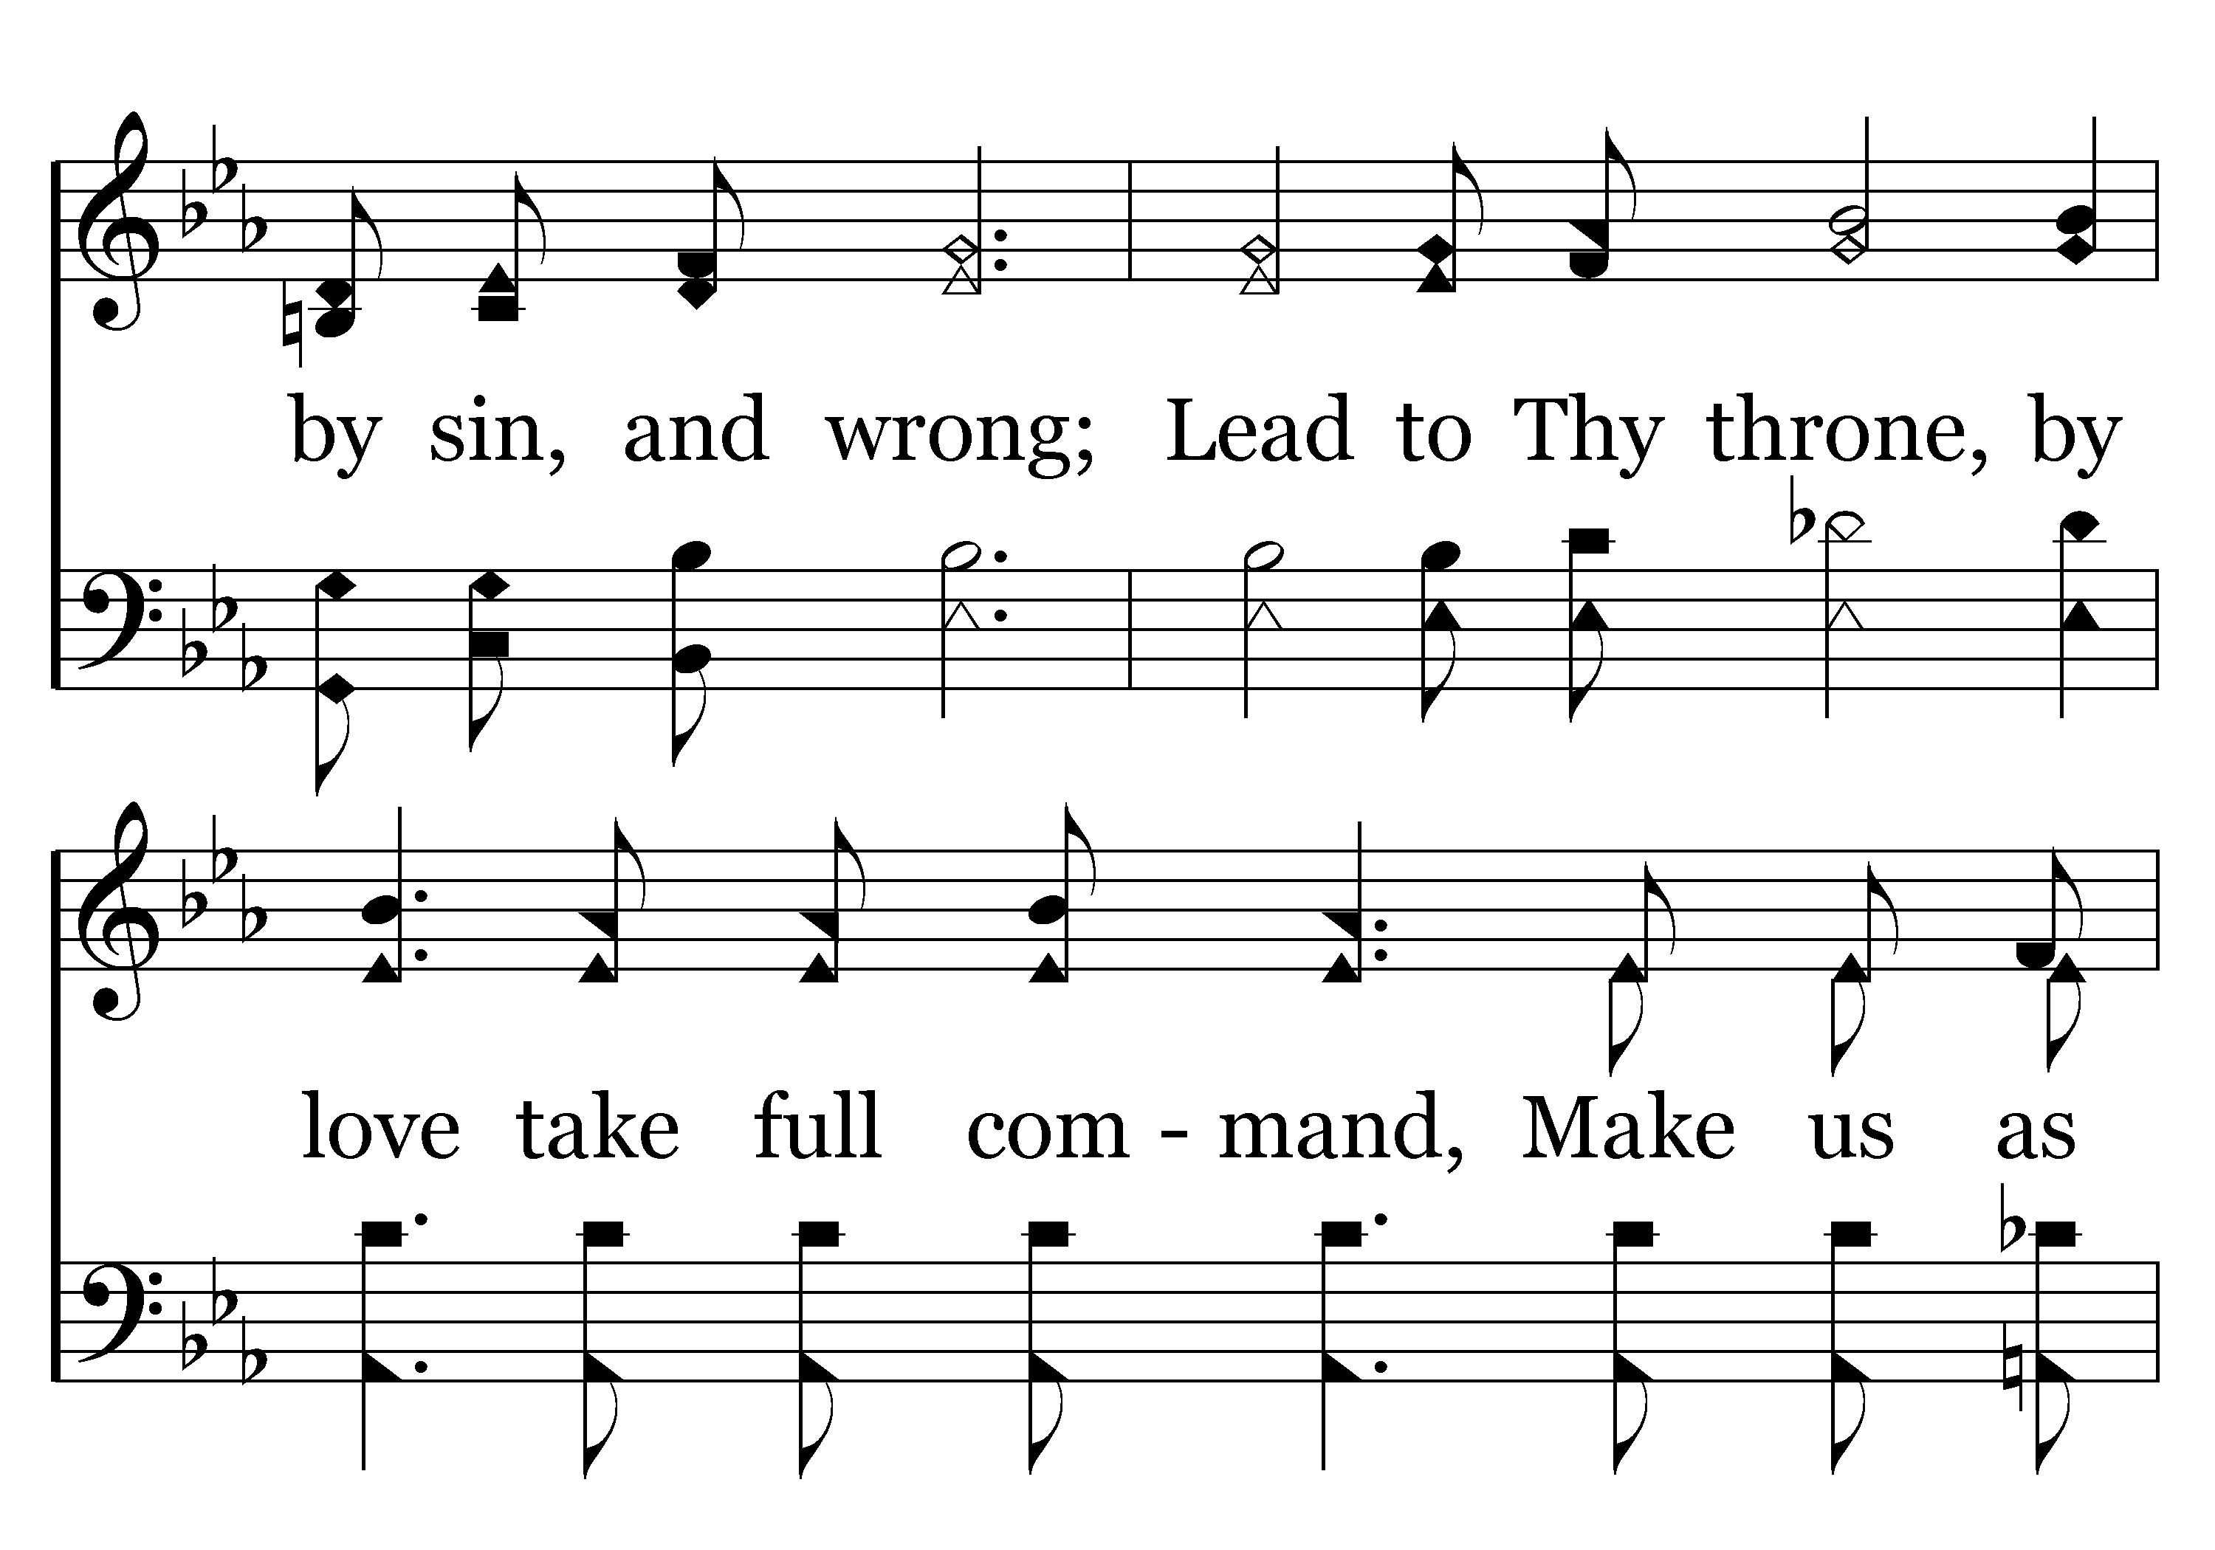
111 - Clay In The Potter's Hand - 3.2

Slide 18
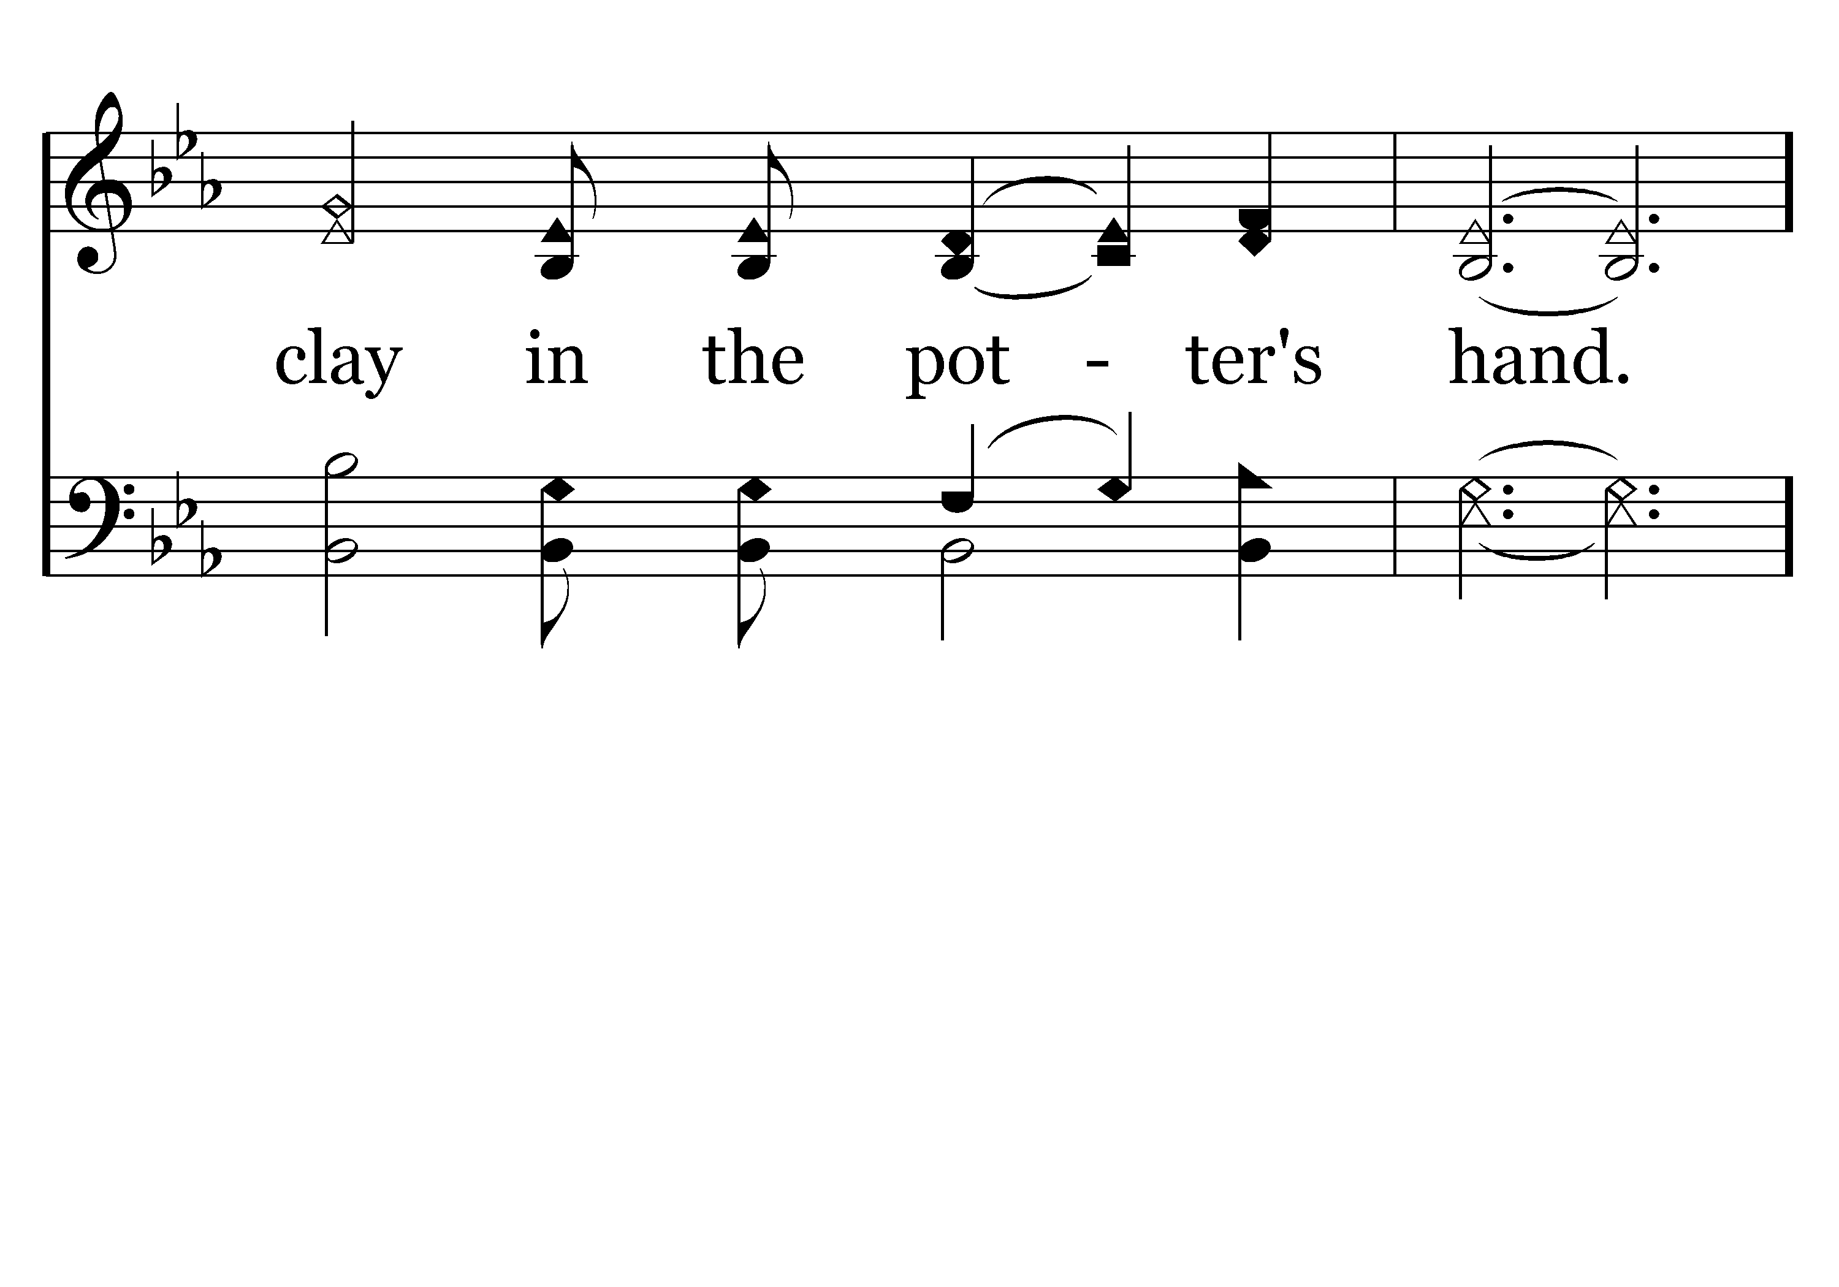
111 - Clay In The Potter's Hand - 3.3

Slide 19
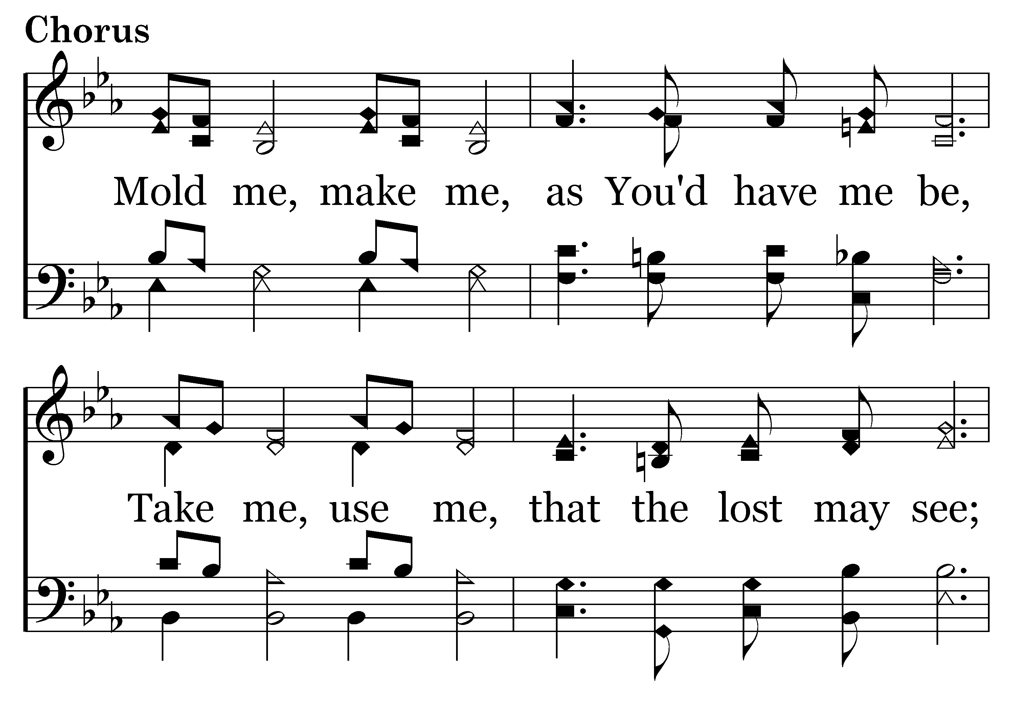
111 - Clay In The Potter's Hand - C.1

Slide 20
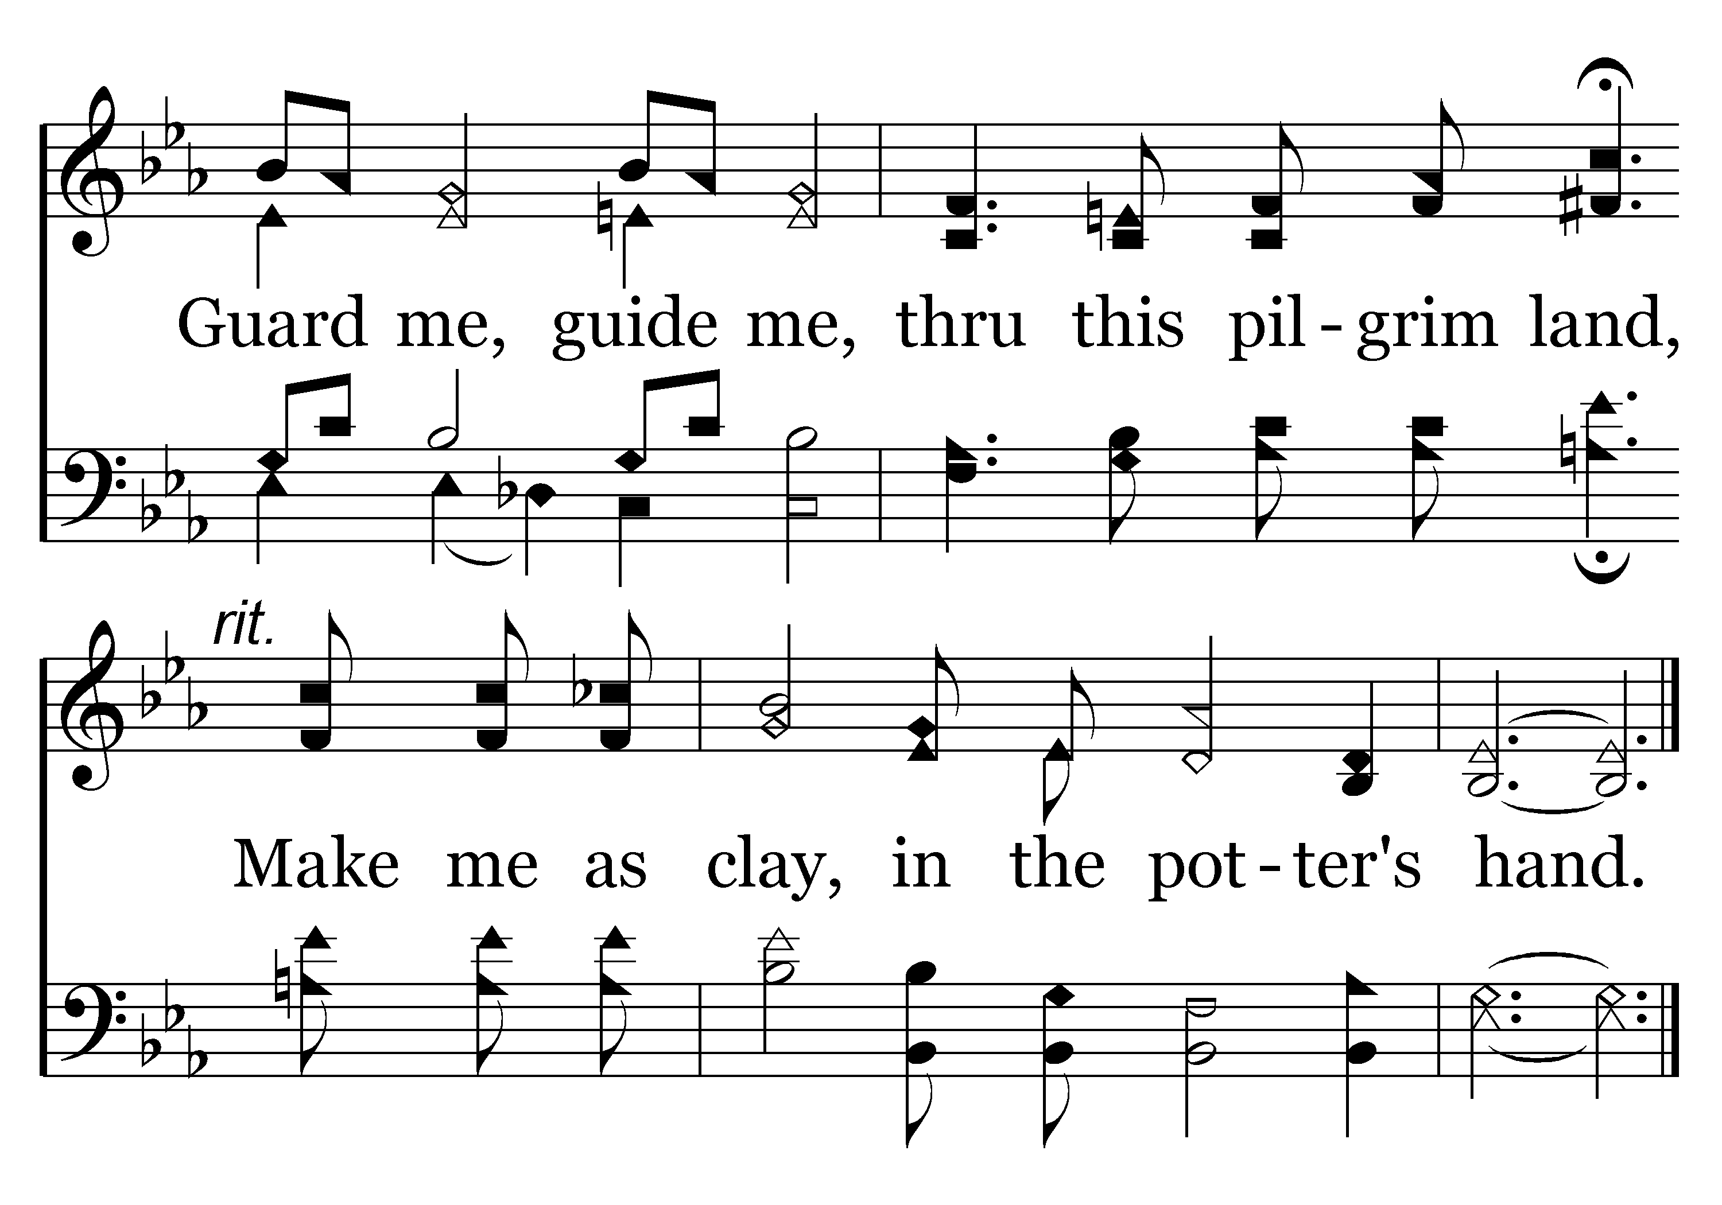
111 - Clay In The Potter's Hand - C.2
End of Song

Slide 21
Question for Us
Do we ‘exist’ for our own purpose (with no value in eternity), or do we ‘live’ for God’s purpose? David served God’s purpose.

Slide 22
Acts 13:36
For David, after he had served his own generation by the will of God, fell asleep, was buried with his fathers
2 – David influenced his generation. Our text uses the word ‘served.’

Slide 23
Questions for Us
Selfishness or selflessness?
To receive a blessing or to be a blessing?
Are we affecting those around us in a way that God is glorified?

Slide 24
Matt 25:14ff Parable of Talents
Five talent servant
Diligent
Praise from his master
One talent servant
Lazy
Condemnation
Two talent servant

Slide 25
Two Talent Servant
What did he receive
Why?
Each according to his ability
He received what he could profitably use
Not a five talent servant…why try?
What did he do with what he received?

Slide 26
Two Talent Servant
What did he not do?
He didn’t ‘DO NOTHING’
Three reasons to do nothing
You are lazy
You lack conviction/commitment
You have quit
Could have just done nothing…

Slide 27
Two Talent Servant
What did he do with what he received?
He did the best he could
Successful?

Slide 28
Compare the Rewards
Five talent servant
21 "His lord said to him, 'Well done, good and faithful servant; you were faithful over a few things, I will make you ruler over many things. Enter into the joy of your lord.'
Two talent servant
23 "His lord said to him, 'Well done, good and faithful servant; you have been faithful over a few things, I will make you ruler over many things. Enter into the joy of your lord.'
exactly the same

Slide 29
Lesson for Us
We are all given different abilities to do different things to ‘serve our generation’
To do the Lord’s work among those around us
What am I doing with the ability the Lord has given me?
How did the Master in this parable react to the servant who offered excuses?

Slide 30
Excuses
'You wicked and lazy servant’
cast the unprofitable servant into the outer darkness
Two points from this part of the parable
1) the judgment on the unprofitable servant—cast him into outer darkness…weeping and gnashing of teeth
2) You use what you have and you will gain more. You fail to use what you have been given, even that will be taken away from you.

Slide 31
Heb 5:12-14
12 For though by this time you ought to be teachers, you need someone to teach you again the first principles of the oracles of God; and you have come to need milk and not solid food.
13 For everyone who partakes only of milk is unskilled in the word of righteousness, for he is a babe.
14 But solid food belongs to those who are of full age, that is, those who by reason of use have their senses exercised to discern both good and evil.

Slide 32
Acts 13:36
For David, after he had served his own generation by the will of God, fell asleep, was buried with his fathers
David served God’s purpose
David influenced his generation
David died

Slide 33
David – “a man after My own heart”
Acts 13:22 "And when He had removed him [speaking of Saul as king of Israel], He raised up for them David as king, to whom also He gave testimony and said, 'I have found David the son of Jesse, a man after My own heart, who will do all My will.'
23 "From this man's seed, according to the promise, God raised up for Israel a Savior--Jesus—

Slide 34
What will God say about me?
David wasn’t perfect, we all know that
Neither will we be perfect
But God said David was a man who would do all His will
He devoted his life to doing what God would have him do
And when he failed, he repented

Slide 35
Jesus Finished God’s Work
John 17:4 "I have glorified You on the earth. I have finished the work which You have given Me to do.
Am I finishing the work God has given me to do?
Am I using my talents, my abilities for Him?
Will the speaker at my funeral be able to say—He finished the work the Lord had for him to do?
Or more importantly, as we stand before the Judge at the gates to eternity, will He say that I finished the work He had for me to do?

Slide 36
He lived, he died…
So it will be said of each of us
But, what we do in between our birth and our death is the important part and that part is our choice

Slide 37
…

